Slide 1
Intro to RNAseq
Justin Savage
Quantitative Living Systems Trainee Breakfast
11/12/25

Slide 2
RNAseq Analysis
Phase I: Sequencing reads FASTQ -> Aligned reads BAM -> Counts table TXT
Phase II: Counts
Normalization
Principal Component Analysis
Differential Expression
Gene Ontology Analysis

Slide 3
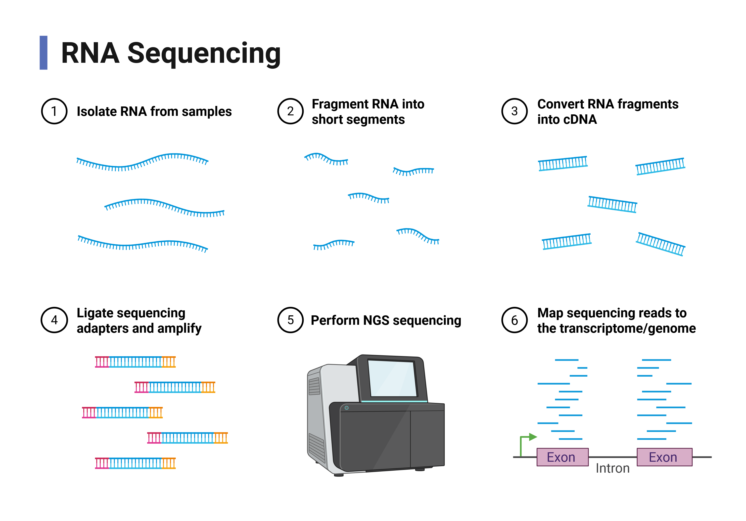

Slide 5
RNAseq Analysis
Phase I: Sequencing reads FASTQ -> Aligned reads BAM -> Counts table TXT

Slide 6
Sequencing Alignment
STAR Aligner https://github.com/alexdobin/STAR
https://hbctraining.github.io/Intro-to-rnaseq-hpc-O2/lessons/03_alignment.html

Slide 7
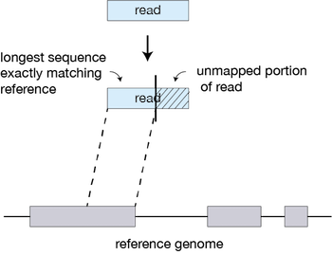
Sequencing Alignment

Slide 8
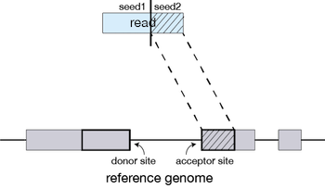
Sequencing Alignment

Slide 9
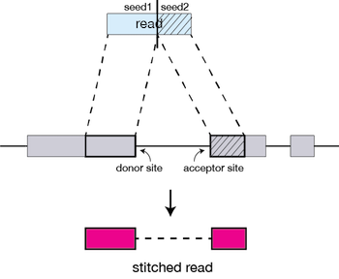
Sequencing Alignment

Slide 10
Genome Browser Visualization
Integrative Genomics Viewer (IGV) https://igv.org/
Can open aligned reads BAM files with the required BAI index file
Can create bai files with something like:
samtools index "$bam_file"

Slide 11
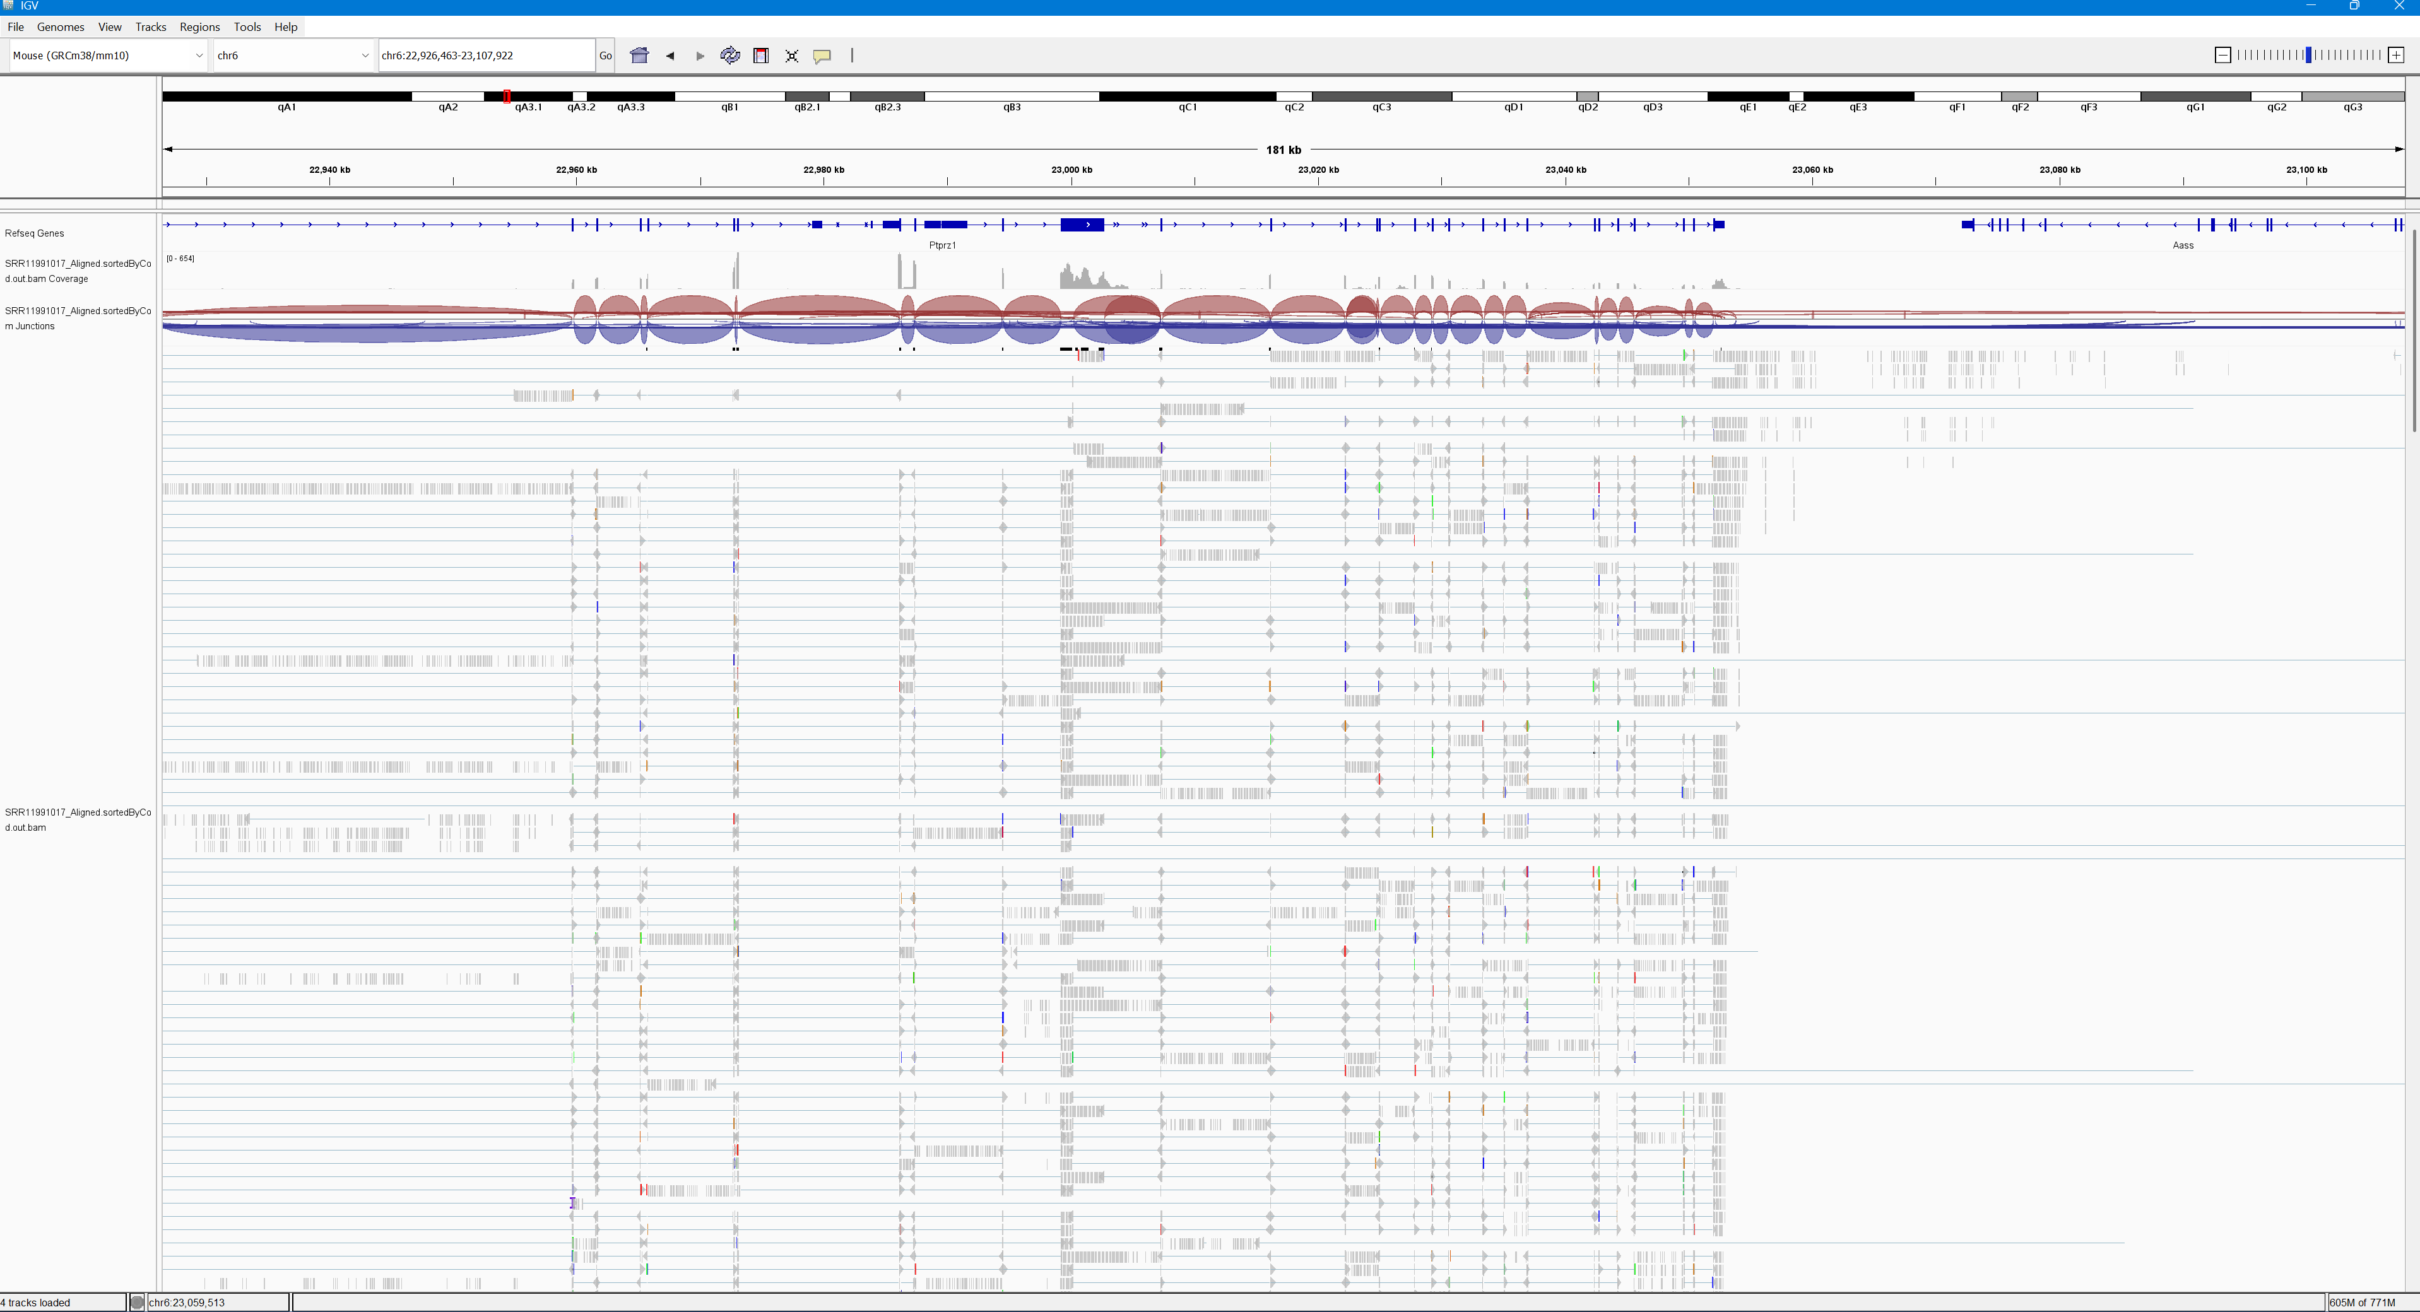

Slide 12
Gene Counting
Subread featureCounts function https://subread.sourceforge.net/featureCounts.html
Determine how often a gene was detected in your aligned sequencing reads

Slide 13
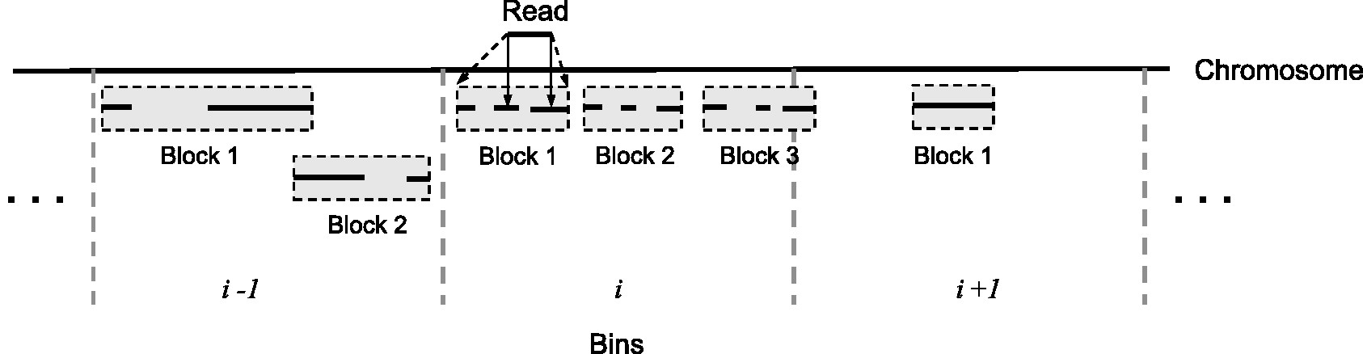
Gene Counting
Subread featureCounts function https://subread.sourceforge.net/featureCounts.html
Determine how often a gene was detected in your aligned sequencing reads

Slide 14
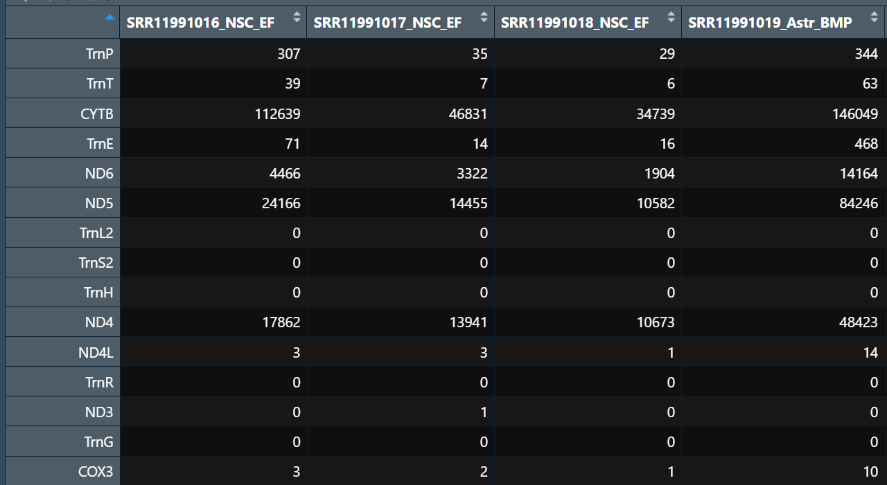
Gene Counts Table

Slide 15
RNAseq Analysis
Phase I: Sequencing reads FASTQ -> Aligned reads BAM -> Counts table TXT

Slide 16
RNAseq Analysis
Phase I: Sequencing reads FASTQ -> Aligned reads BAM -> Counts table TXT
Phase II: Counts
Normalization
Principal Component Analysis
Differential Expression
Gene Ontology Analysis

Slide 17
Differential Expression Analysis
Goal: determine which genes are significantly changing between two conditions

Slide 18
Differential Expression Analysis
DESeq2 https://bioconductor.org/packages/release/bioc/html/DESeq2.html
Modern Statistics for Modern Biology https://web.stanford.edu/class/bios221/book/08-chap.html

Slide 19
Differential Expression Analysis
Goal: determine which genes are significantly changing between two conditions
Problem 1: ~30,000 genes to compare

Slide 20
Differential Expression Analysis
Goal: determine which genes are significantly changing between two conditions
Problem 1: ~30,000 genes to compare
Problem 2: Gene counts are not normally distributed

Slide 21
Differential Expression Analysis
Goal: determine which genes are significantly changing between two conditions
Problem 1: ~30,000 genes to compare
Problem 2: Gene counts are not normally distributed
Problem 3: Technical variation in measuring different samples/genes

Slide 22
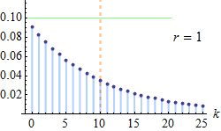
Differential Expression Analysis
DESeq2 Gamma-Poisson (negative-binomial) distribution
Discrete
Tuned to skewed data

Slide 23
Normalization FPKM
Divide the total number of reads in sample by 1 million (sample scaling factor)
Divide count for the given gene by that sample’s scaling factor (Fragments per million)
Divide the FPM by the length of the gene in kilobases (Fragments per kilobase per million; FPKM)

Slide 24
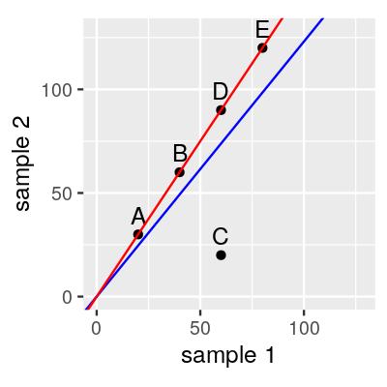
Normalization
Size factor estimation (DESeq2)
Assumes that most genes are not changing
Fits a better size factor through regression to the experimental data

Slide 25
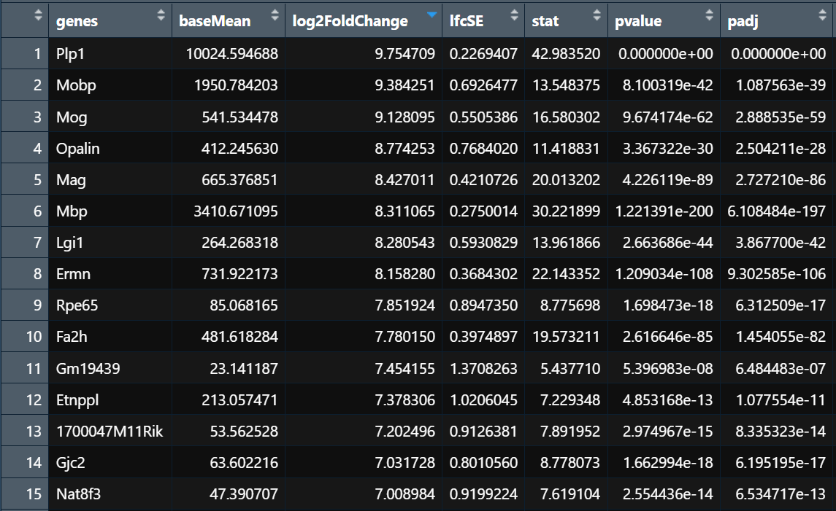
Differential Expression Output

Slide 26
Differential Expression Output
Typically filter output genes into significantly upregulated and significantly downregulated
p-adj < 0.05 & abs(fold change) > 1.5

Slide 27
Volcano Plot
Enhanced Volcano Plot https://bioconductor.org/packages/release/bioc/vignettes/EnhancedVolcano/inst/doc/EnhancedVolcano.html

Slide 28
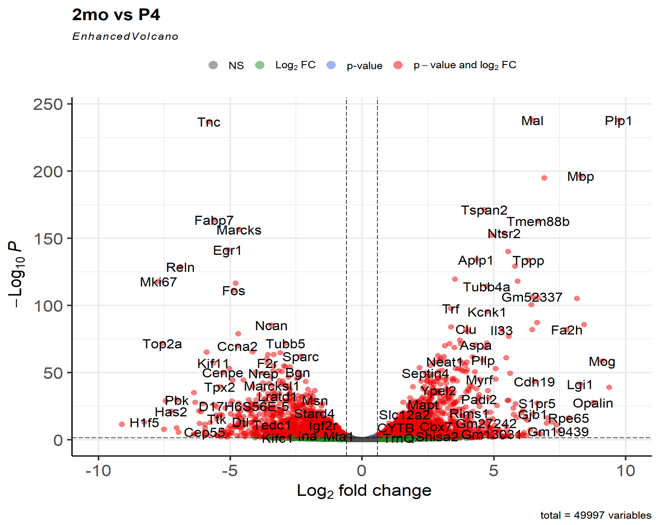
Volcano Plot

Slide 29
Principal Component Analysis
PCA Nature Reviews Methods Primers https://www.proquest.com/docview/3225868717?pq-origsite=summon&accountid=10598&sourcetype=Scholarly%20Journals
DESeq2 plotPCA https://bioconductor.org/packages/devel/bioc/vignettes/DESeq2/inst/doc/DESeq2.html#principal-component-plot-of-the-samples

Slide 30
Principal Component Analysis
Example Gallup World Poll
Five indicators:
  Social = social support
  Life = life expectancy
  Choices = freedom to make your own choices
  Generosity = generosity of the general population
  Corruption = perceptions of corruption levels
PC 1 = 0.538 Social + 0.563 Life + 0.498 Choices – 0.004 Generosity – 0.381 Corruption

Slide 31
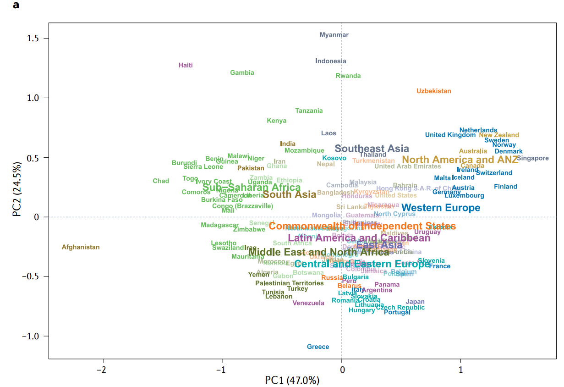
Principal Component Analysis
Example Gallup World Poll
PC 1 = 0.538 Social + 0.563 Life + 0.498 Choices – 0.004 Generosity – 0.381 Corruption
PC 2 = -0.266 Social – 0.243 Life + 0.258 Choices + 0.799 Generosity – 0.407 Corruption

Slide 32
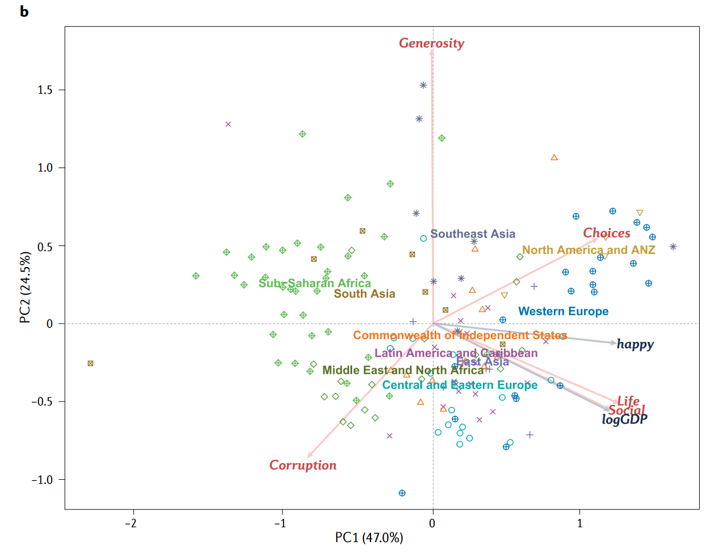
Principal Component Analysis
Example Gallup World Poll
PC 1 = 0.538 Social + 0.563 Life + 0.498 Choices – 0.004 Generosity – 0.381 Corruption
PC 2 = -0.266 Social – 0.243 Life + 0.258 Choices + 0.799 Generosity – 0.407 Corruption

Slide 33
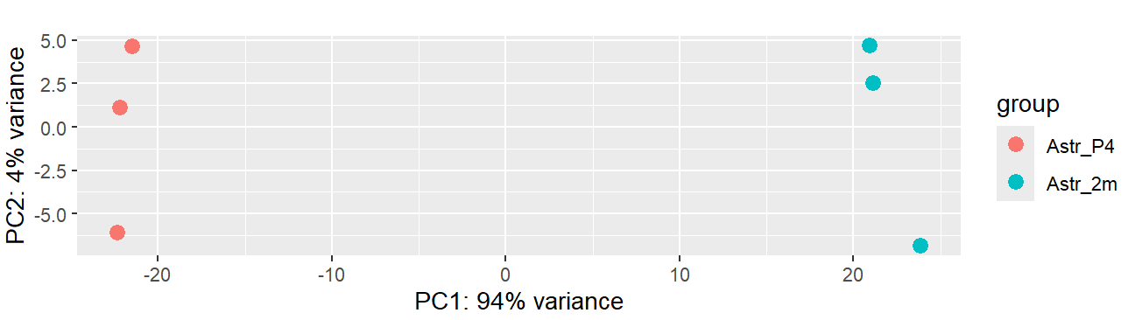
Principal Component Analysis

Slide 34
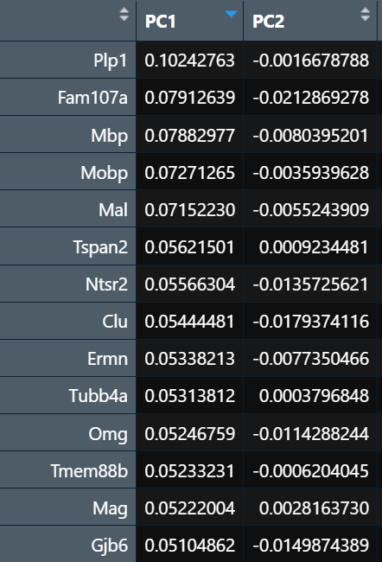
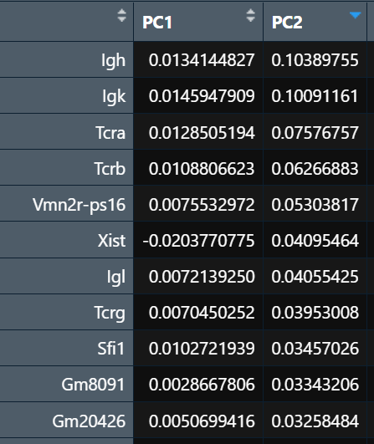
Principal Component Analysis

Slide 35
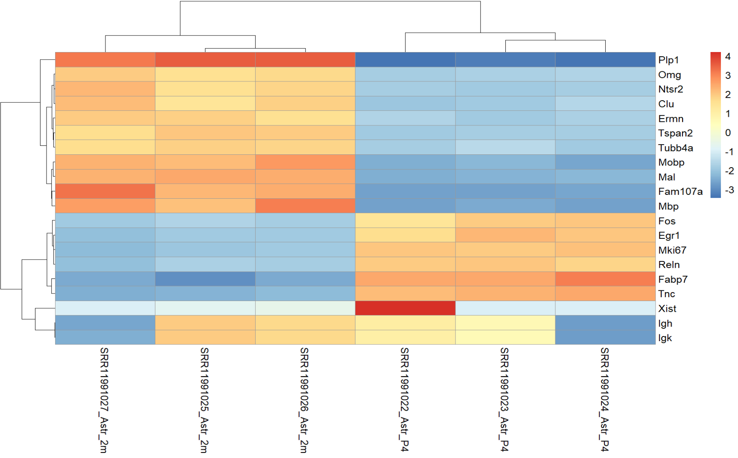
Principal Component Analysis

Slide 36
Gene Ontology Analysis
Gene Ontology Handbook https://link.springer.com/book/10.1007/978-1-4939-3743-1
https://geneontology.org/
Cluster Profiler https://yulab-smu.top/biomedical-knowledge-mining-book/clusterprofiler-go.html

Slide 37
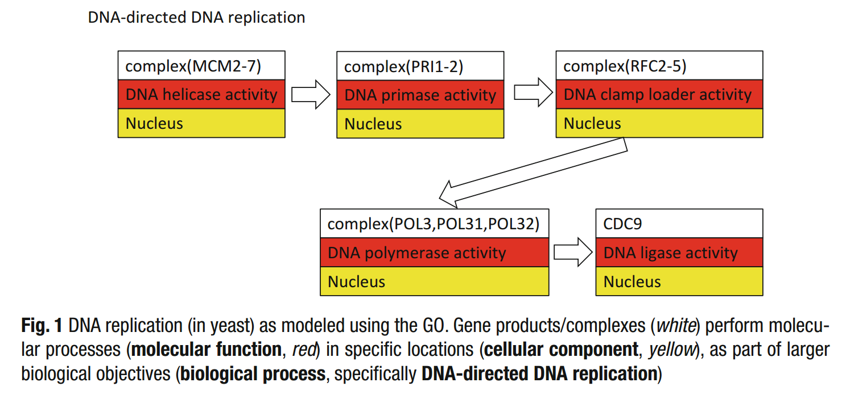
Gene Ontology Analysis

Slide 38
Gene Ontology Analysis
GO Enrichment Analysis tests if a genes from a given GO term have greater representation in a dataset than expected by chance

Slide 39
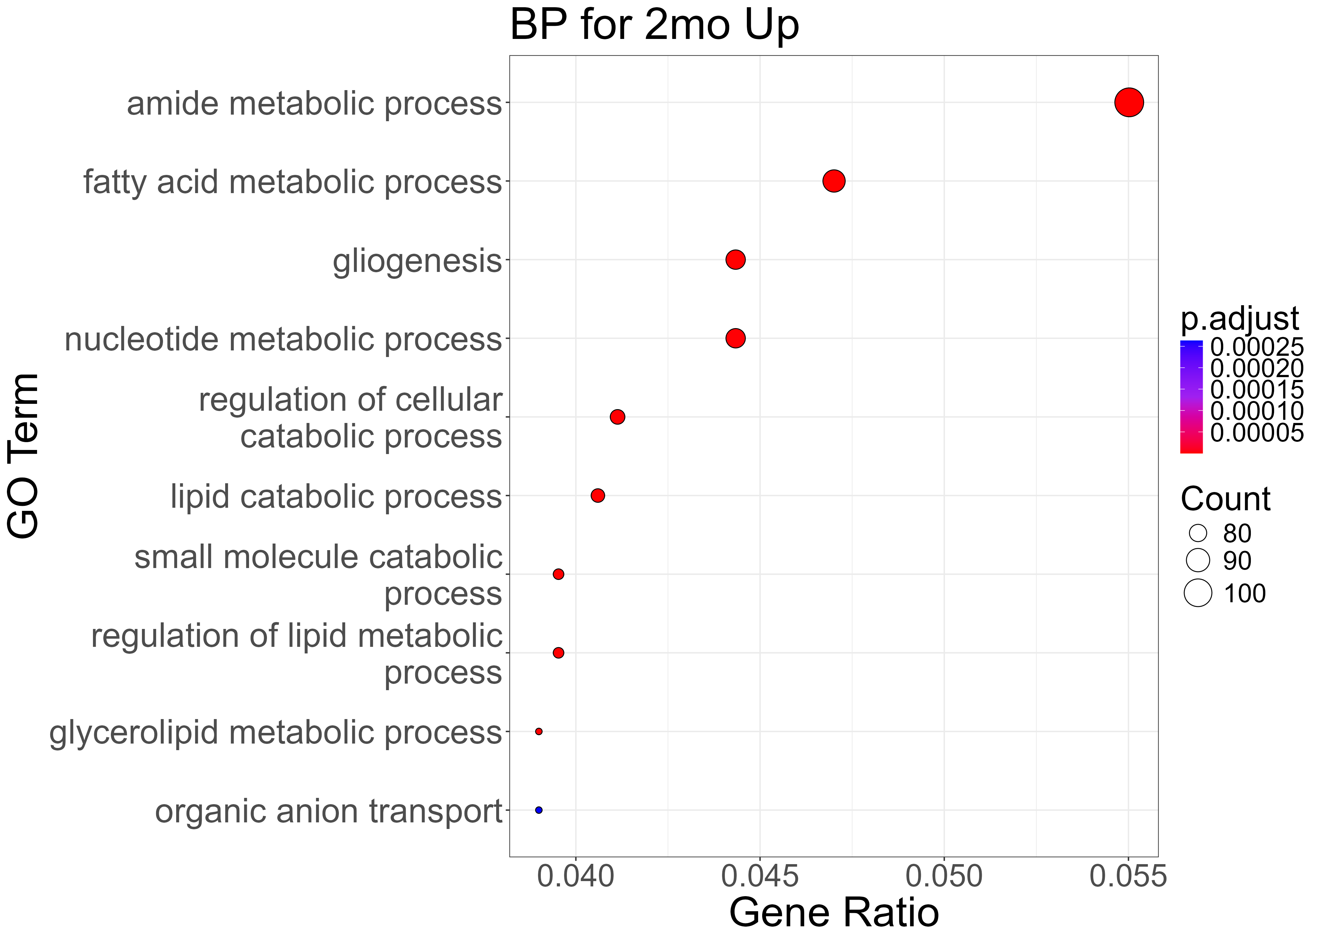
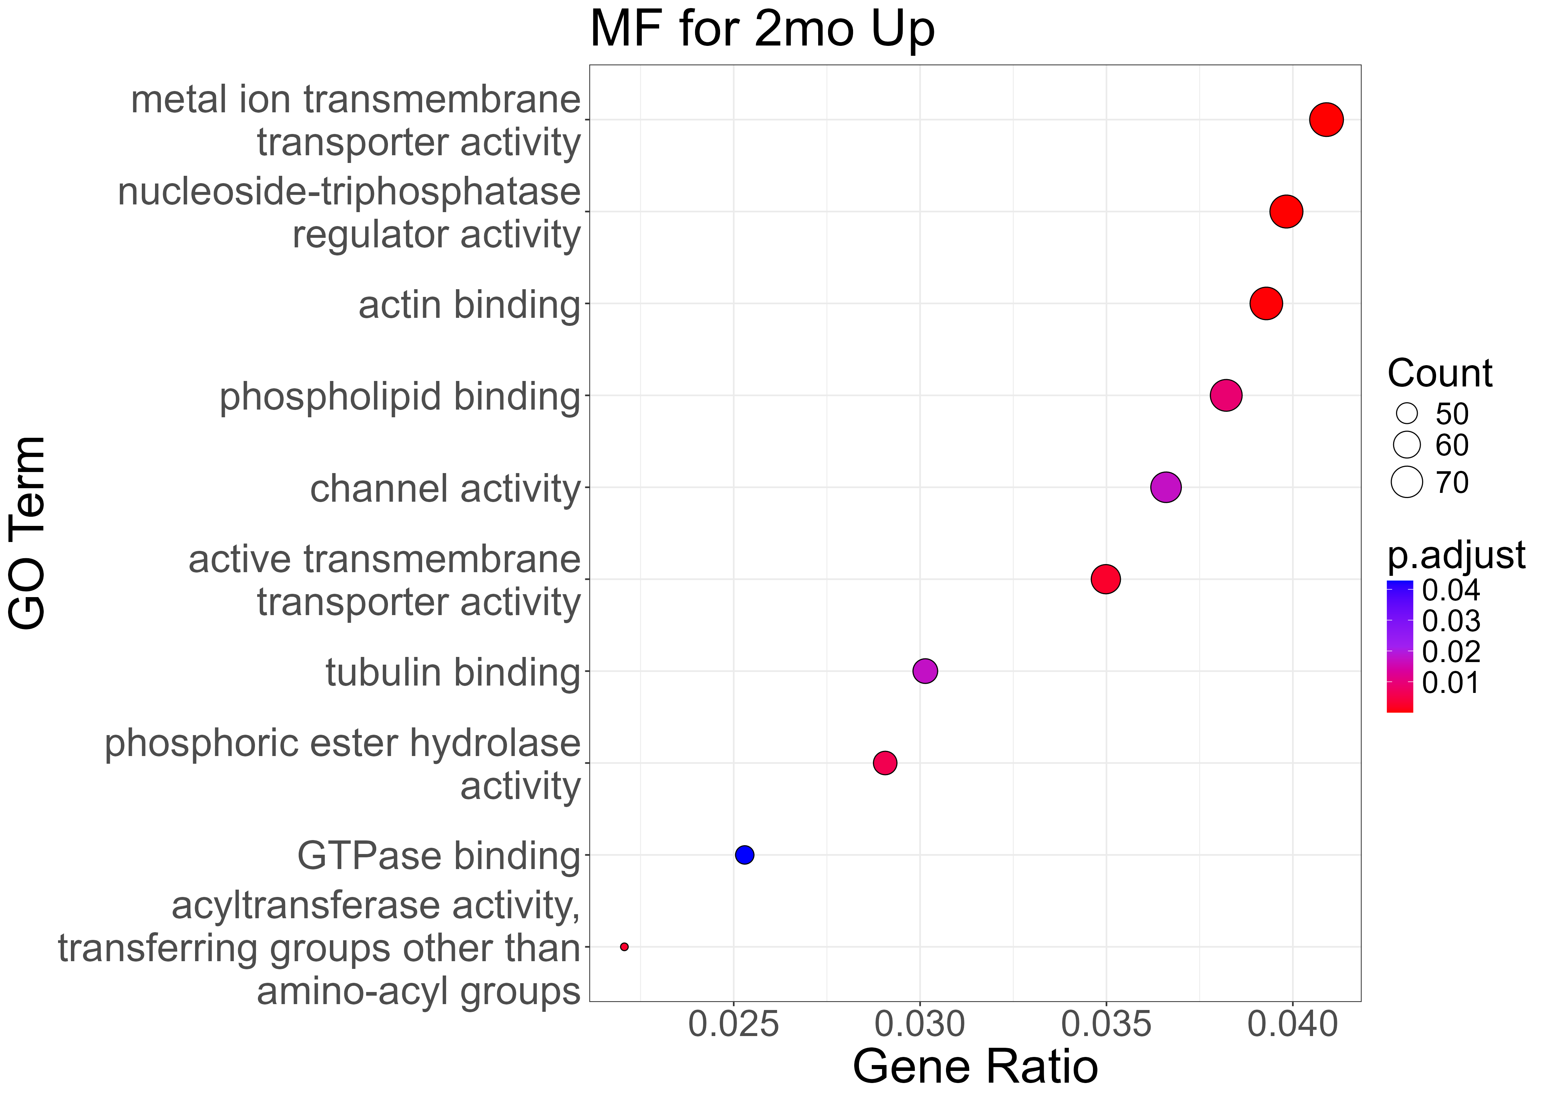
Gene Ontology Analysis
GO Enrichment Analysis tests if a genes from a given GO term have greater representation in a dataset than expected by chance

Slide 40
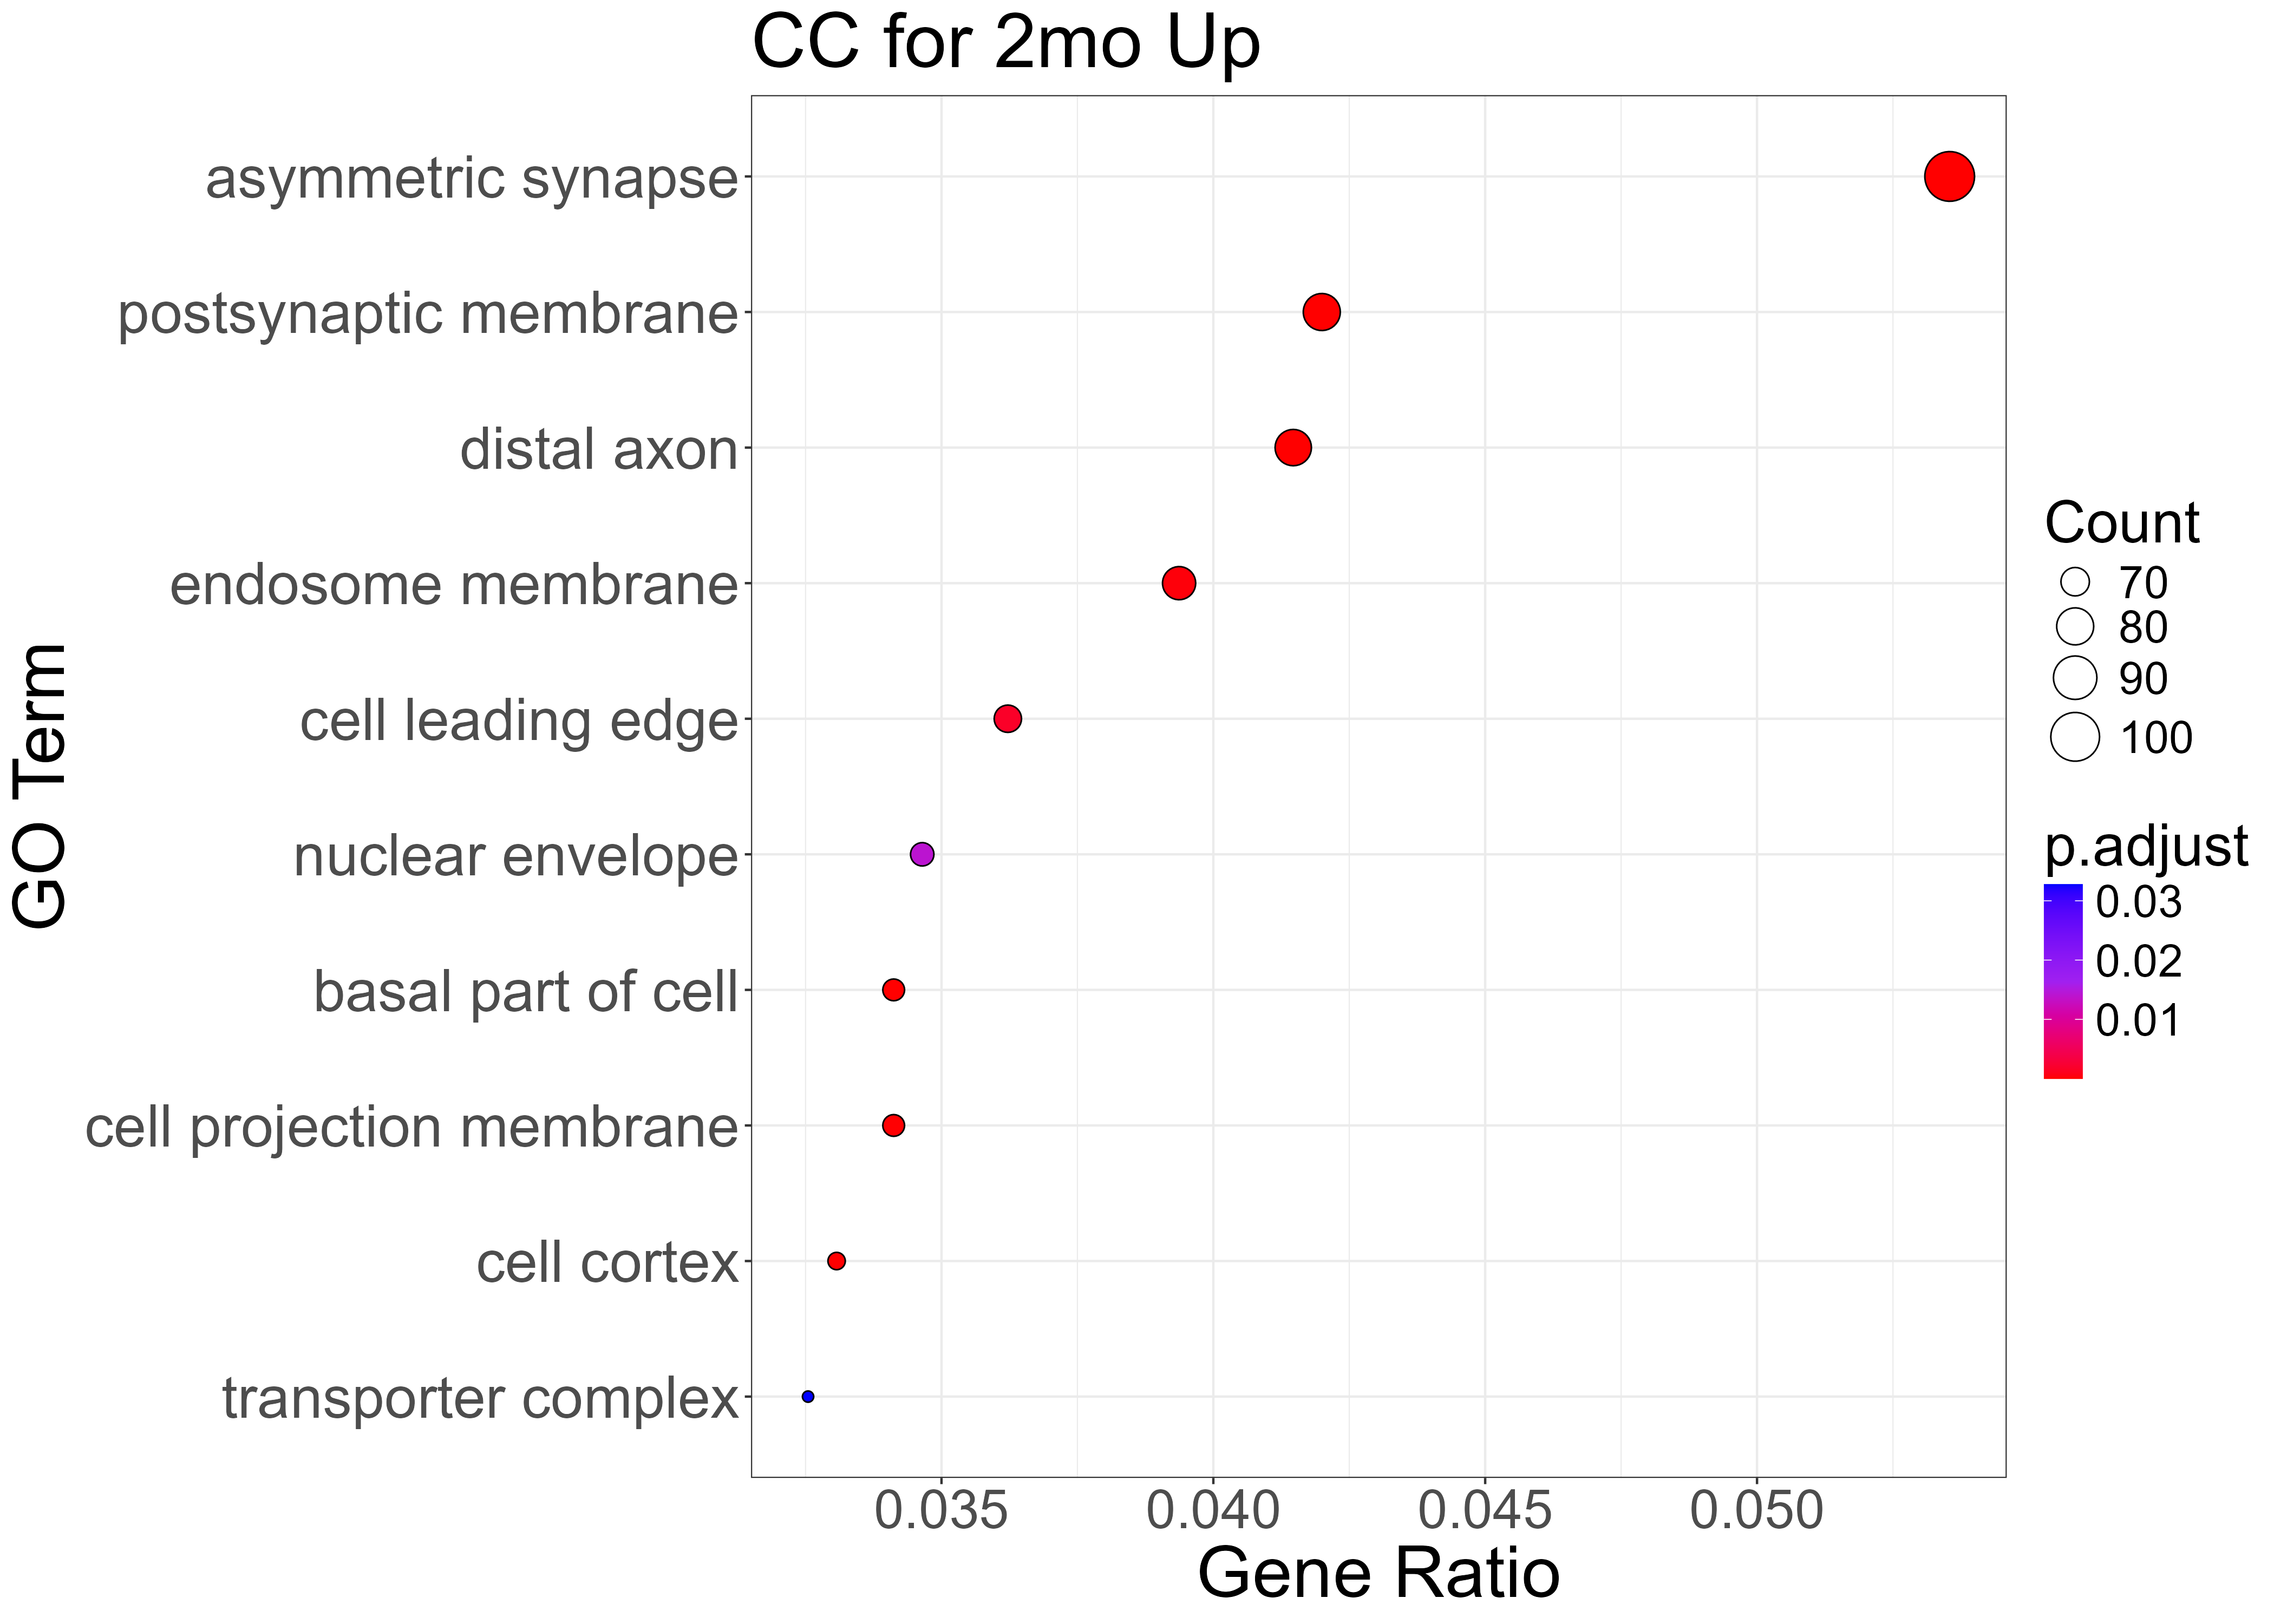
Gene Ontology Analysis
GO Enrichment Analysis tests if a genes from a given GO term have greater representation in a dataset than expected by chance

Slide 41
Gene Ontology Redundancy
Revigo http://revigo.irb.hr/
RRVGO https://bioconductor.org/packages/release/bioc/html/rrvgo.html

Slide 42
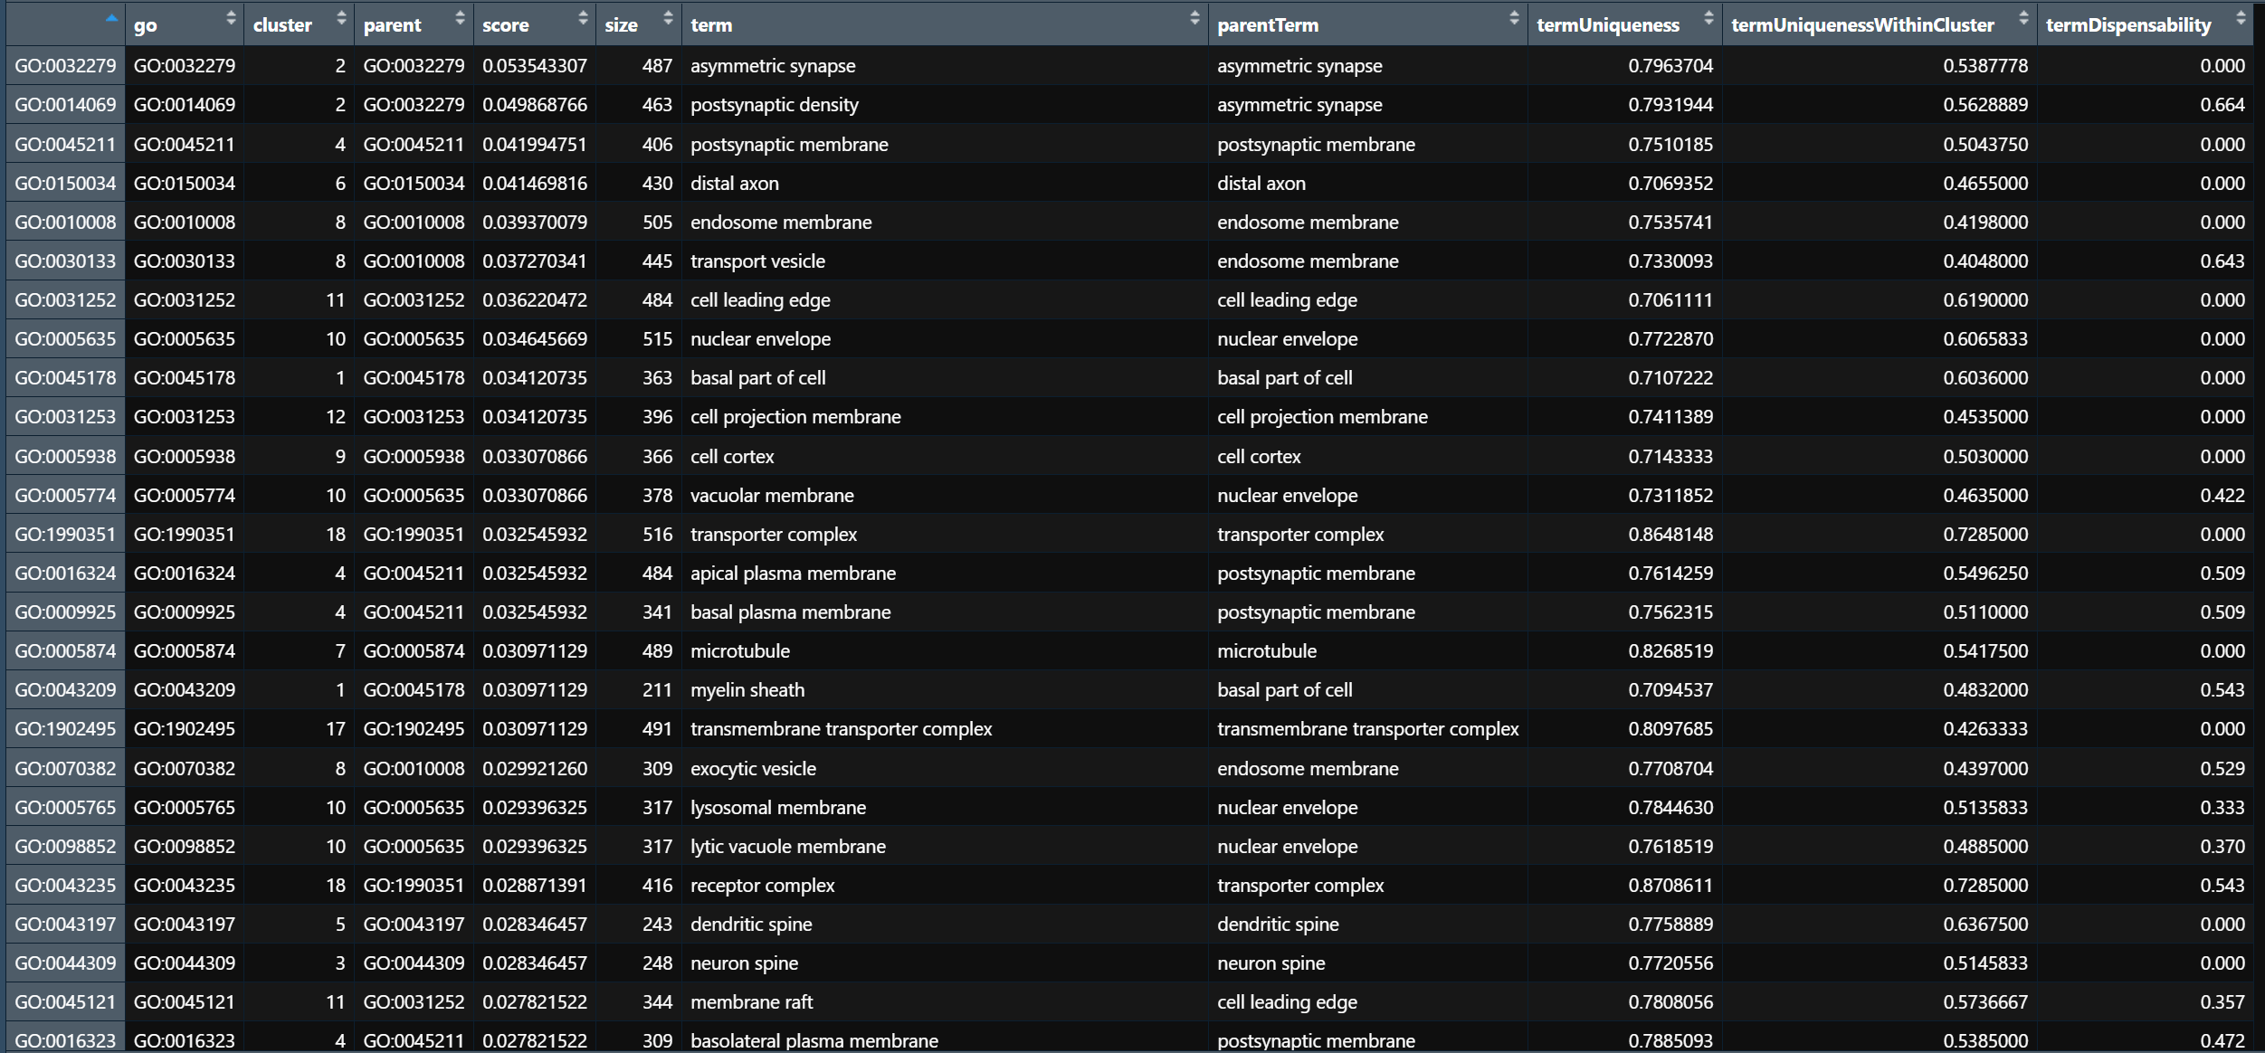
Gene Ontology Redundancy

Slide 43
Gene Ontology Redundancy

Slide 44
RNAseq Analysis
Phase I: Sequencing reads FASTQ -> Aligned reads BAM -> Counts table TXT
Phase II: Counts
Normalization
Principal Component Analysis
Differential Expression
Gene Ontology Analysis

