Slide 1
Intro to epigenomic DNAseq
Justin Savage
Quantitative Living Systems Trainee Breakfast
12/3/25

Slide 2
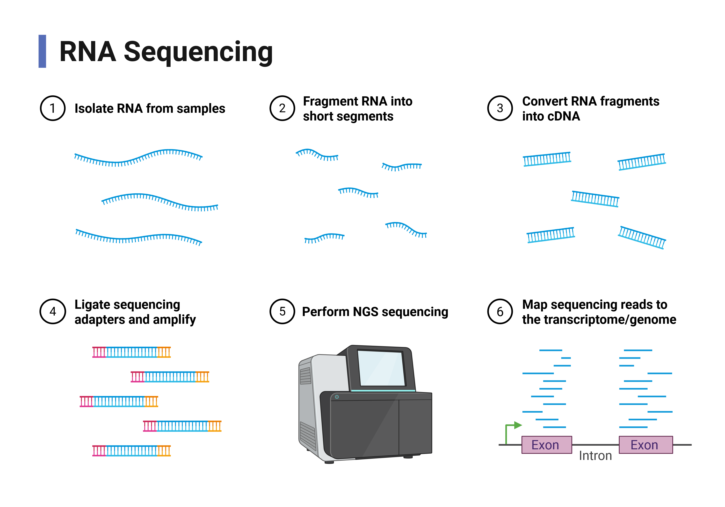

Slide 3
DNA
DNA
DNA
DNA

Slide 4
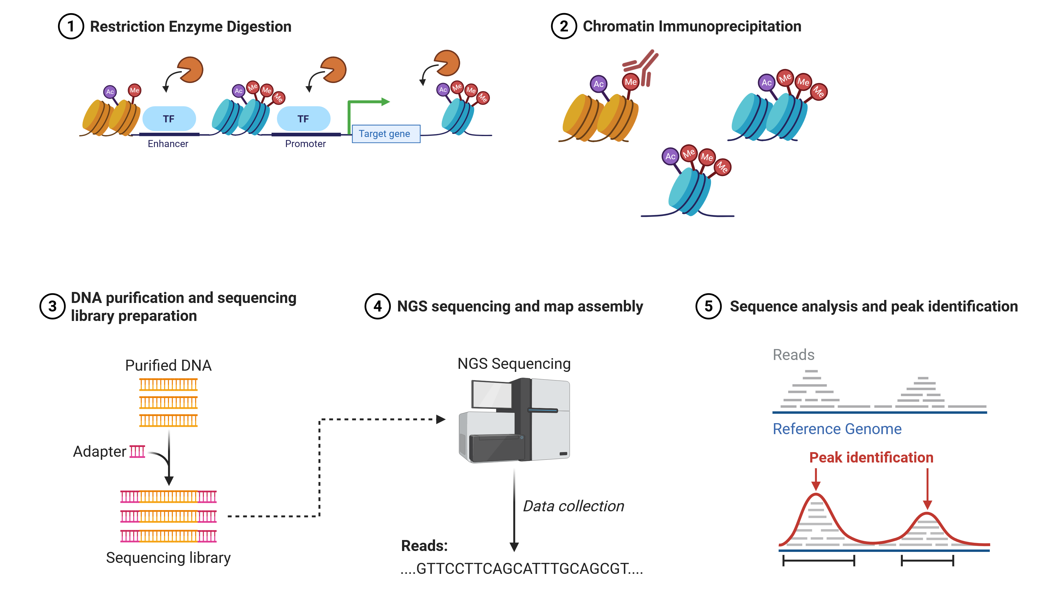
Chromatin Immunoprecipitation (ChIP) Sequencing

Slide 5
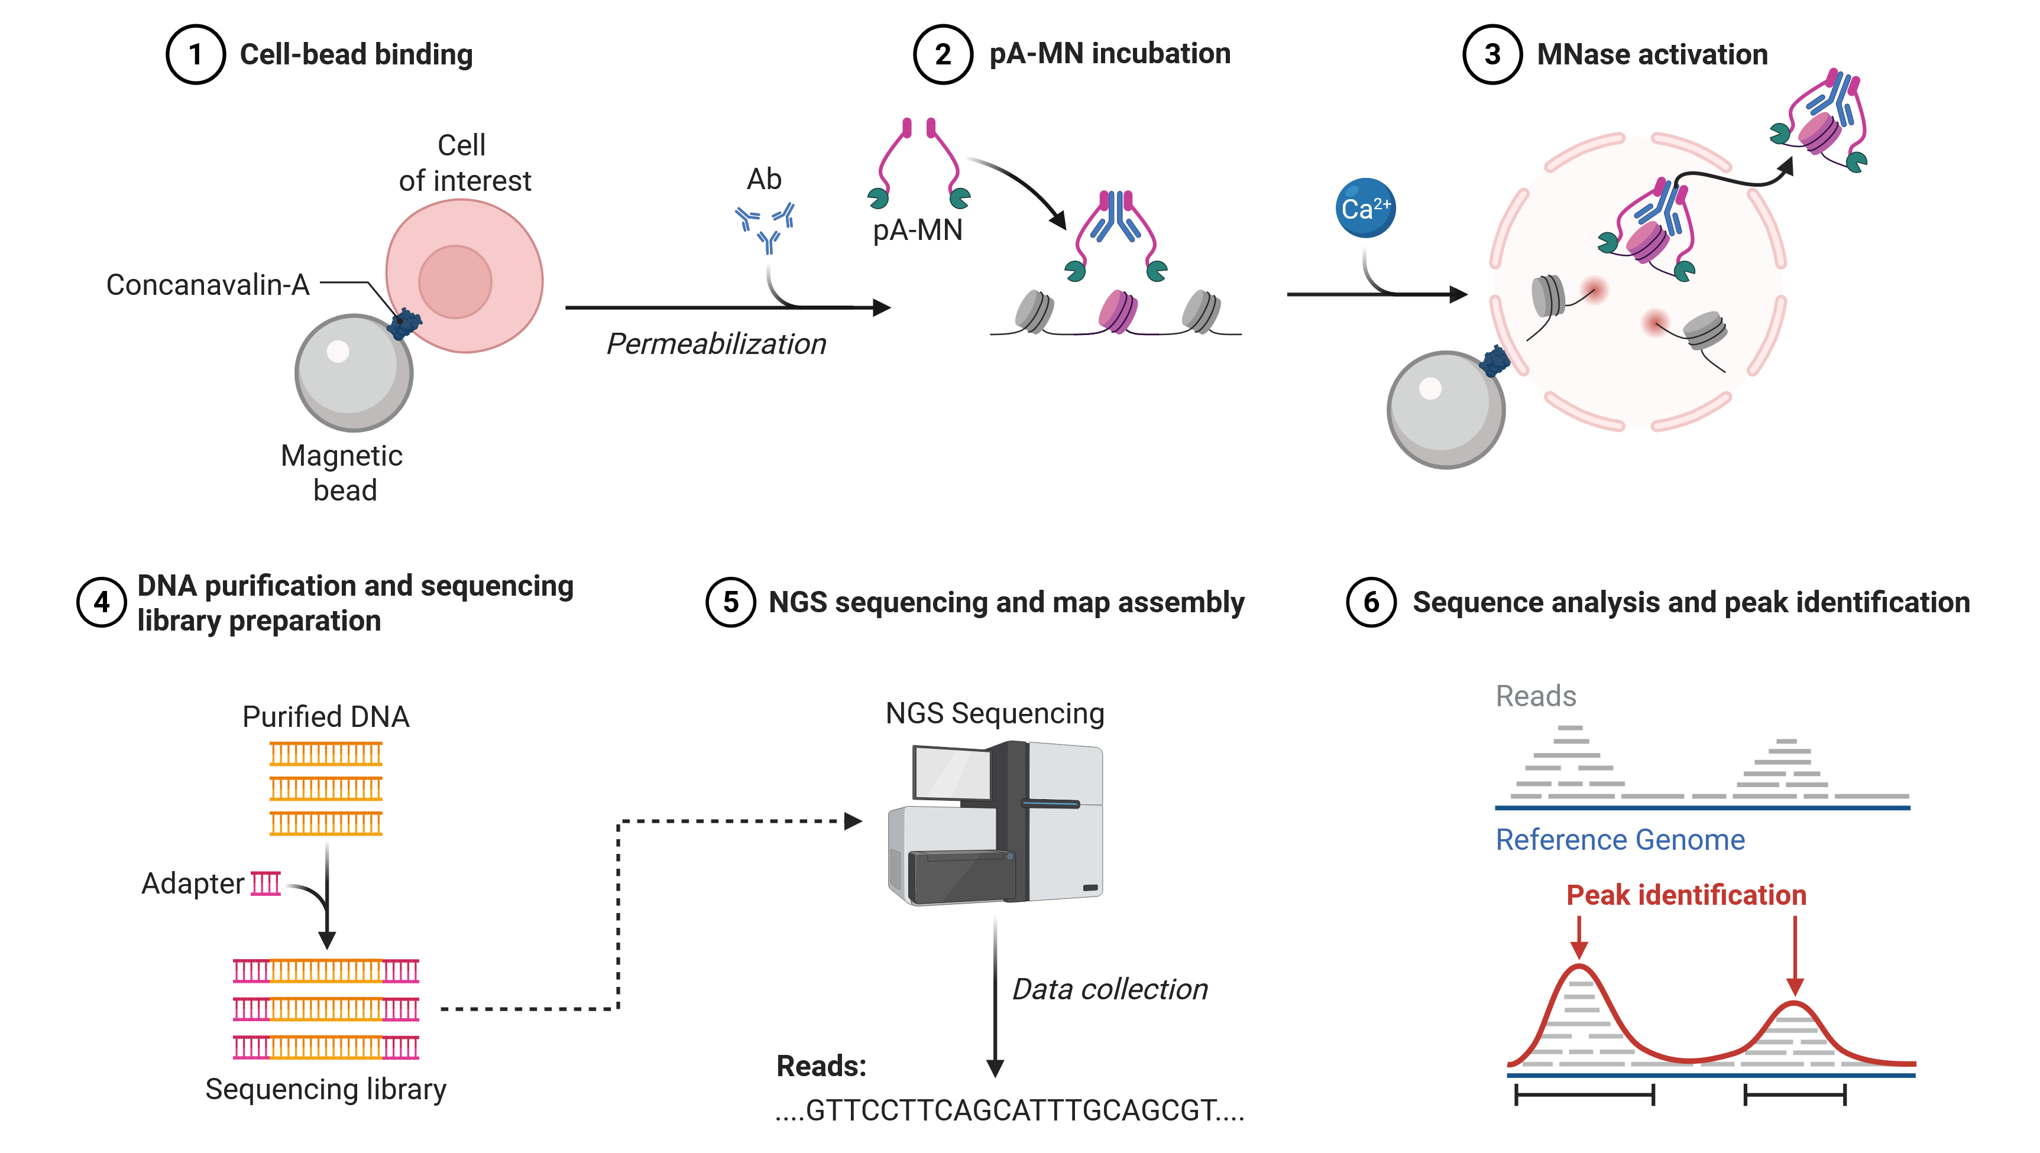
Cut&Run Sequencing

Slide 6
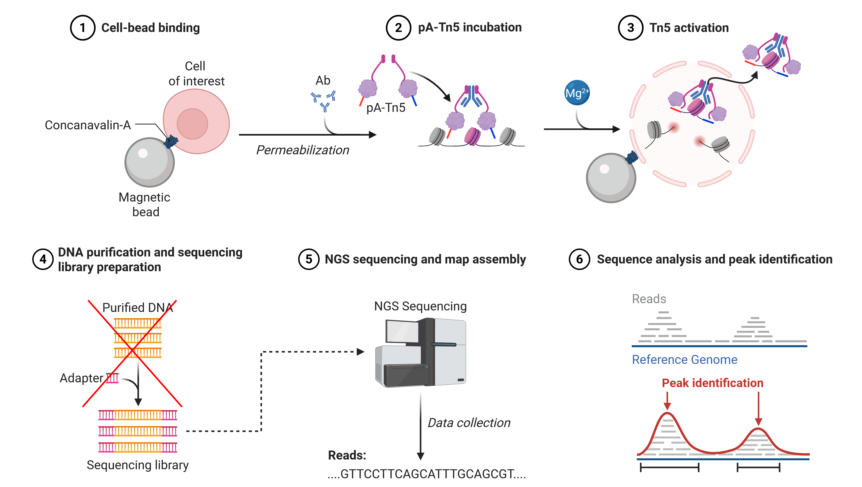
Cut&Tag Sequencing

Slide 7
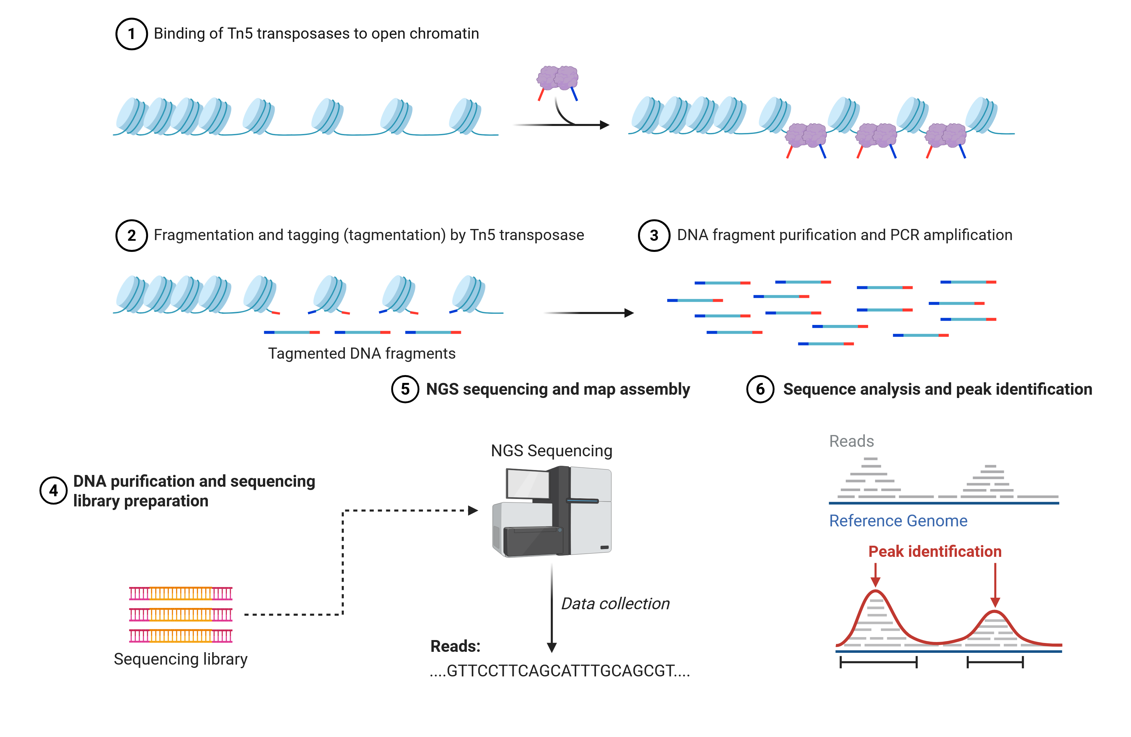
ATAC Sequencing

Slide 8
Resources
https://hbctraining.github.io/Investigating-chromatin-biology-ChIPseq/schedule/links-to-lessons.html

Slide 9
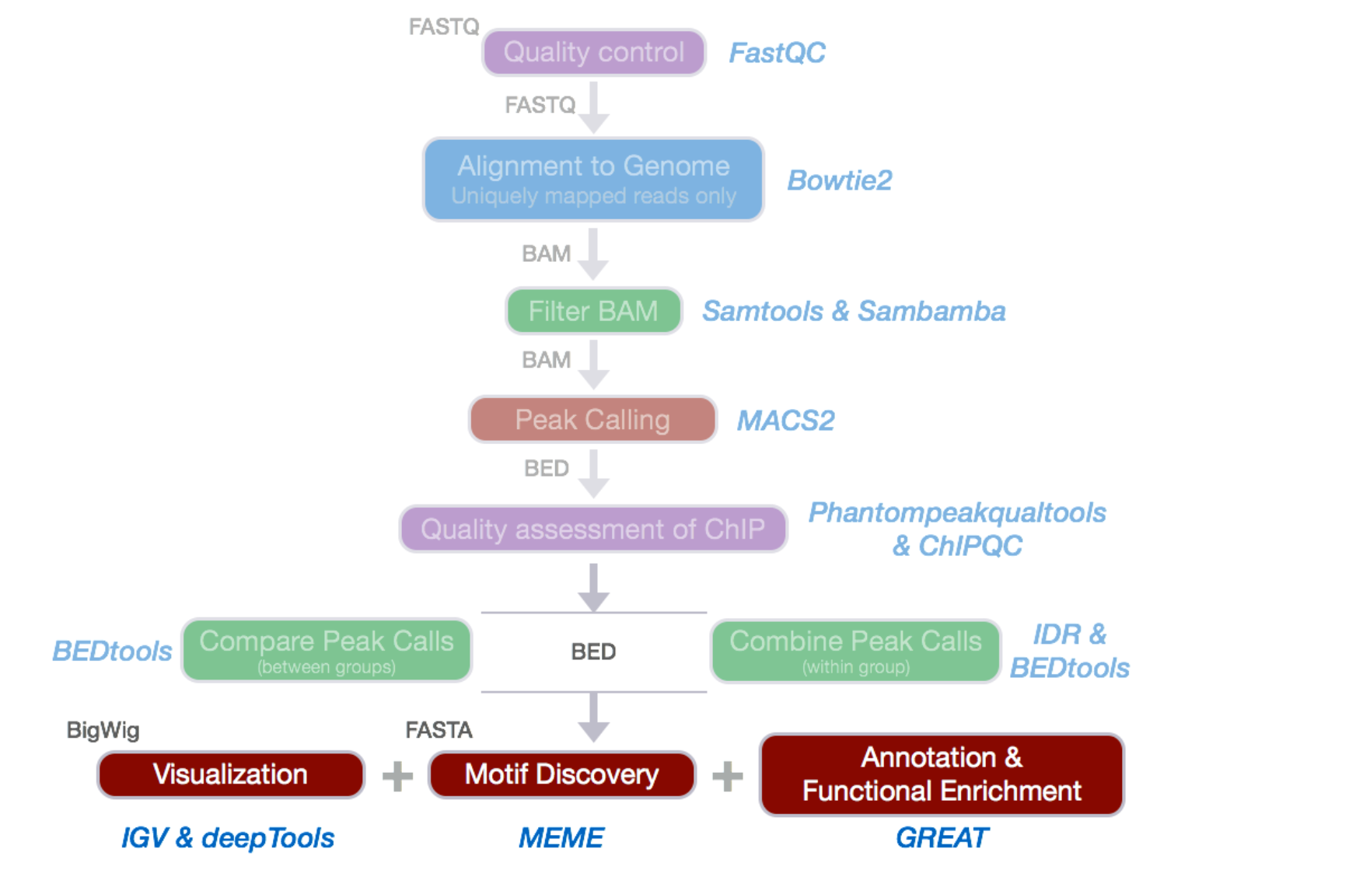

Slide 10
Sequencing Alignment
Bwa https://bio-bwa.sourceforge.net/
Bowtie2 https://bowtie-bio.sourceforge.net/bowtie2/index.shtml
https://hbctraining.github.io/Investigating-chromatin-biology-ChIPseq/lessons/04_alignment_using_bowtie2.html

Slide 11
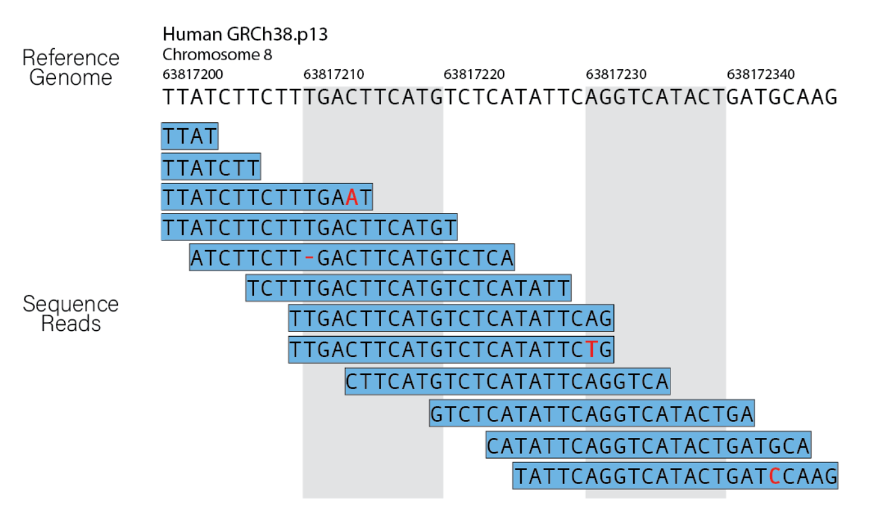
Sequencing Alignment

Slide 12
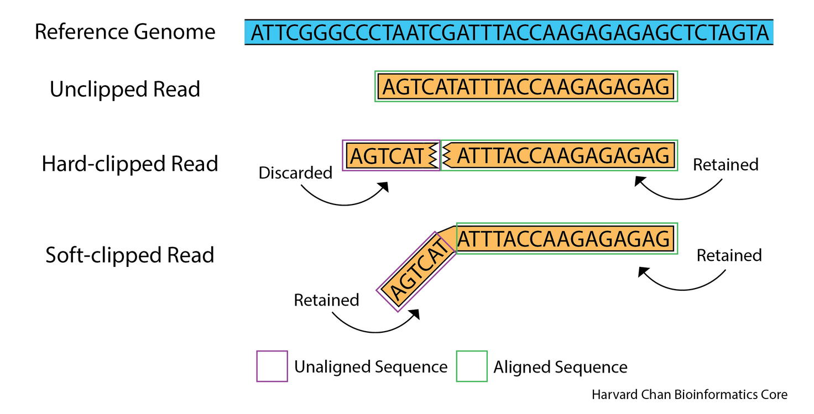
Sequence Adapter Trimming

Slide 13
Genome Browser Visualization
Integrative Genomics Viewer (IGV) https://igv.org/
Can open aligned reads BAM files with the required BAI index file
Can create bai files with something like:
samtools index "$bam_file"

Slide 14
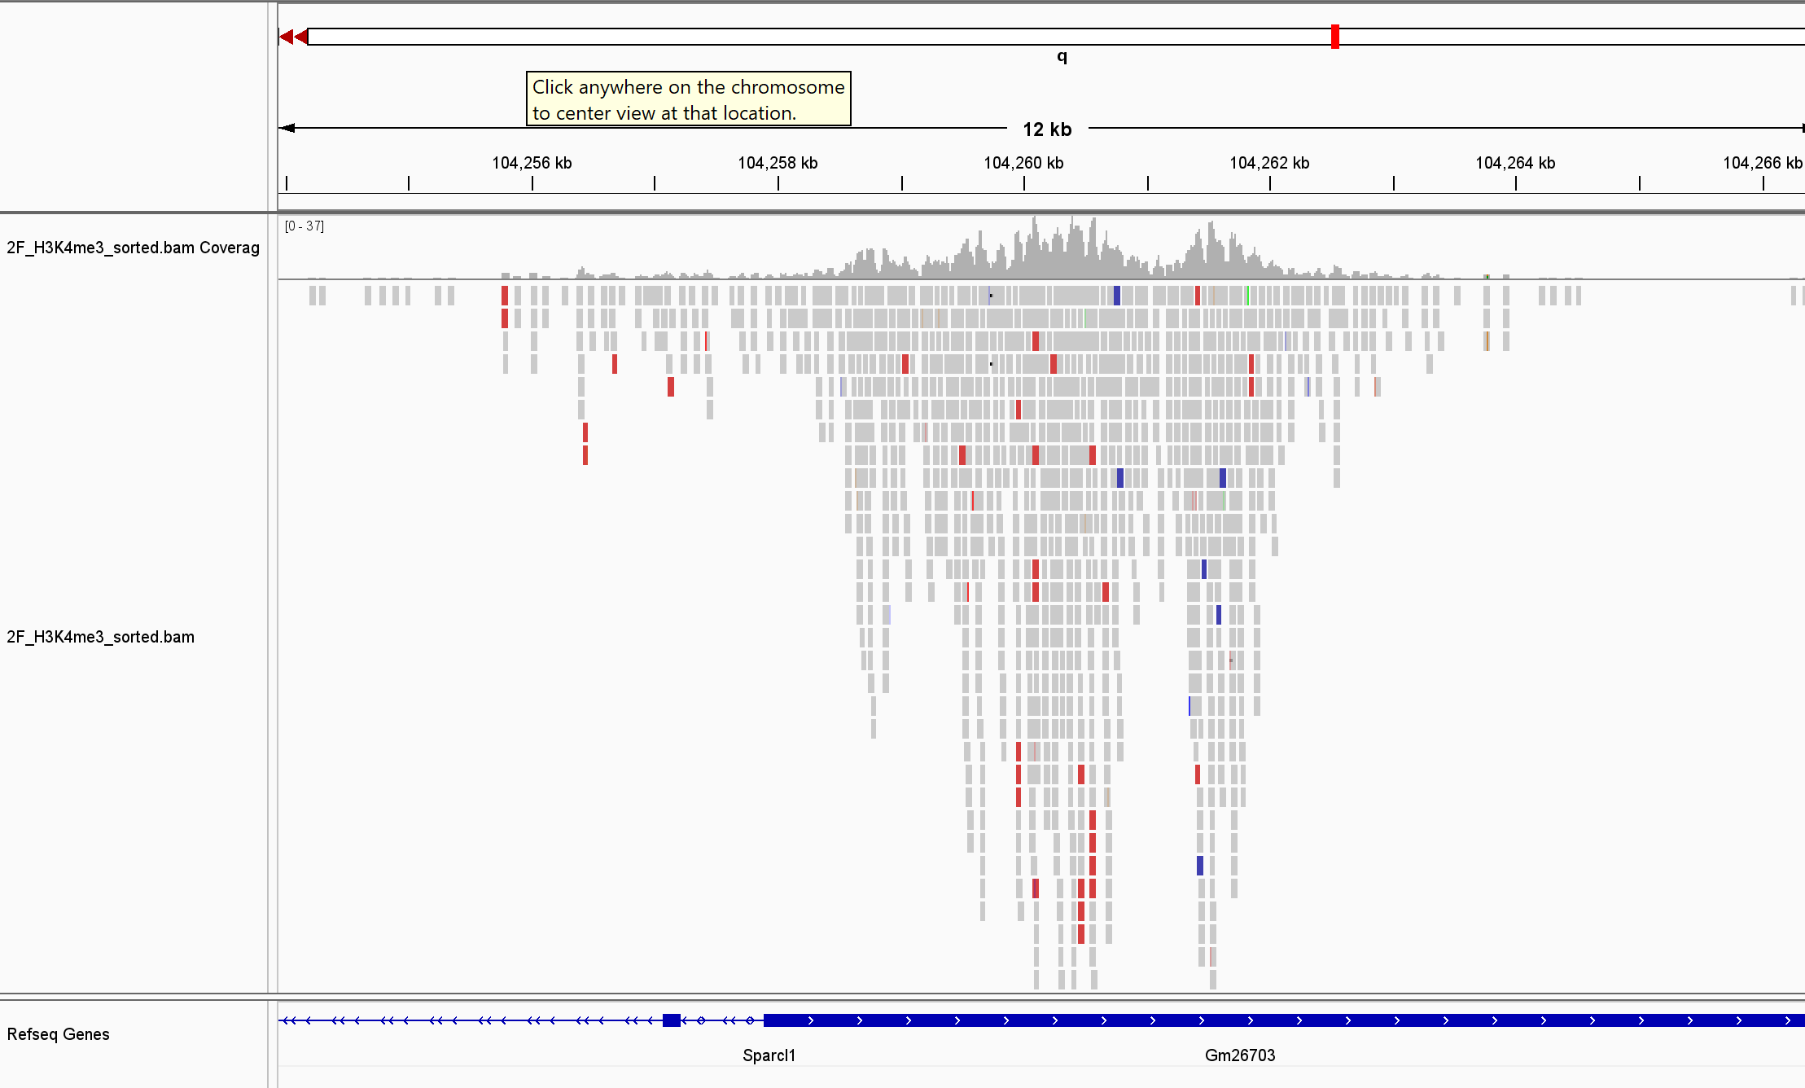

Slide 15
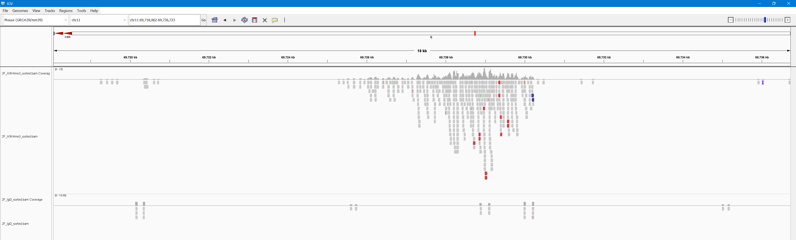

Slide 16
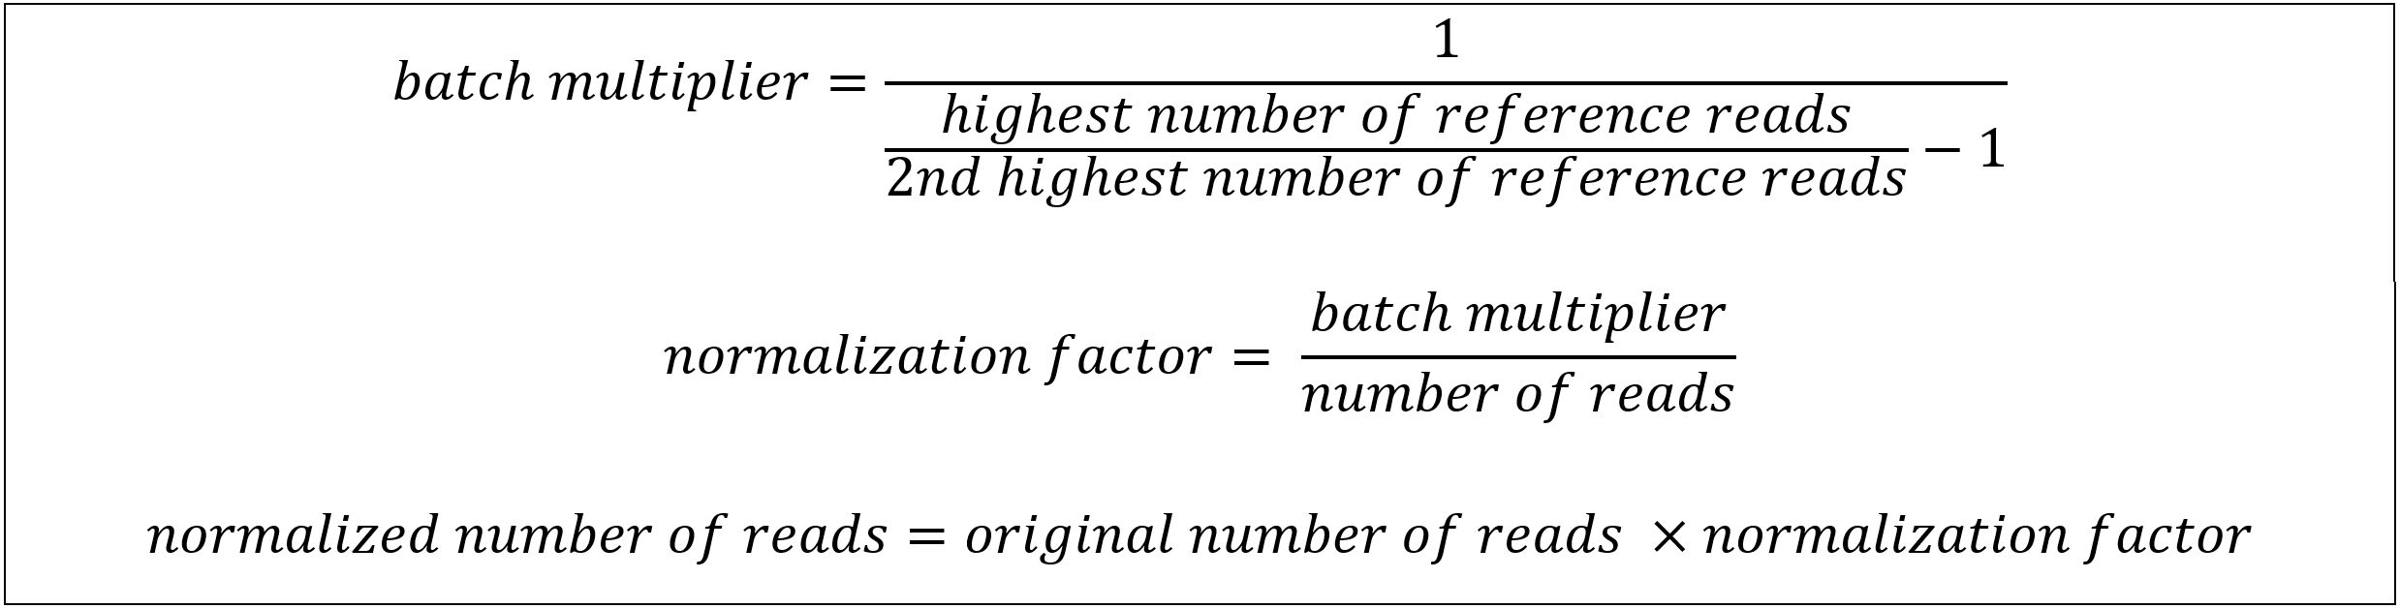
Normalization
Total read normalization (like RNAseq)
Spike-in normalization against DNA from another species

Slide 17
Visualize Results Genome-wide
deepTools https://deeptools.readthedocs.io/en/latest/
https://nbis-workshop-epigenomics.readthedocs.io/en/latest/content/tutorials/quantitativeChip/cut-and-run-data.html

Slide 18
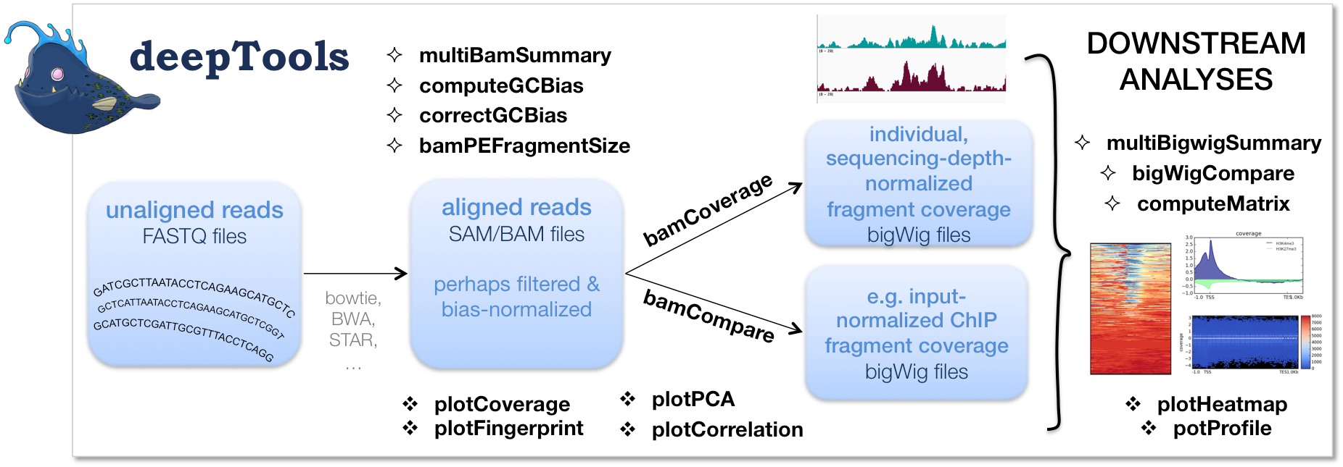
Visualize Results Genome-wide
deepTools https://deeptools.readthedocs.io/en/latest/

Slide 19
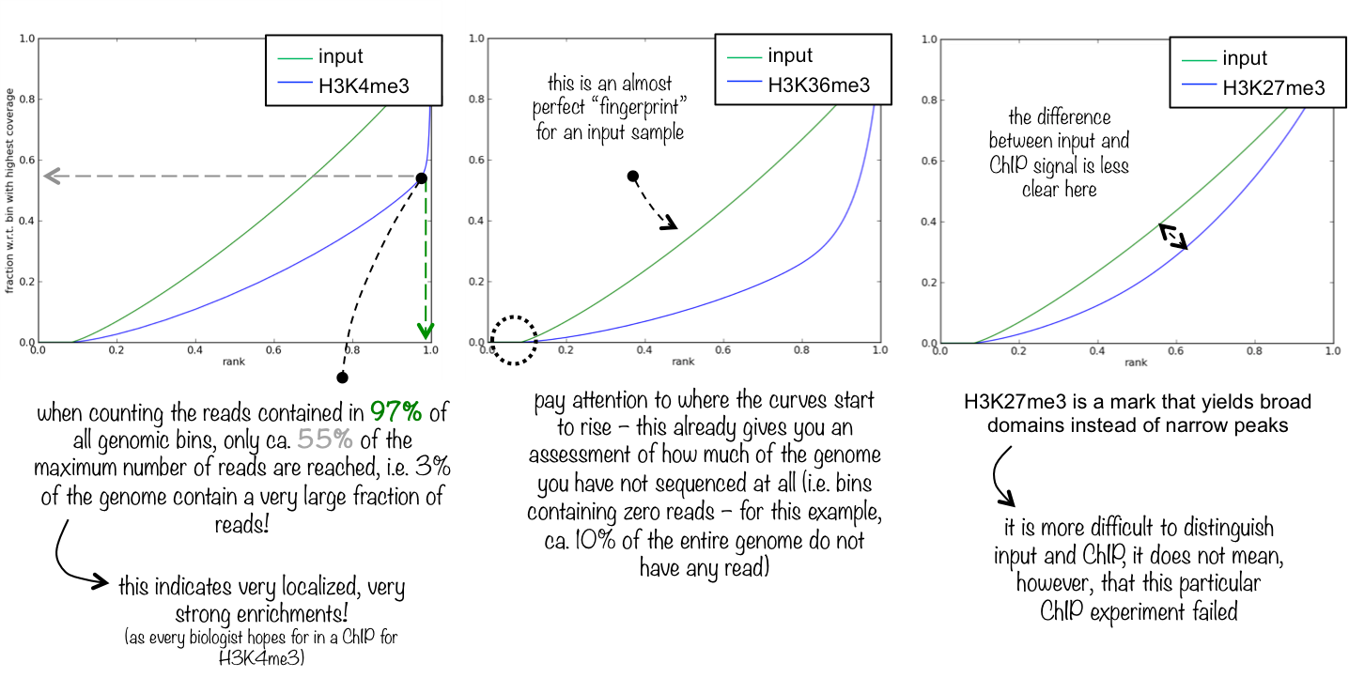
plotFingerprint

Slide 20
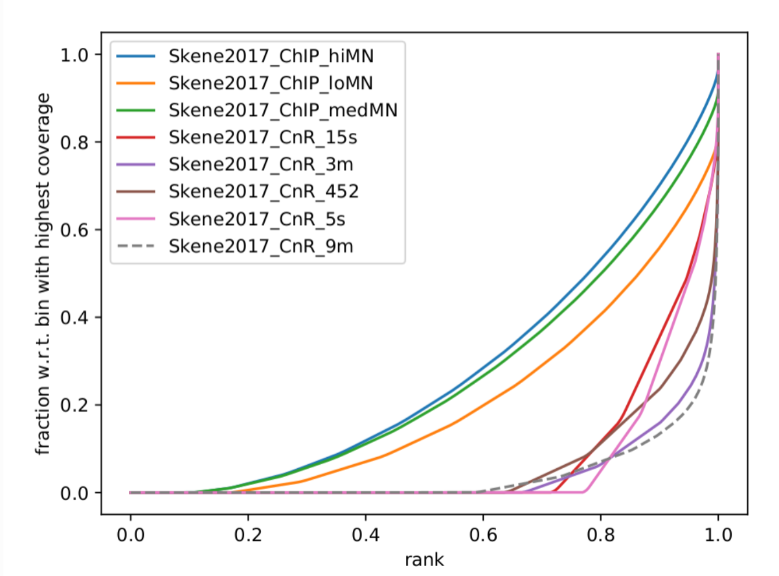
plotFingerprint

Slide 21
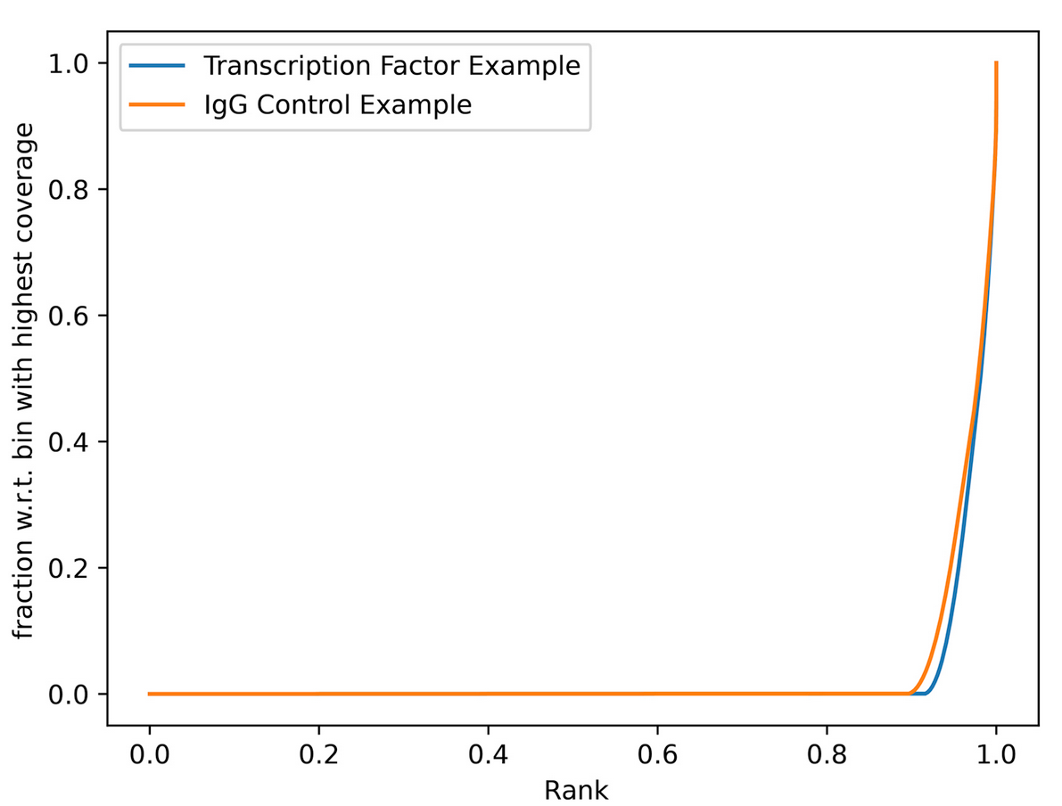
plotFingerprint Cut&Run

Slide 22
multiBamSummary
Takes multiple BAM files as input
Computes a compressed numpy array of coverage
Can be run for certain regions or the whole genome

Slide 23
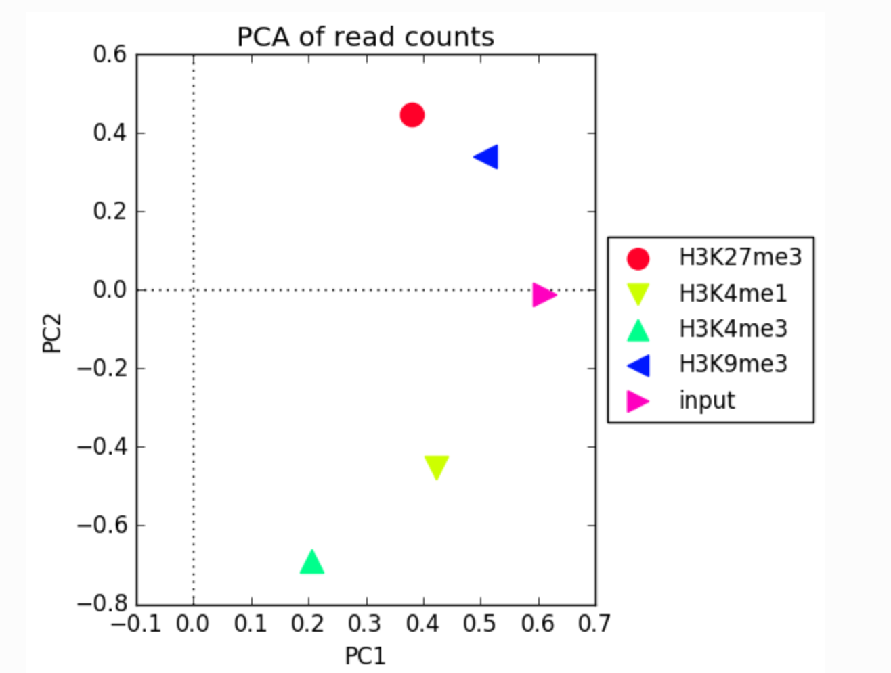
plotPCA
Runs PCA using multiBamSummary output
Shows how similar or different samples are overall

Slide 24
bamCoverage and bamCompare
Creates a BigWig file from BAM file inputs
BigWig has a coverage score for each genomic location
Can be done in isolation (bamCoverage) or compared to a control (bamCompare)

Slide 25
bamCoverage and bamCompare

Slide 26
bamCoverage and bamCompare

Slide 27
computeMatrix and plotHeatmap
computeMatrix takes the output of BigWig files and computes an intermediate matrix file for genomic loci of interest.
plotHeatmap takes the matrix file and creates the actual plot
Allows for small changes to the plots to run much more quickly since the more computationally intensive calculations are saved

Slide 28
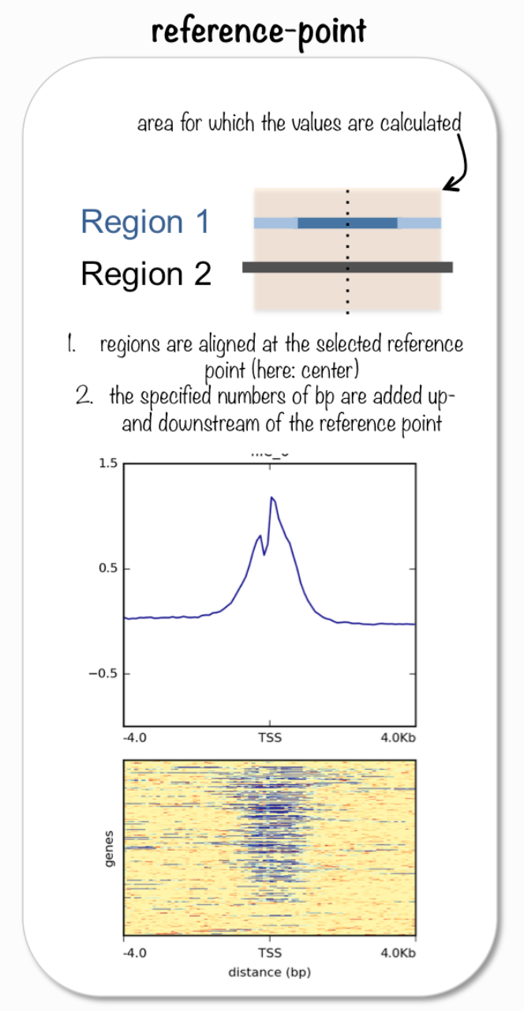

Slide 29
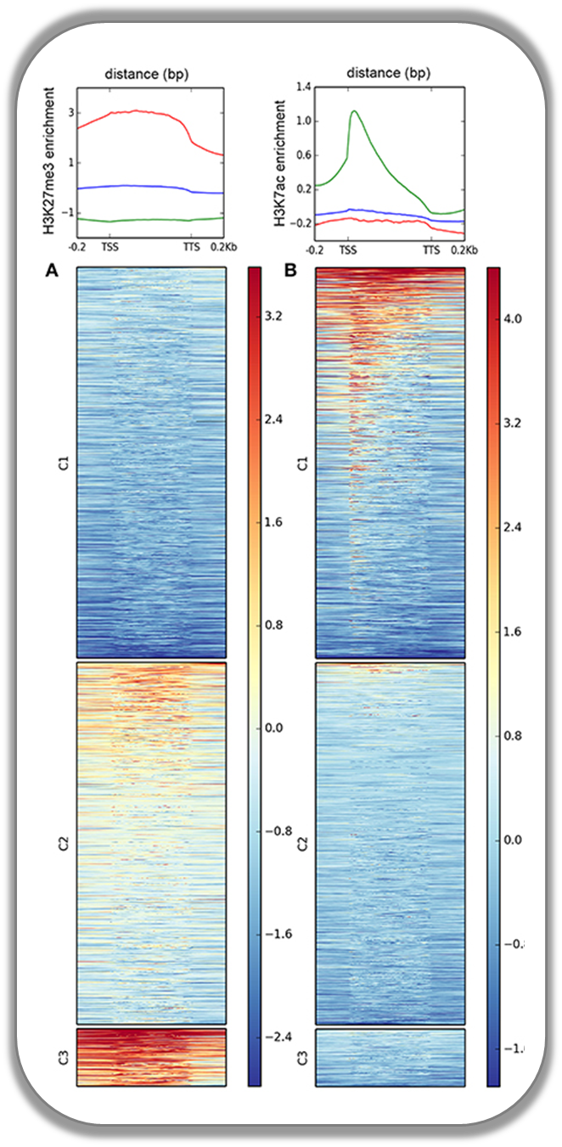

Slide 30
Peak calling
MACS2 https://hbctraining.github.io/Intro-to-ChIPseq/lessons/05_peak_calling_macs.html
Homer http://homer.ucsd.edu/homer/ngs/peaks.html
Caras https://github.com/mbassalbioinformatics/CaRAS

Slide 31
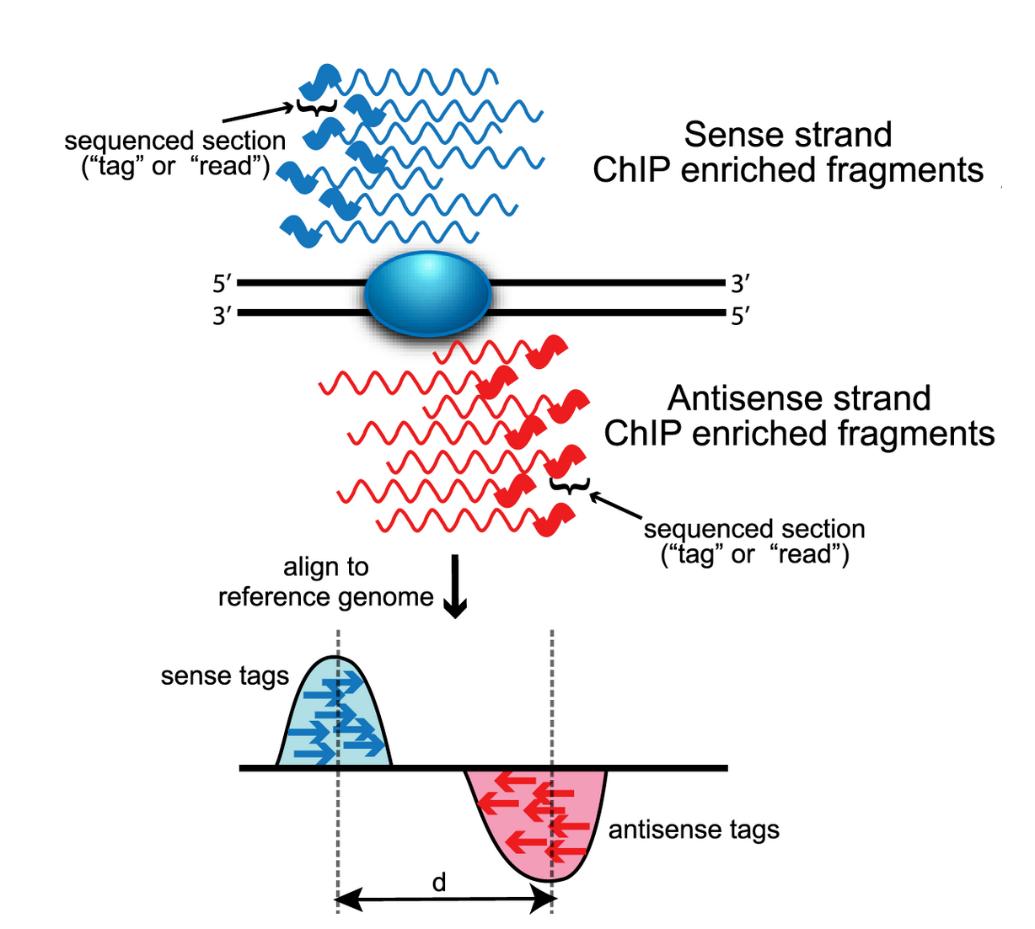
Peak calling

Slide 32
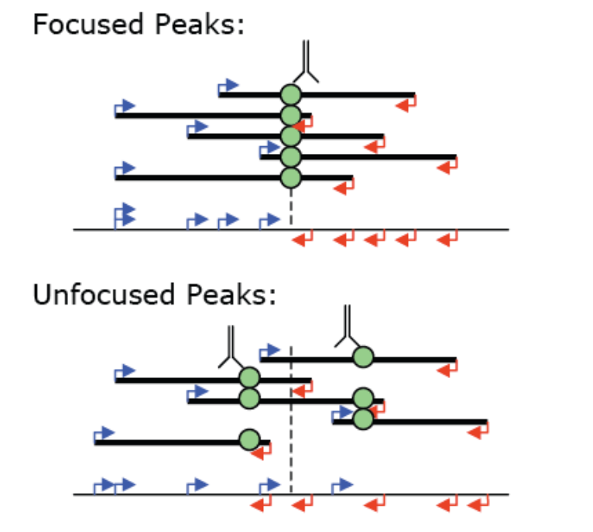
Peak calling

Slide 33
Peak calling – variable sizes
Narrow Peaks (H3K27ac and most transcription factors)
Broad Peaks (most histone modifications)

Slide 34
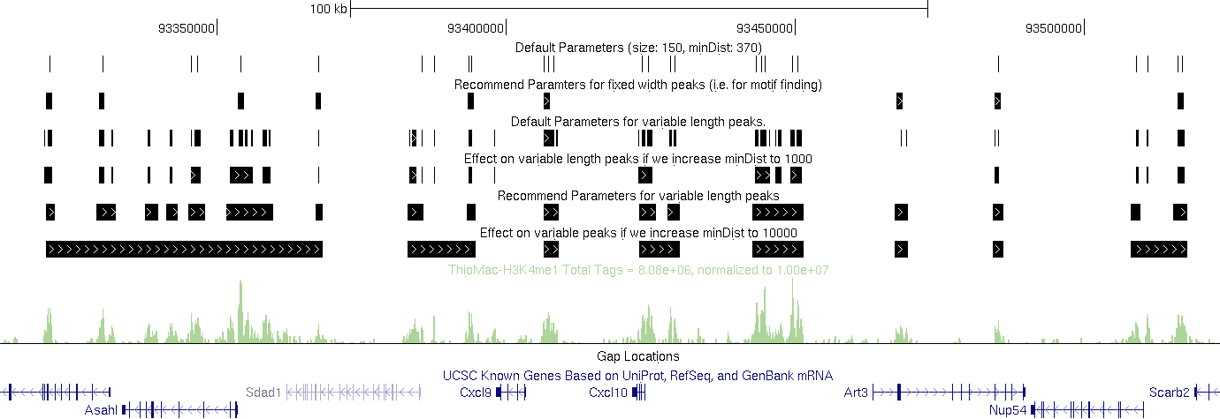
Peak calling

Slide 35
Peak calling – variable threshold
Peak callers will use different thresholds for each candidate peak (tag) based on the expected number of reads compared to a control sample

Slide 36
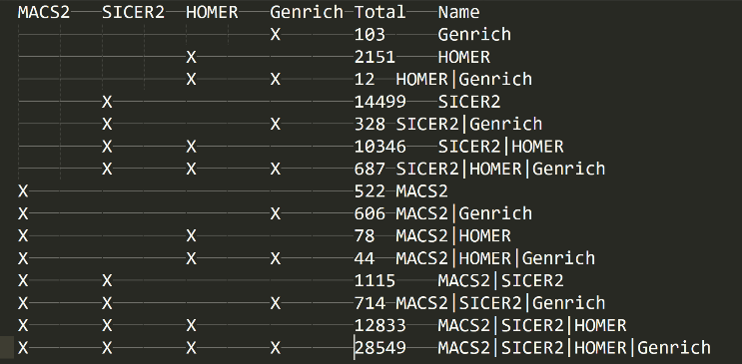
Caras – for when peak callers disagree

Slide 37
Differential Expression Analysis
Can generate a count matrix for called peaks and run differential expression between conditions https://hbctraining.github.io/Intro-to-ChIPseq/lessons/08_diffbind_differential_peaks.html

Slide 38
Peak annotation
ChIPseeker https://www.bioconductor.org/packages/release/bioc/html/ChIPseeker.html
Promoter
5’ UTR
3’ UTR
Exon
Intron
Downstream
Intergenic

Slide 39
Motif Discovery
MEME-suite https://meme-suite.org/meme/
https://hbctraining.github.io/In-depth-NGS-Data-Analysis-Course/sessionV/lessons/12_functional_analysis.html

Slide 40
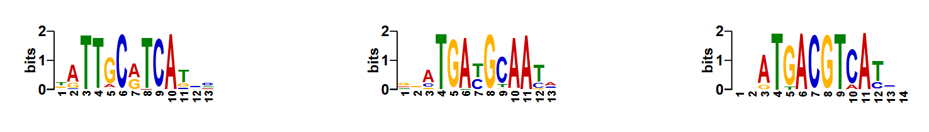
AME – find known motifs
https://meme-suite.org/meme//doc/ame-tutorial.html?man_type=web
Searches for known transcription factor motifs

Slide 41
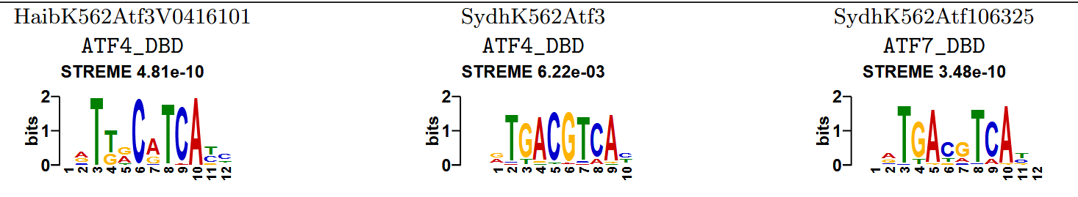
STREME – discover new motifs
https://meme-suite.org/meme//tools/streme
https://academic.oup.com/bioinformatics/article/37/18/2834/6184861#408304103

Slide 42
TomTom – compare discovered motifs to known motifs
https://meme-suite.org/meme/tools/tomtom

