Slide 1
Getting Started with R and Python on the DCC
Justin Savage
Duke Quantitative Living Systems Center
1/14/26

Slide 2
Outline
Duke Computer Cluster Basics
Making a custom R package library on the DCC
Running basic R code on the DCC
Interactive Rstudio through OnDemand
Custom Python package management using miniconda
Running basic Python code on the DCC
Interactive Jupyter Notebooks through OnDemand

Slide 3
Resources for DCC, R, and Python
DCC
https://oit-rc.pages.oit.duke.edu/rcsupportdocs/
https://oit-rc.pages.oit.duke.edu/rcsupportdocs/help/training/
R
https://r4ds.hadley.nz/
Python
https://github.com/jakevdp/PythonDataScienceHandbook

Slide 4
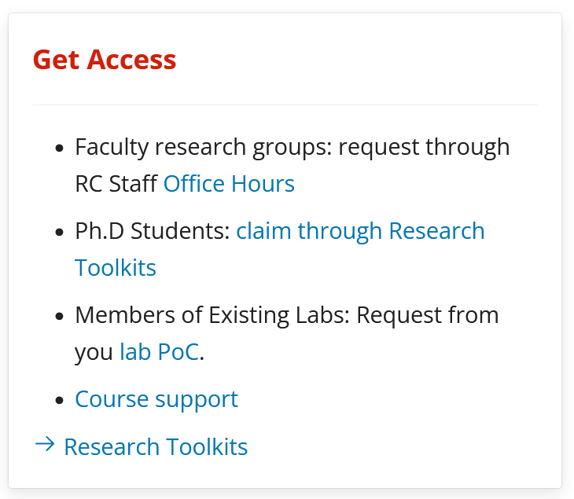
Getting access to the DCC
https://oit-rc.pages.oit.duke.edu/rcsupportdocs/

Slide 5
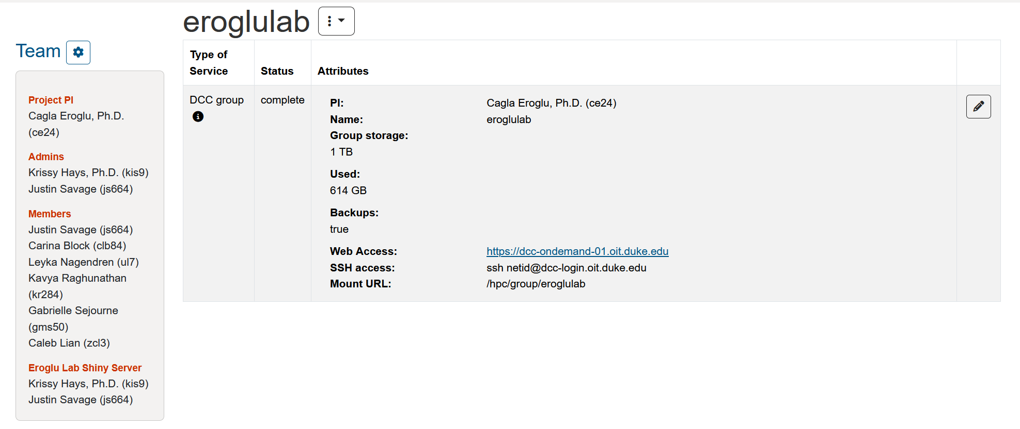
Getting access to the DCC
https://rtoolkits.web.duke.edu/

Slide 6
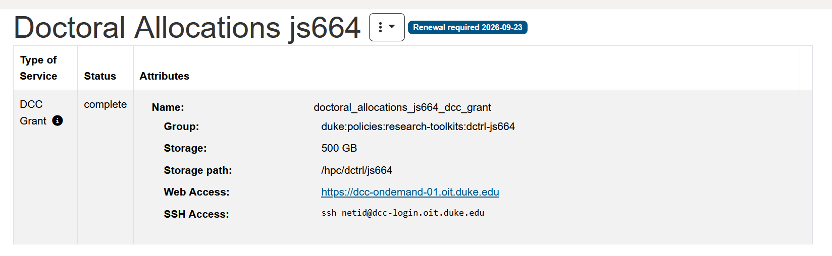
Getting access to the DCC
https://oit-rc.pages.oit.duke.edu/rcsupportdocs/help/Phdstudentaccess/

Slide 7
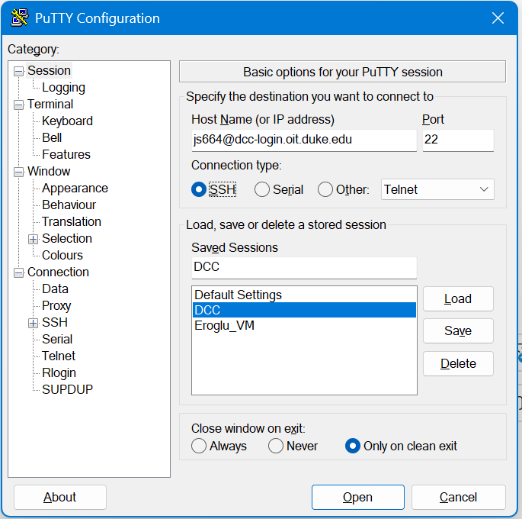
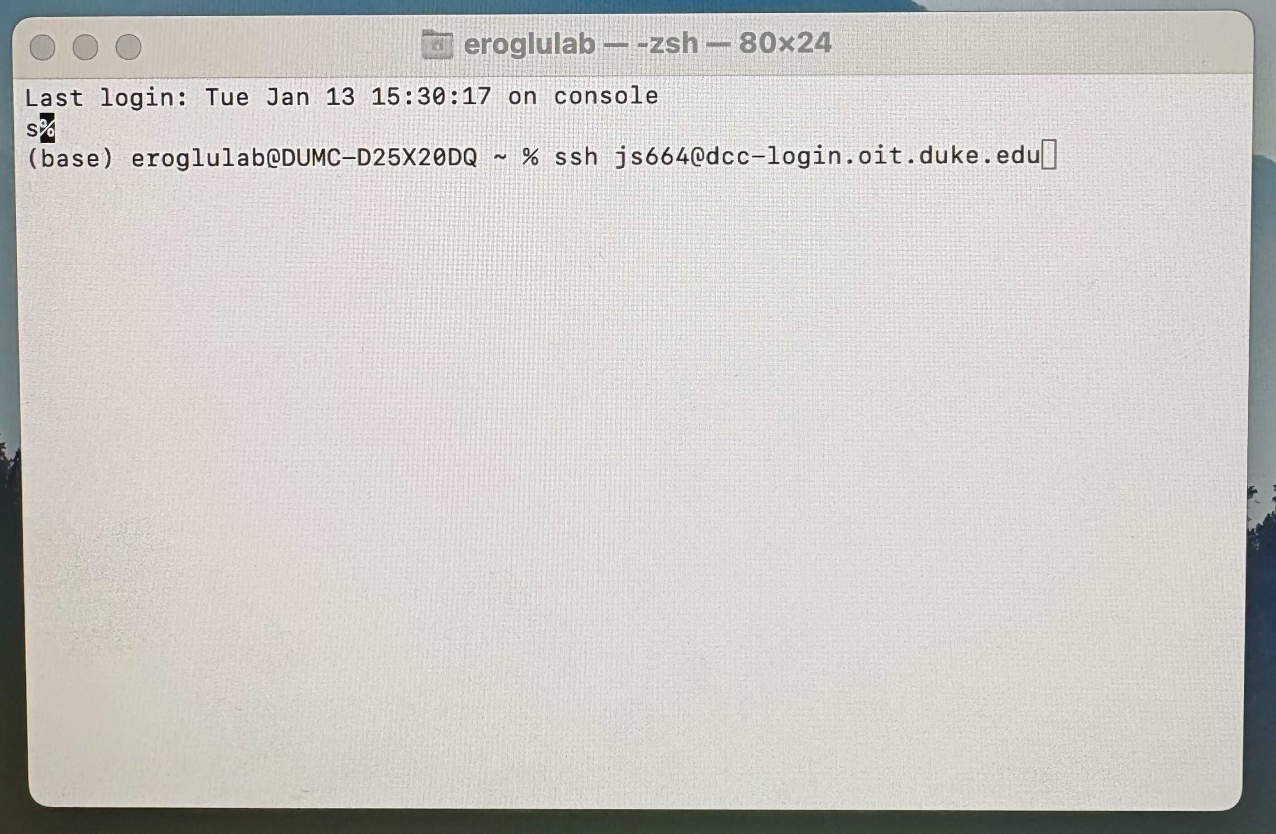
Connecting to the DCC
Mac run the following in terminal:
ssh <netid>@dcc-login.oit.duke.edu
Windows (through Putty)

Slide 8
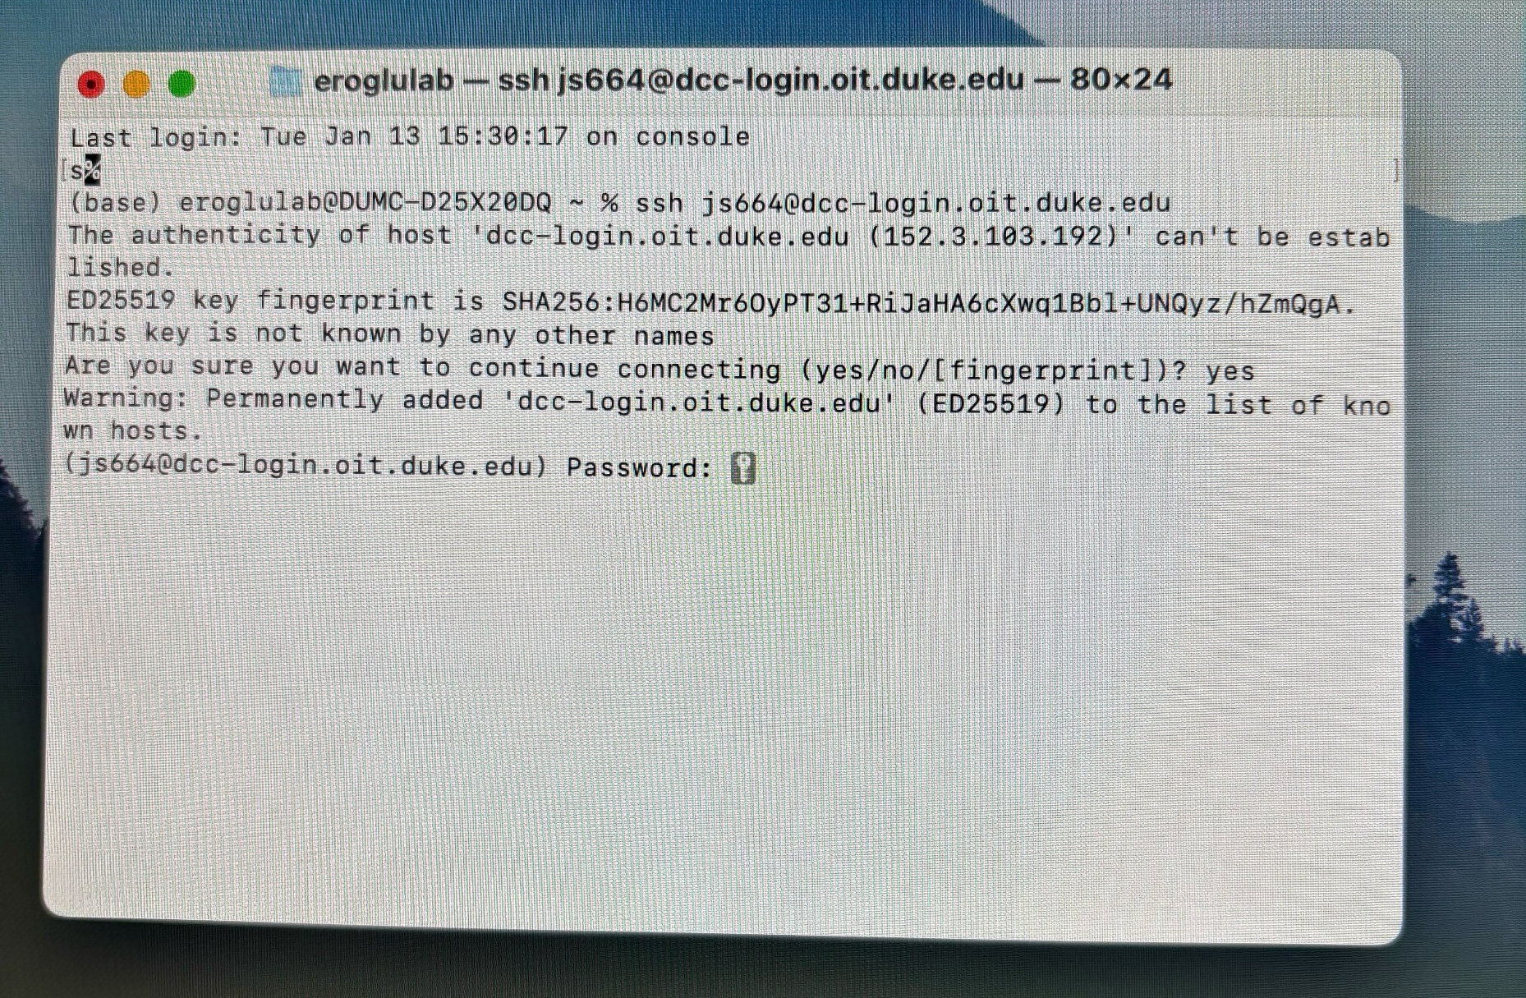
Connecting to the DCC
Mac run the following in terminal:
ssh <netid>@dcc-login.oit.duke.edu
Windows (through Putty)

Slide 9
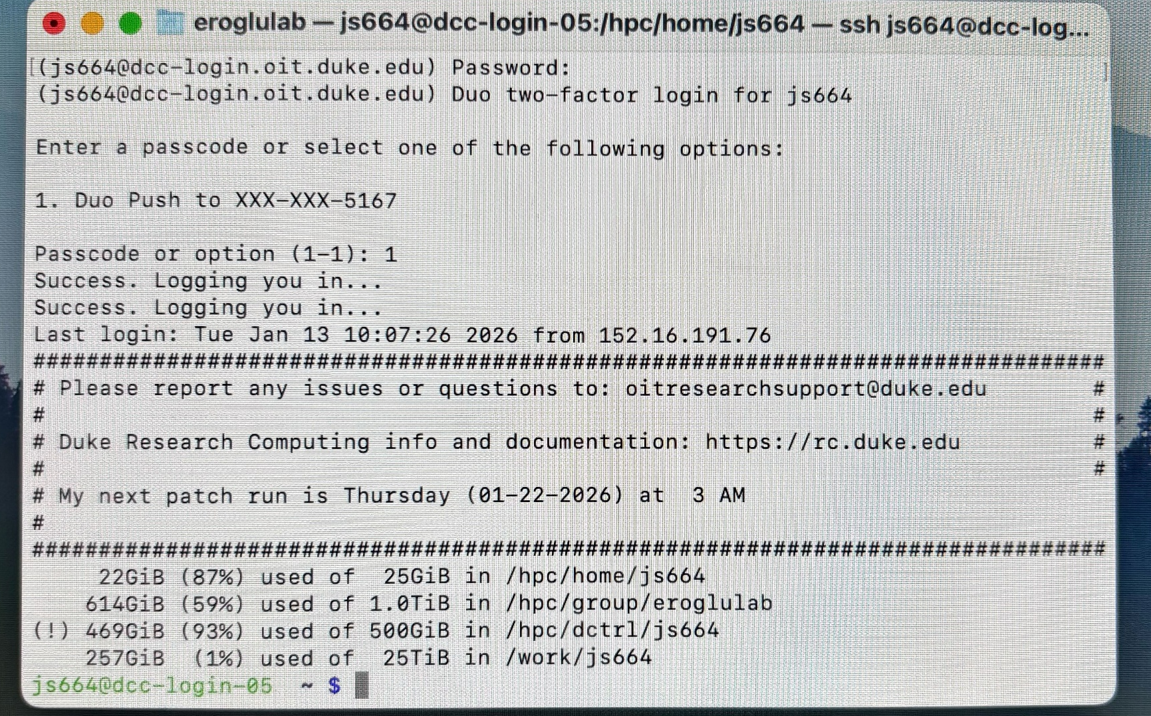
Connecting to the DCC
Mac run the following in terminal:
ssh <netid>@dcc-login.oit.duke.edu
Windows (through Putty)

Slide 10
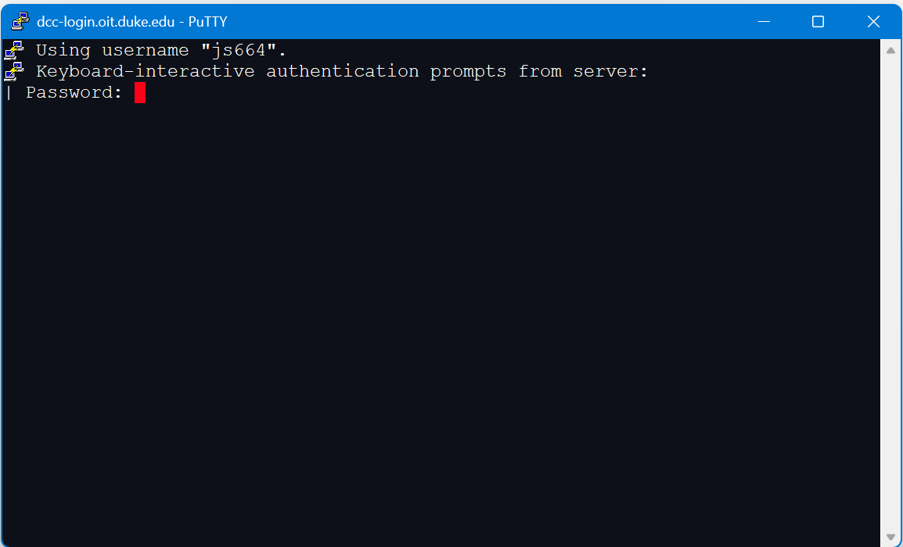
Connecting to the DCC
Windows (through Putty)

Slide 11
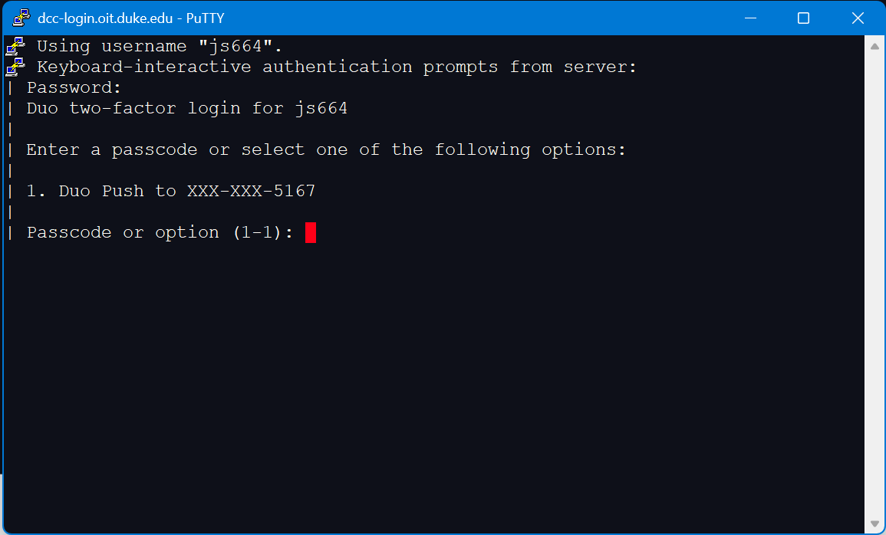
Connecting to the DCC
Windows (through Putty)

Slide 12
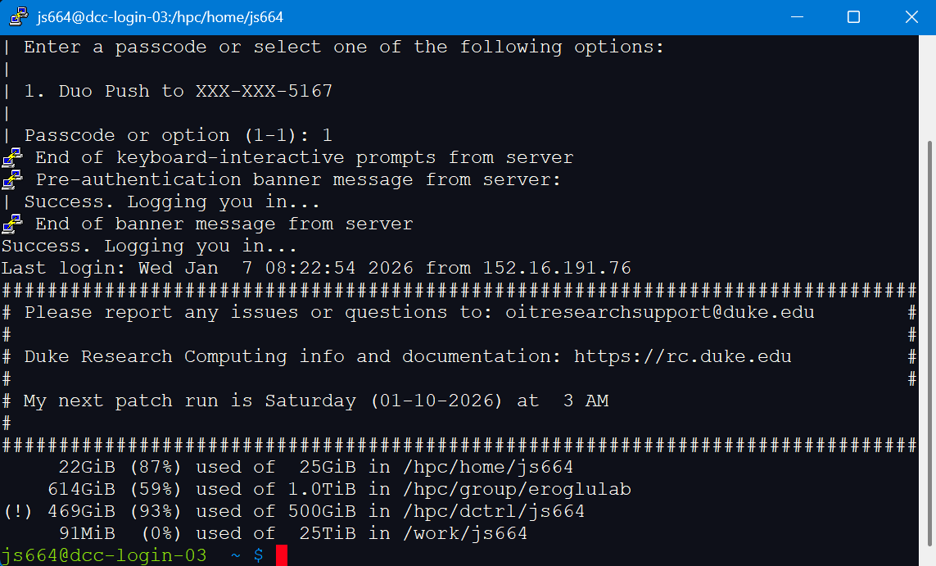
Connecting to the DCC

Slide 13
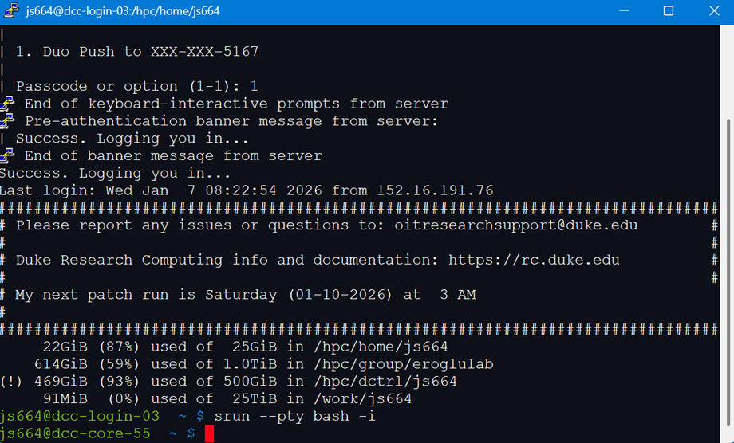
Connecting to an interactive node
srun --pty bash -i

Slide 14
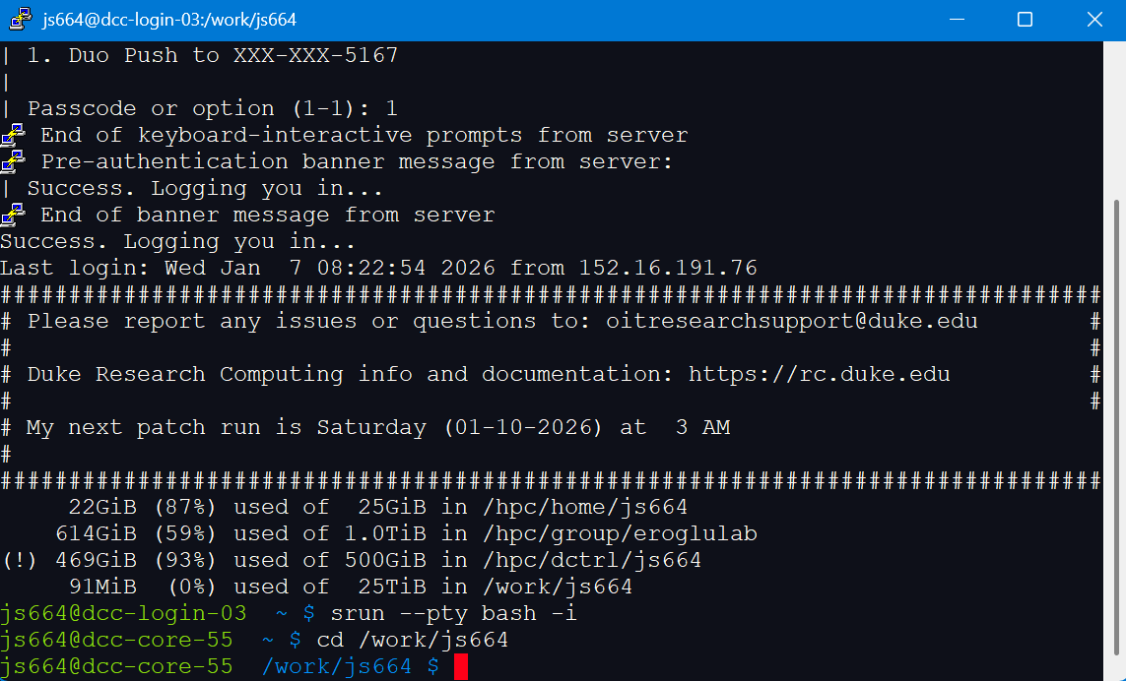
Changing directory
cd /work/<netid>

Slide 15
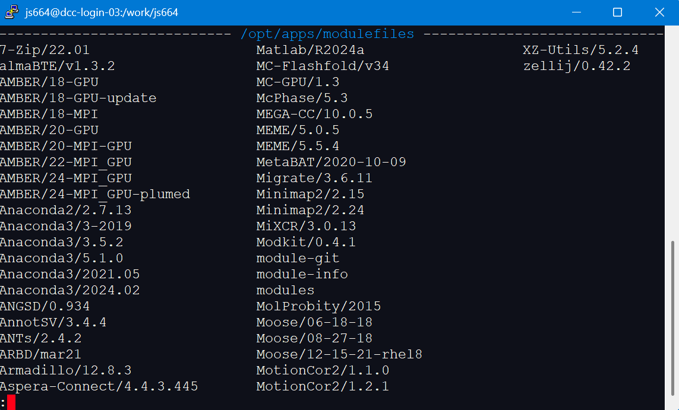
Checking available modules
module avail

Slide 16
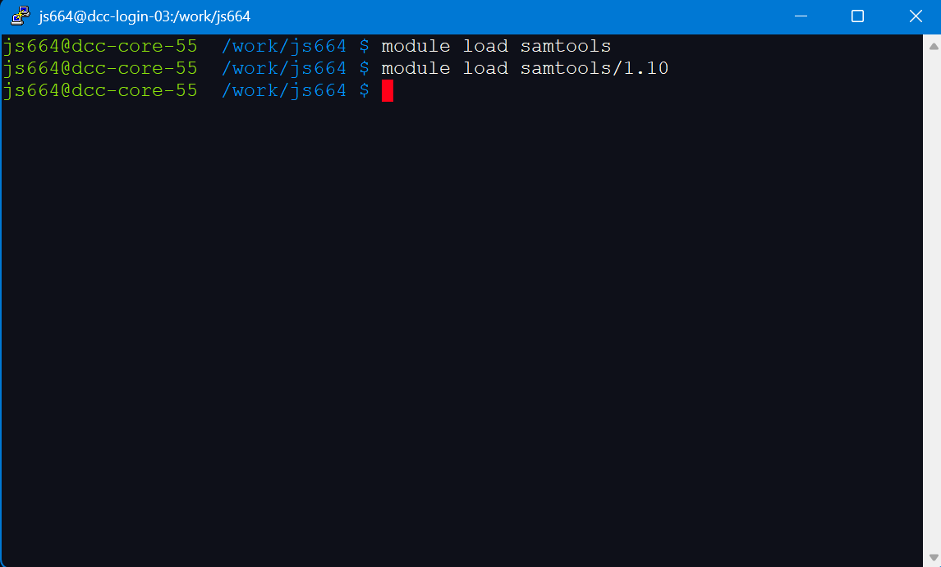
Loading DCC Modules
module load <module-name>

Slide 17
When to use DCC modules
Helpful for most software tools
Not recommended for tools that require customization
You do not have write permission for modules so tools that require writing to their package location will not work

Slide 18
When to use DCC modules
Helpful for most software tools
Not recommended for tools that require customization
You do not have write permission for modules so tools that require writing to their package location will not work
We can overcome this limitation for R and Python

Slide 19
Making a personal package library for R
Allows you to load R from the modules but access your own R packages installed in your DCC space
Should be located in a folder that won’t be deleted (group or dctrl)
Can be put into work, but then you may need to repeat setup often

Slide 20
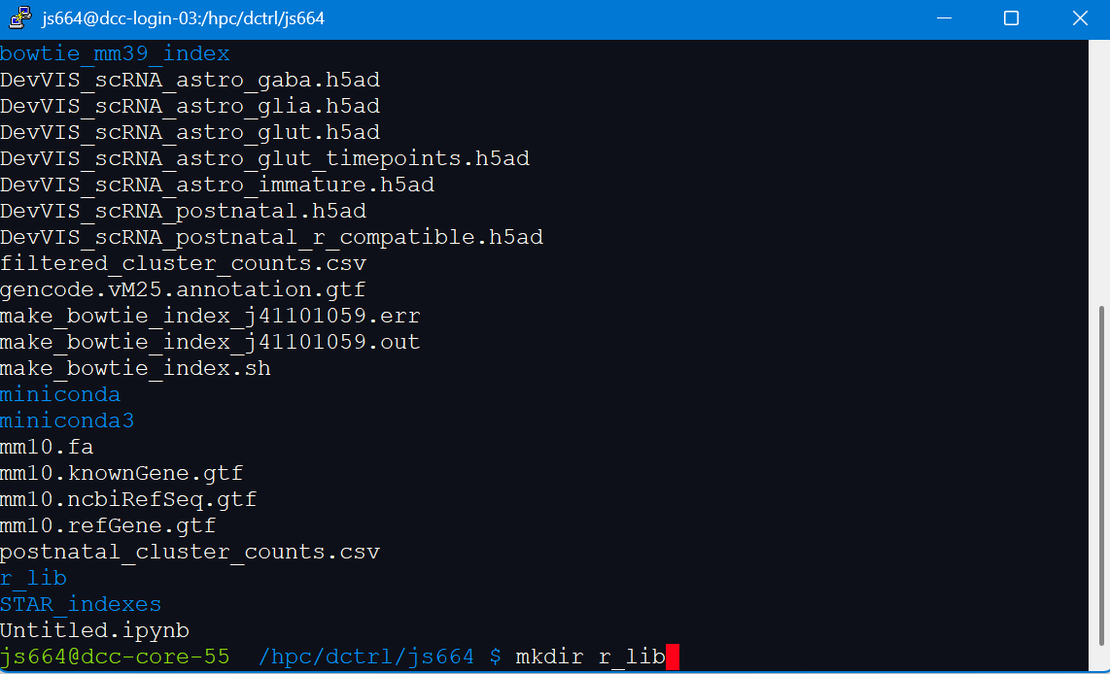
Making a personal package library for R
mkdir r_lib

Slide 21
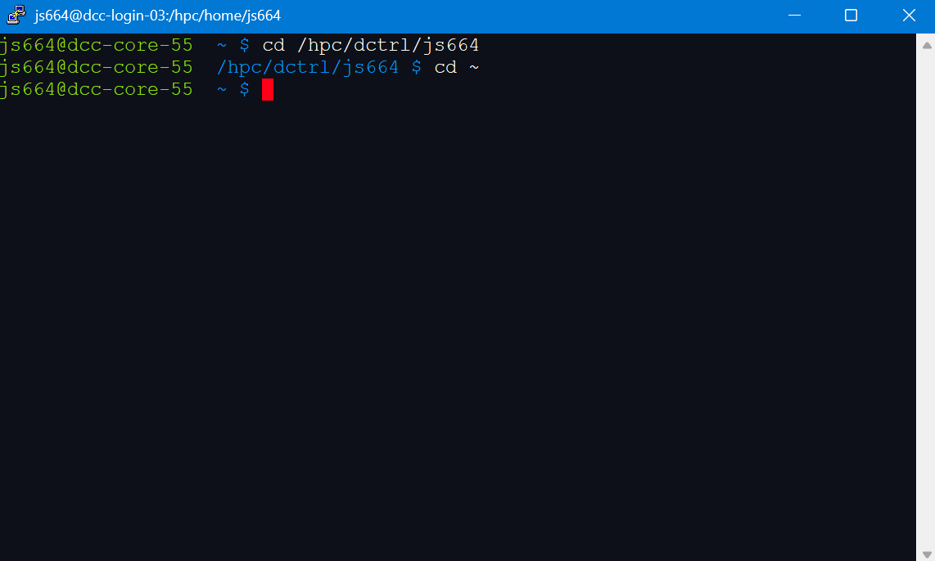
Configuring R to look in your library
cd ~

Slide 22
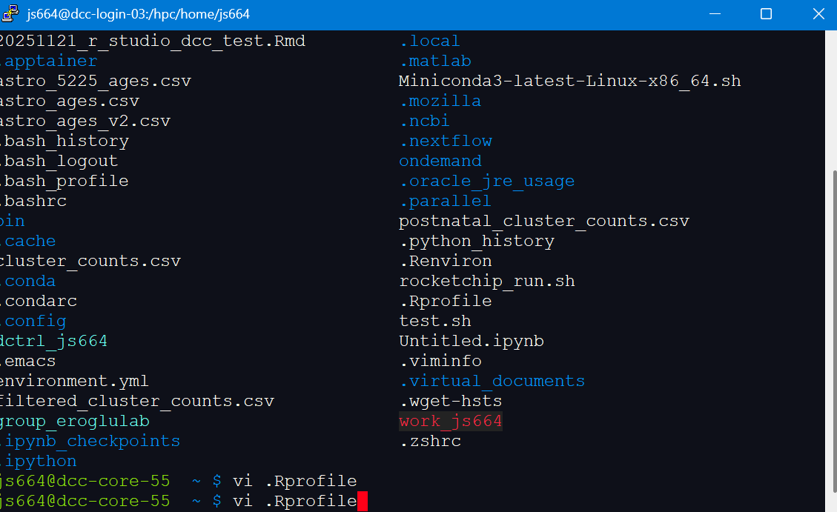
Configuring R to look in your library
vi .Rprofile

Slide 23
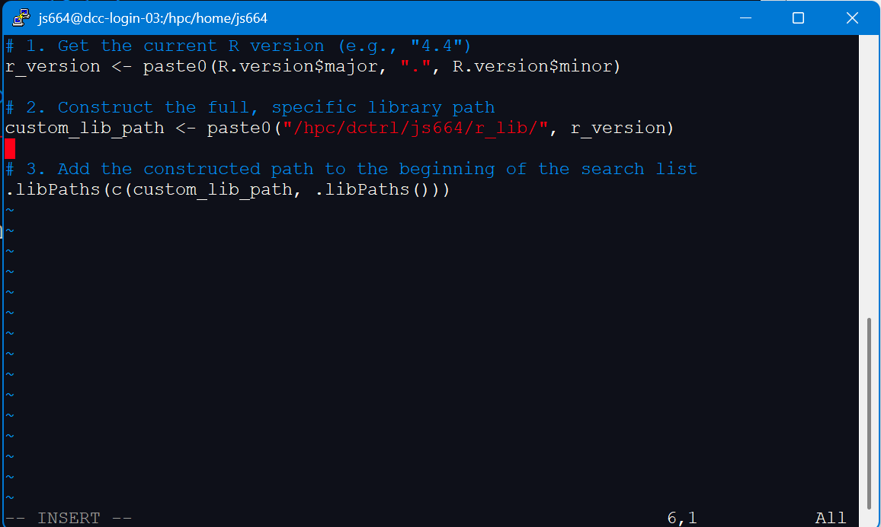
Configuring R to look in your library
vi .Rprofile

Slide 24
Configuring R to look in your library
# 1. Get the current R version (e.g., "4.4")
r_version <- paste0(R.version$major, ".", R.version$minor)
# 2. Construct the full, specific library path
custom_lib_path <- paste0("/hpc/dctrl/<netID>/r_lib/", r_version)
# 3. Add the constructed path to the beginning of the search list
.libPaths(c(custom_lib_path, .libPaths()))

Slide 25
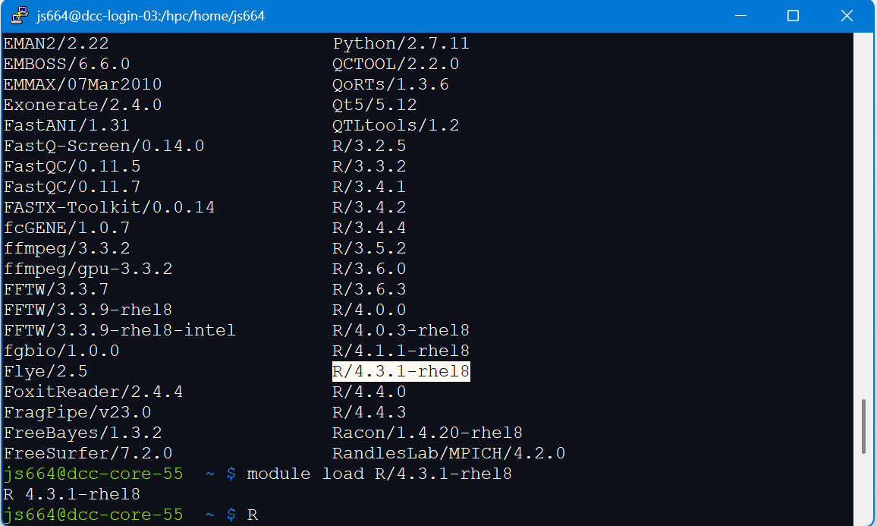
Running R console in the command line
module load R/4.3.1-rhel8

Slide 26
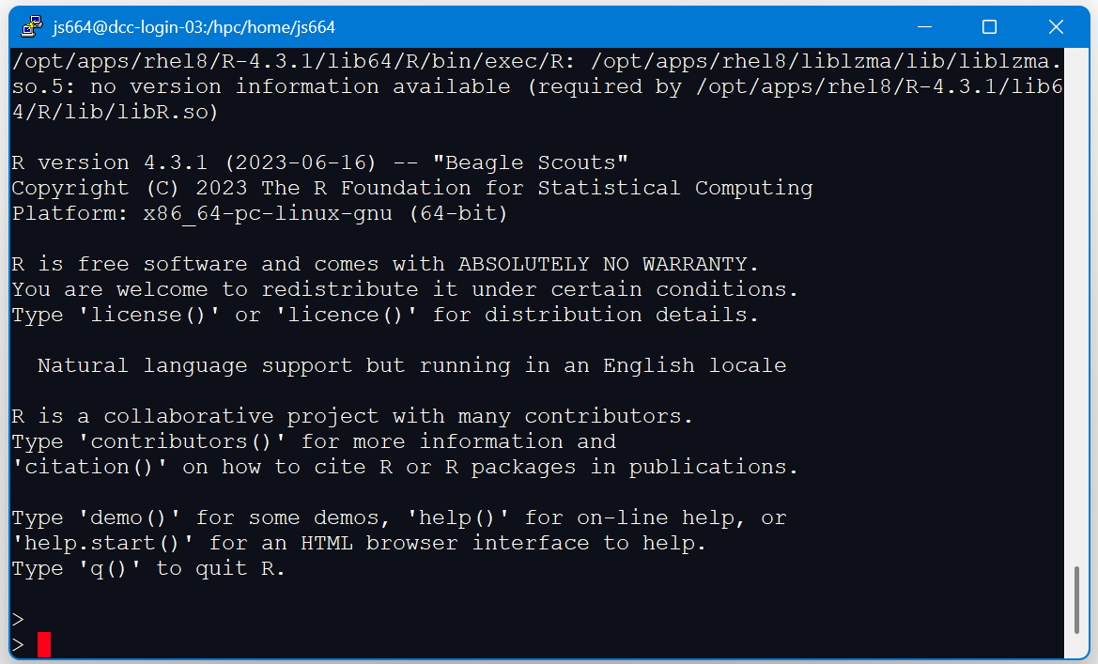
Running R console in the command line
R

Slide 27
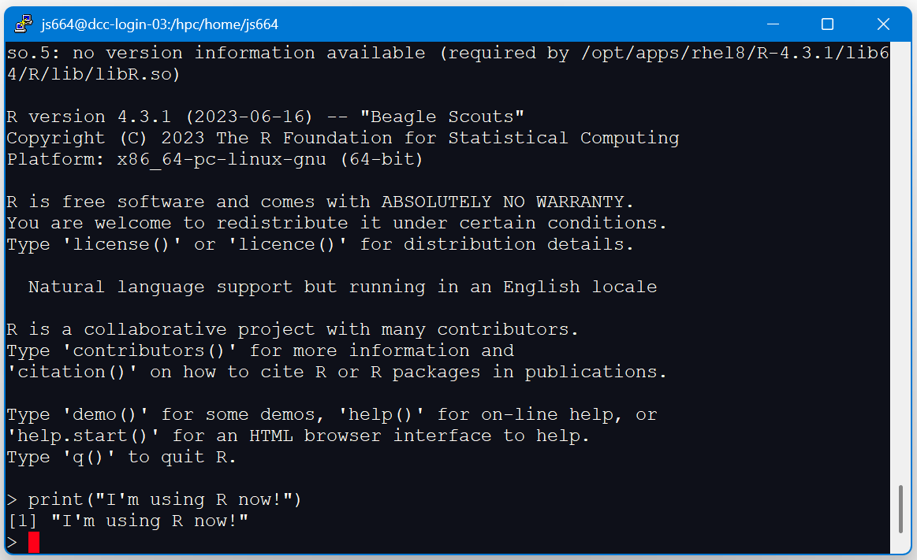
Running R console in the command line

Slide 28
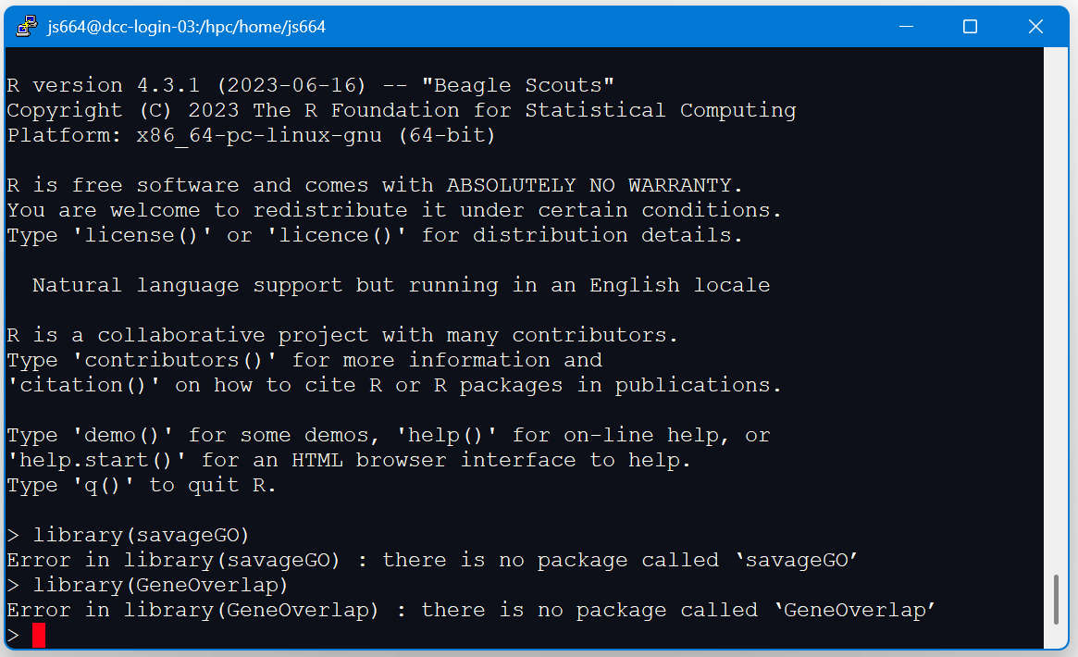
Running R console in the command line

Slide 29
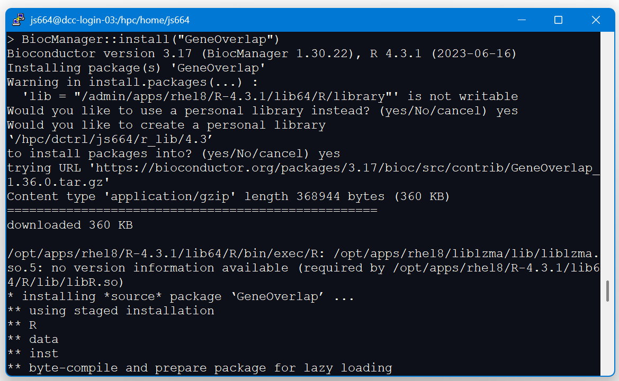
Installing R packages

Slide 30
Configuring R to look in your library
> BiocManager::install("GeneOverlap")
Bioconductor version 3.17 (BiocManager 1.30.22), R 4.3.1 (2023-06-16)
Installing package(s) 'GeneOverlap'
Warning in install.packages(...) :
'lib = "/admin/apps/rhel8/R-4.3.1/lib64/R/library"' is not writable
Would you like to use a personal library instead? (yes/No/cancel) yes
Would you like to create a personal library
‘/hpc/dctrl/js664/r_lib/4.3’
to install packages into? (yes/No/cancel) yes
trying URL 'https://bioconductor.org/packages/3.17/bioc/src/contrib/GeneOverlap_1.36.0.tar.gz'

Slide 31
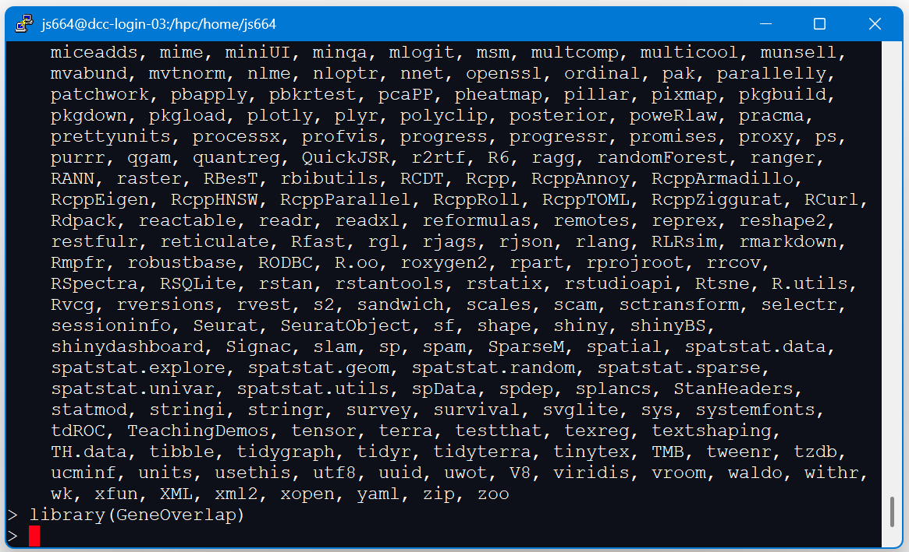
Testing R packages

Slide 32
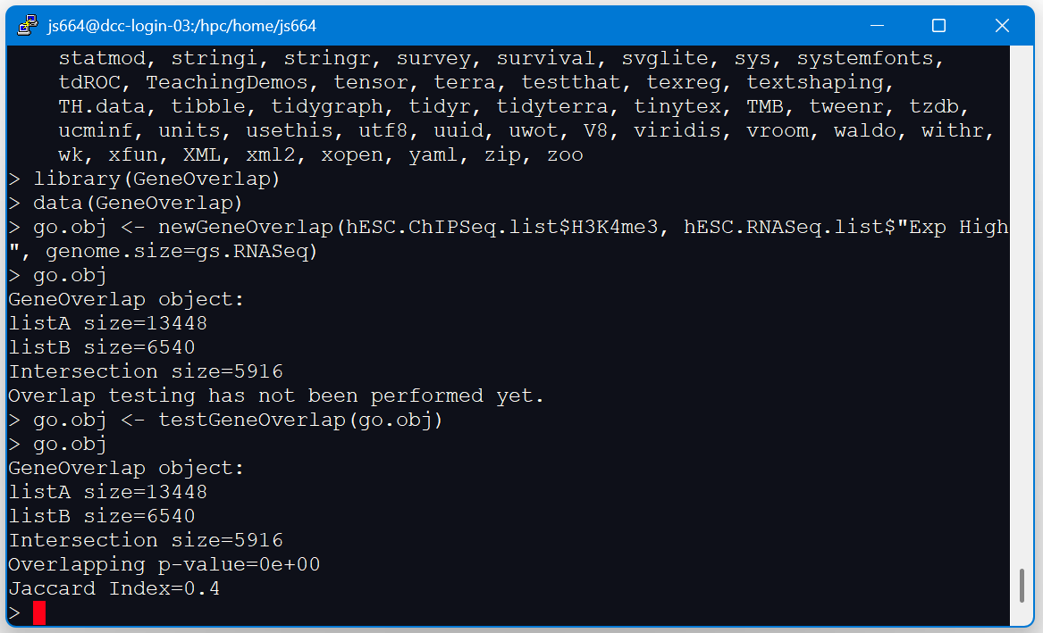
Testing R packages

Slide 33
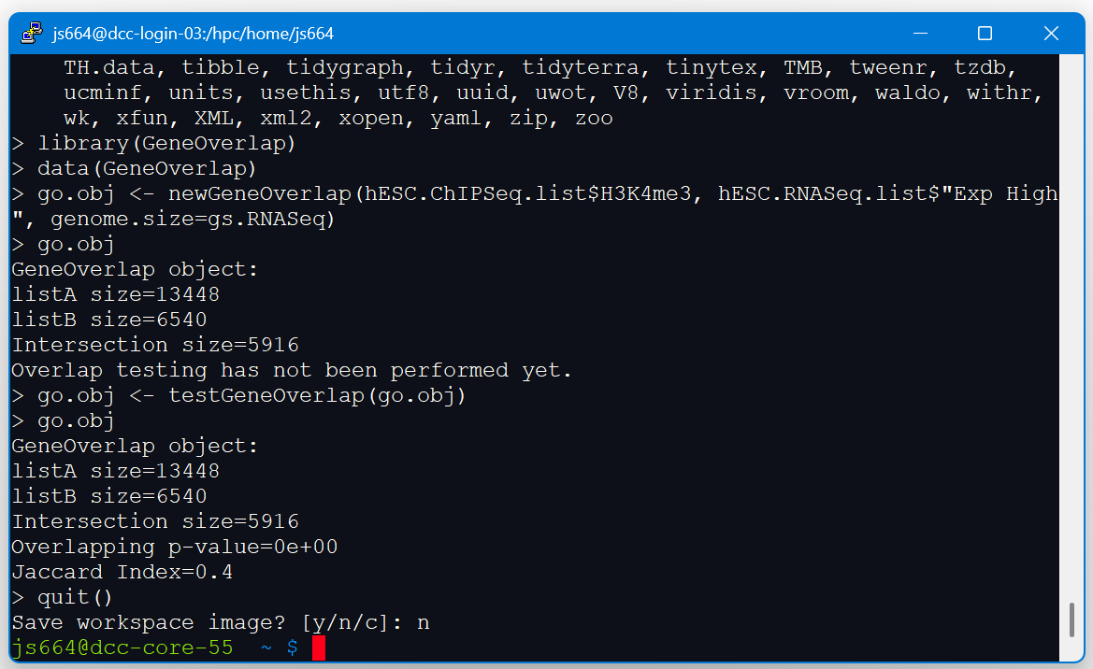
Exiting R console in the command line
quit()

Slide 34
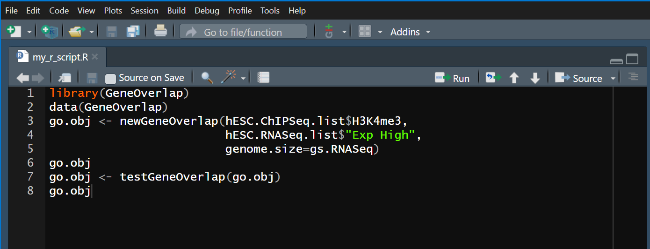
Running R scripts in the command line
Save R code as my_r_script.R

Slide 35
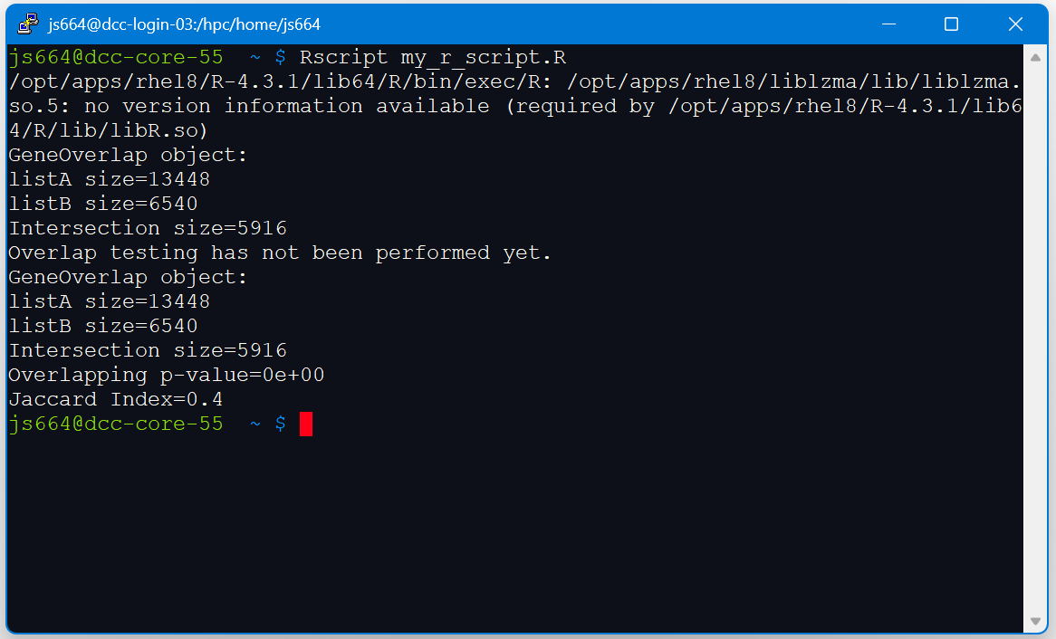
Running R scripts in the command line
Rscript my_r_script.R

Slide 36
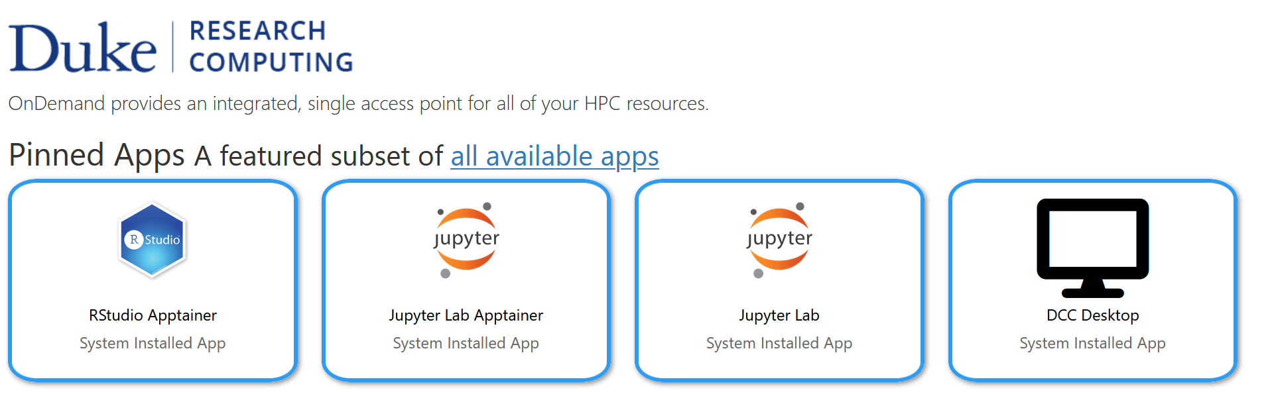
Running Rstudio through OnDemand
https://oit-rc.pages.oit.duke.edu/rcsupportdocs/OpenOnDemand/RStudio/
dcc-ondemand-01.oit.duke.edu

Slide 37
Running Rstudio through OnDemand
dcc-ondemand-01.oit.duke.edu

Slide 38
Running Rstudio through OnDemand
dcc-ondemand-01.oit.duke.edu

Slide 39
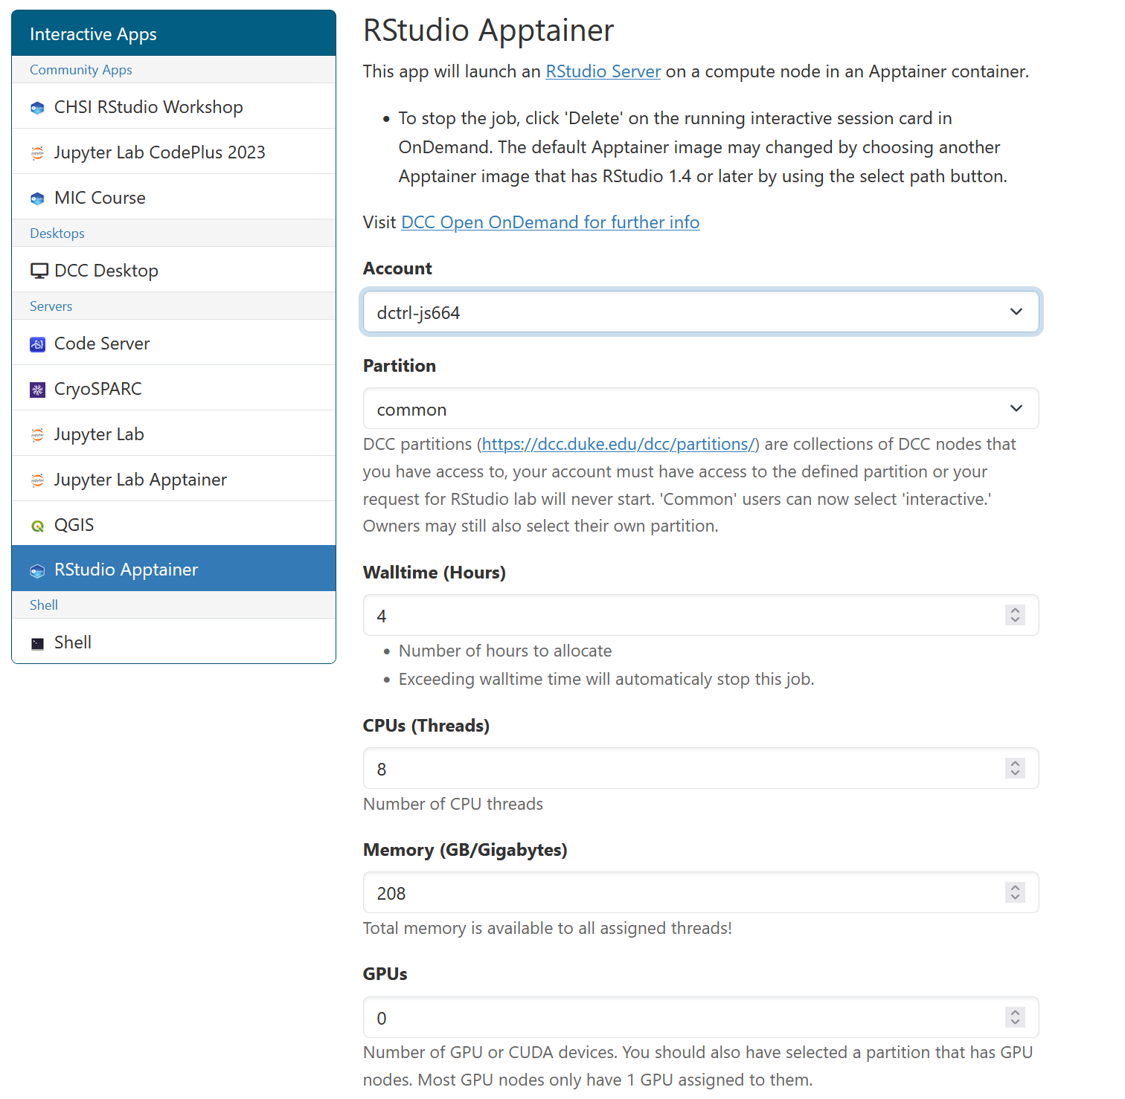
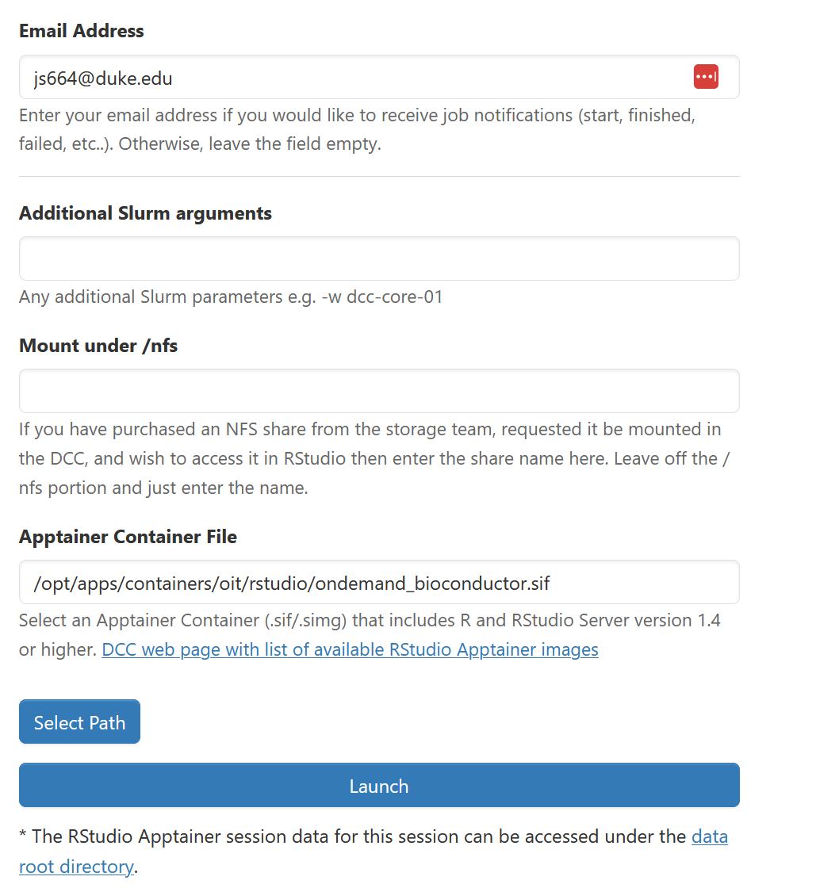
Running Rstudio through OnDemand

Slide 40
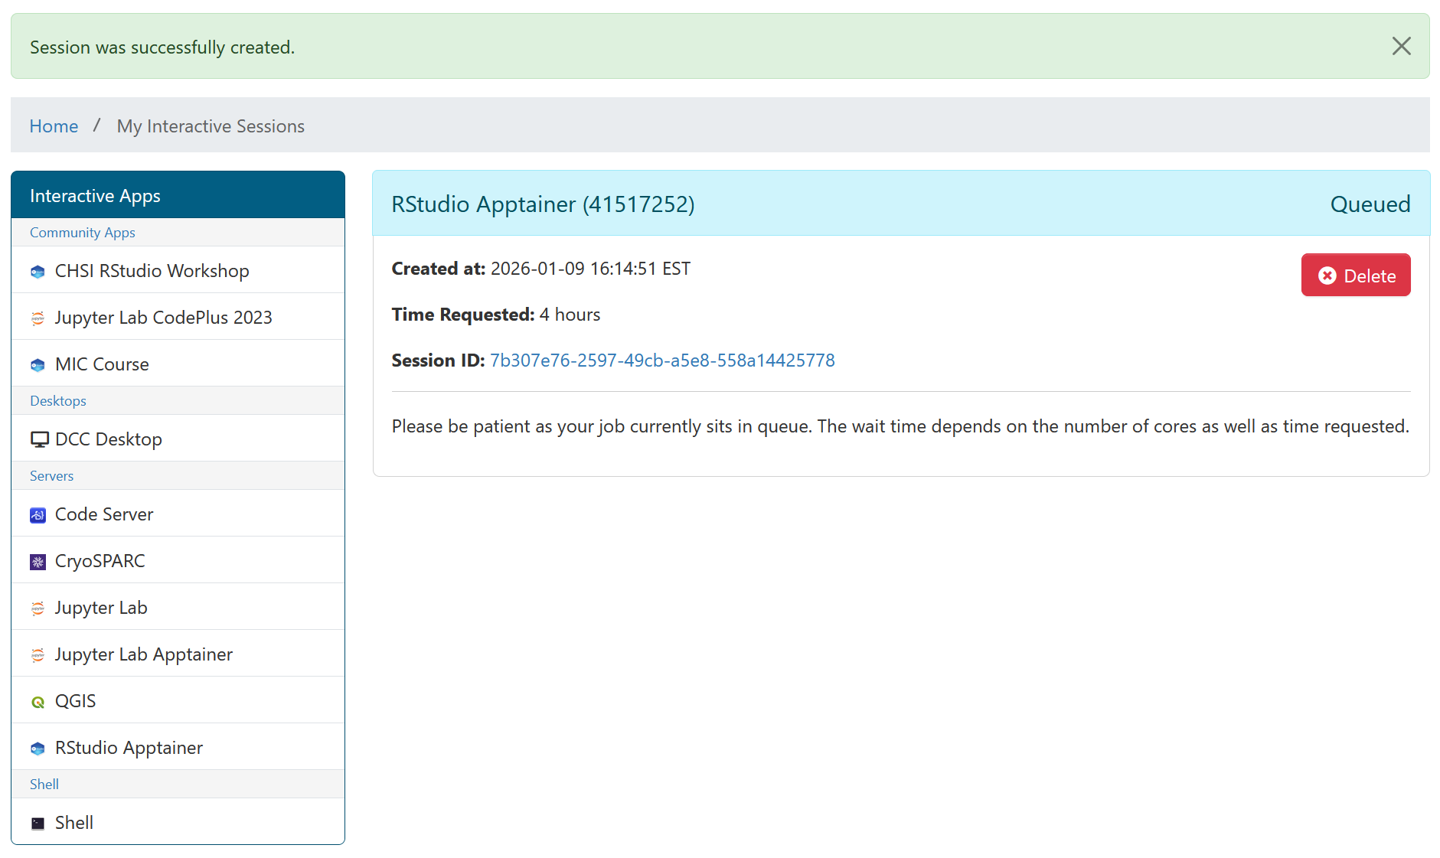
Running Rstudio through OnDemand

Slide 41
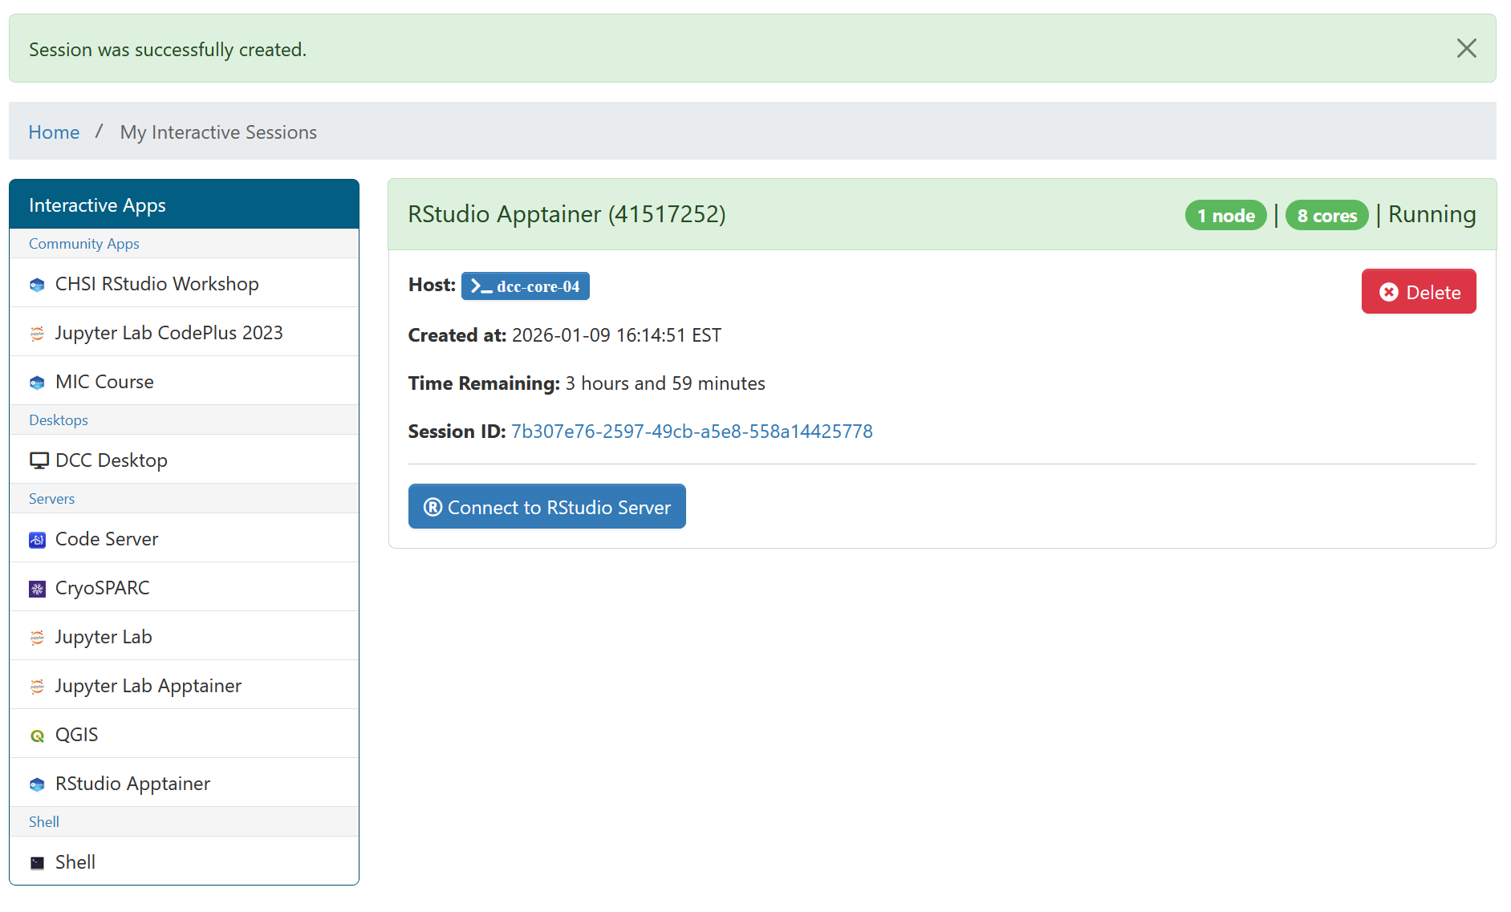
Running Rstudio through OnDemand

Slide 42
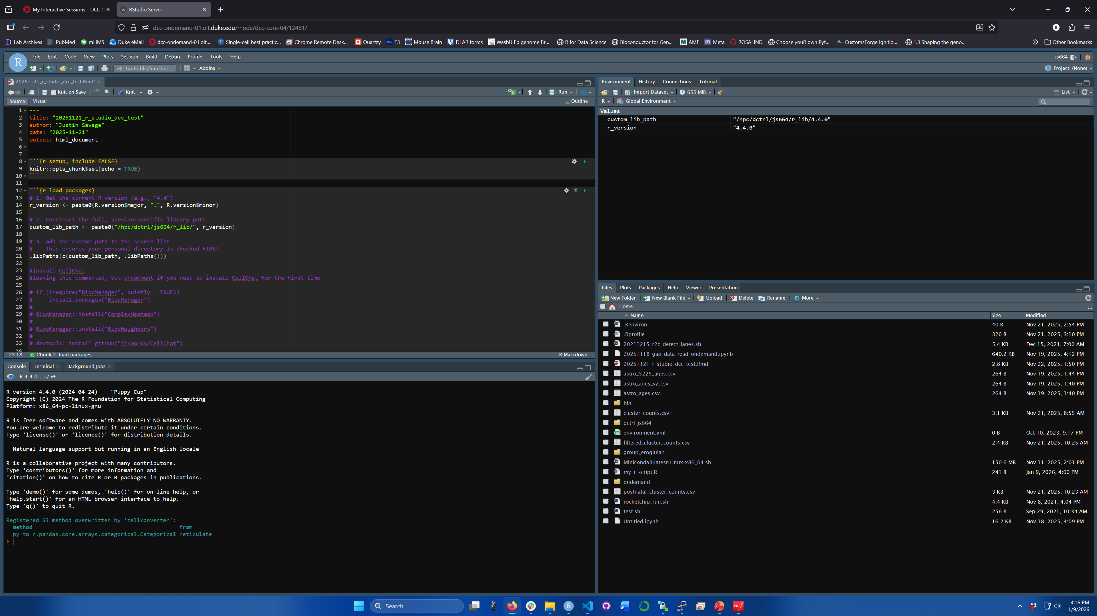

Slide 43
Remind OnDemand RStudio of your r_lib

Slide 44
Creating python environments with Anaconda
Anaconda is a package manager for Python
Allows for creation of self-contained virtual environments

Slide 45
Creating python environments with Anaconda
Anaconda is a package manager for Python
Allows for creation of self-contained virtual environments

Slide 46
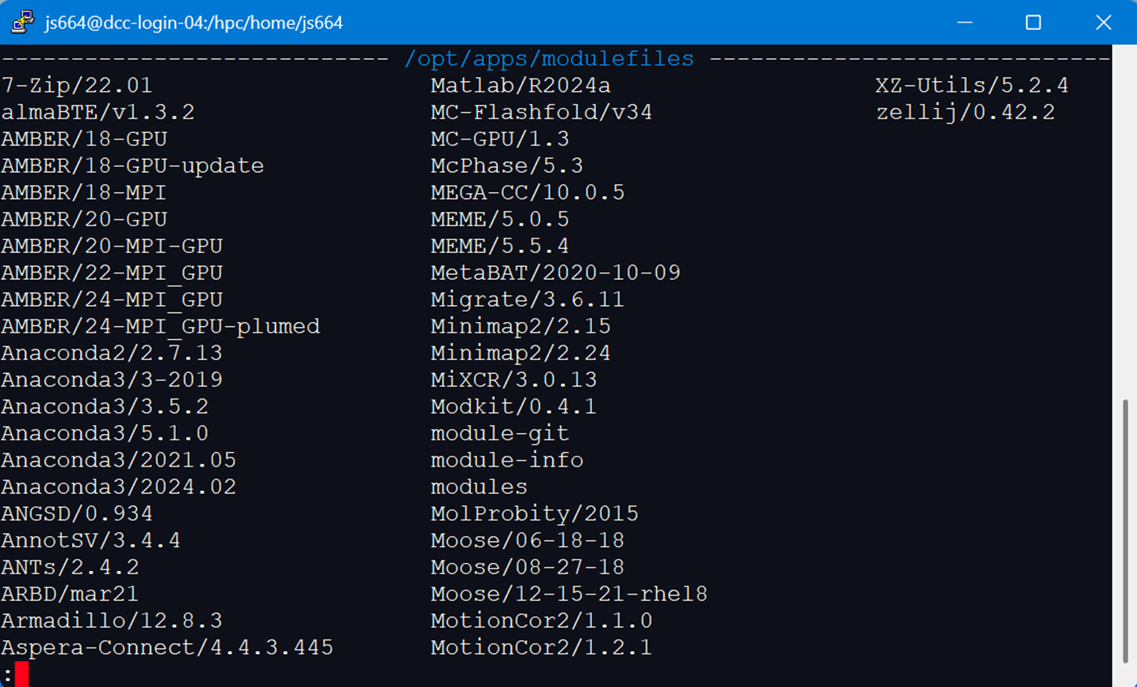
Creating python environments with Anaconda
module avail

Slide 47
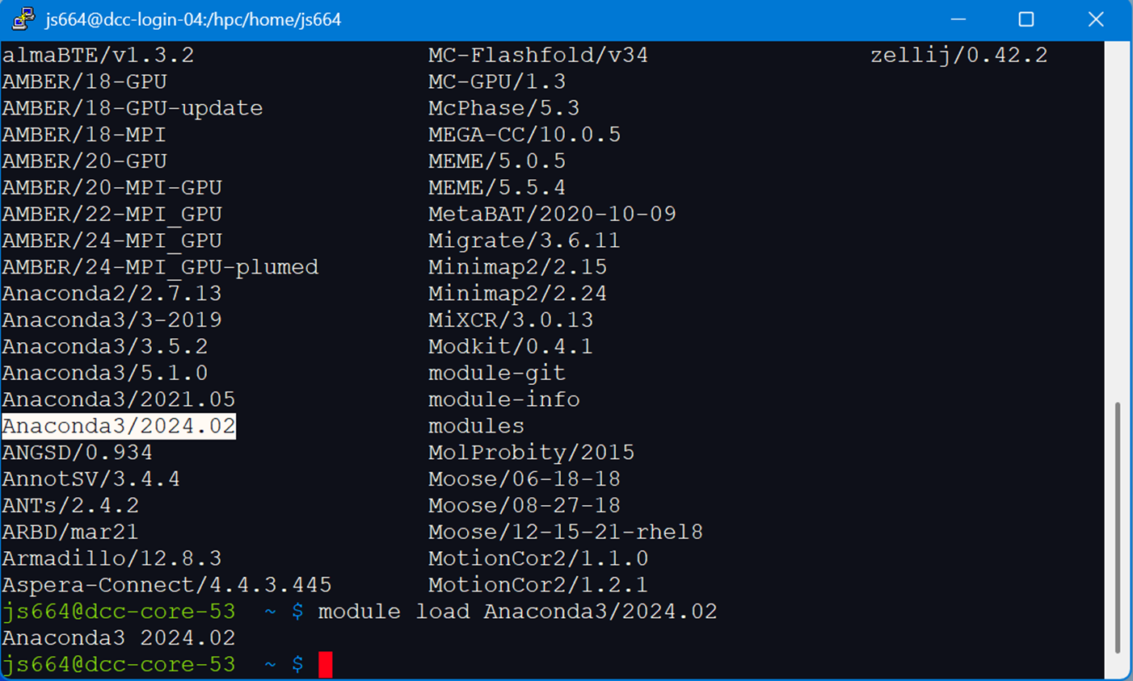
Creating python environments with Anaconda
module load Anaconda

Slide 48
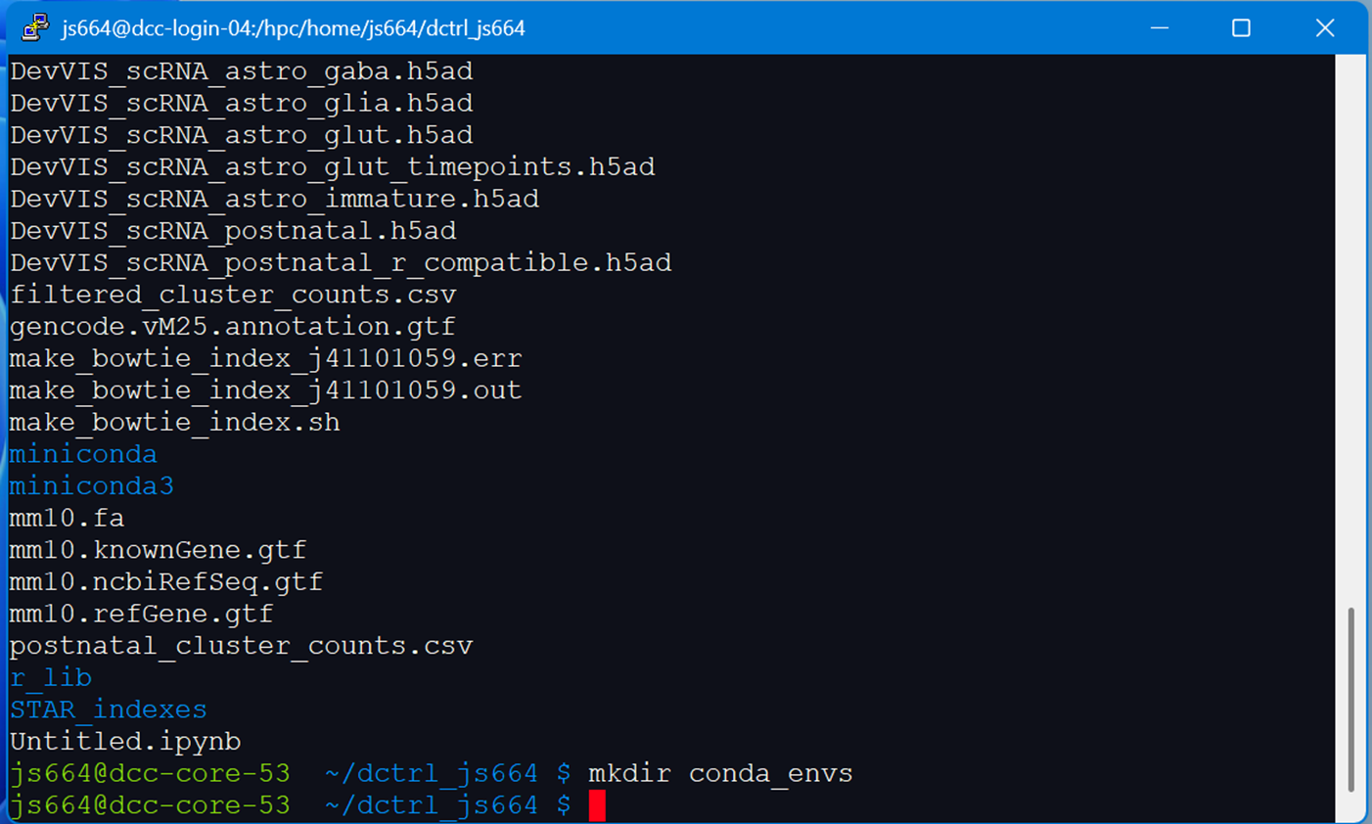
Creating python environments with Anaconda
mkdir conda_envs

Slide 49
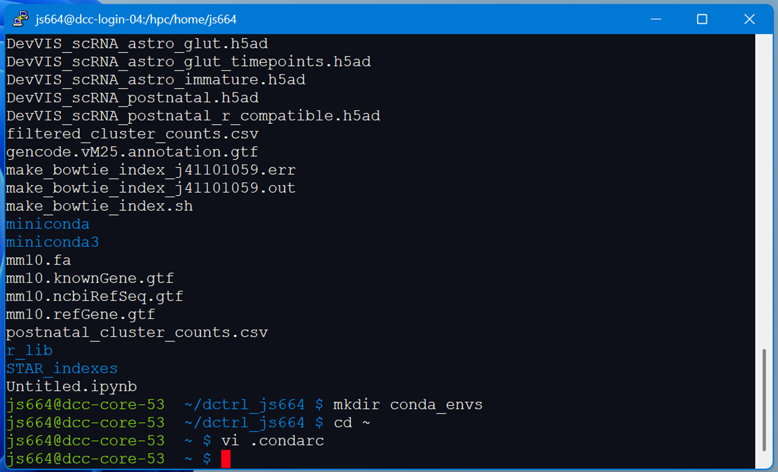
Creating python environments with Anaconda
cd ~
vi .condarc

Slide 50
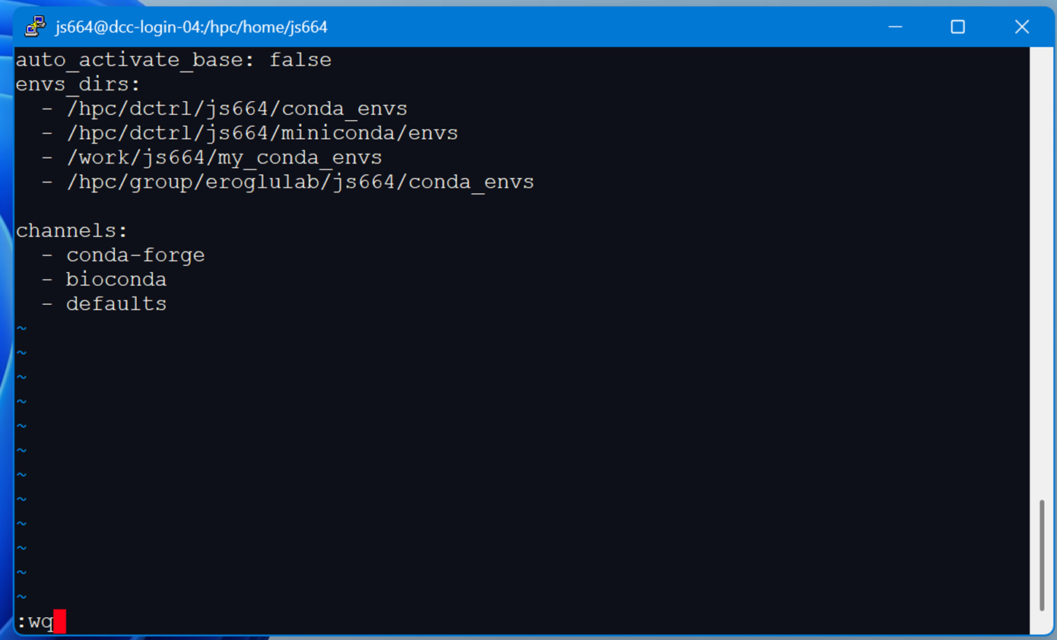
Creating python environments with Anaconda

Slide 51
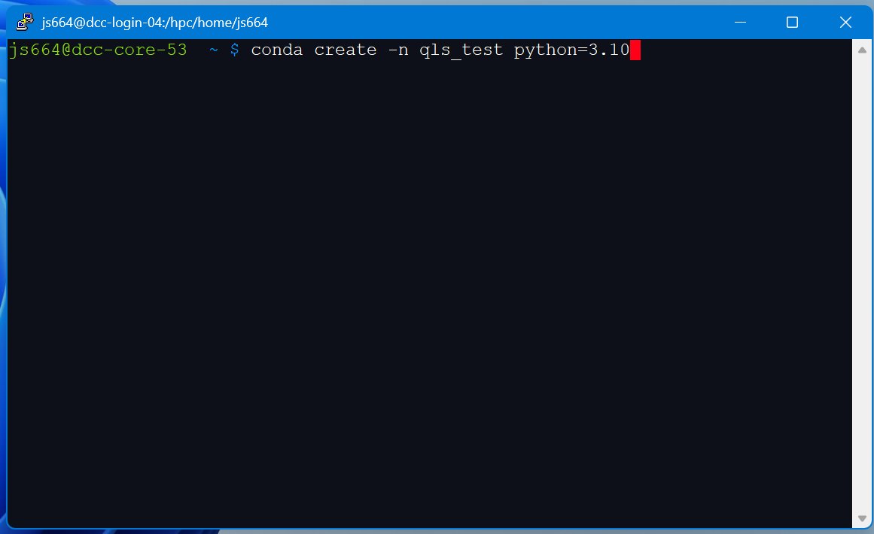
Creating python environments with Anaconda
conda create –n qls_test python=3.10

Slide 52
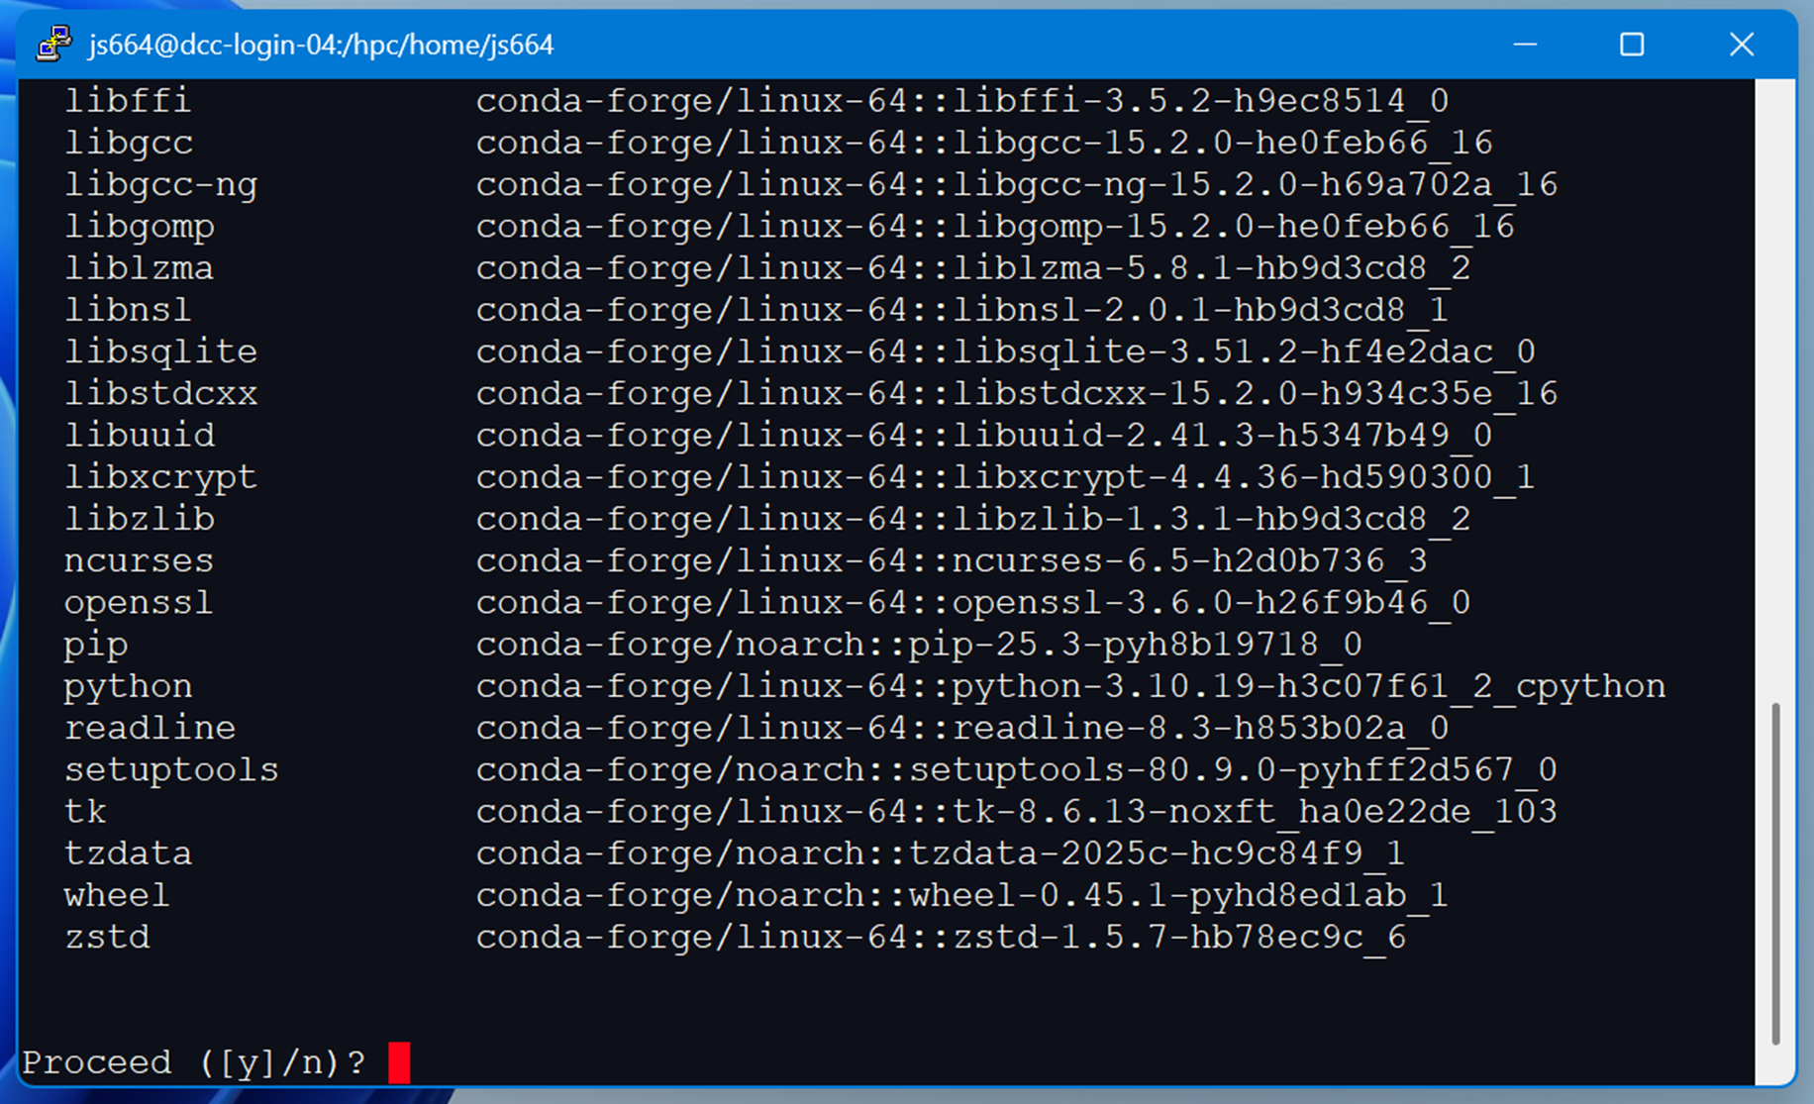
Creating python environments with Anaconda
Proceed ([y]/n)?

Slide 53
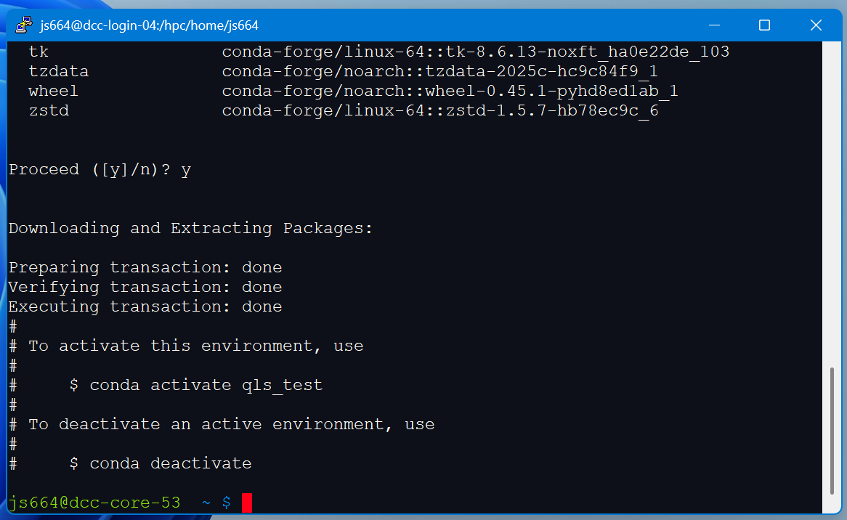
Creating python environments with Anaconda
Proceed ([y]/n)? y

Slide 54
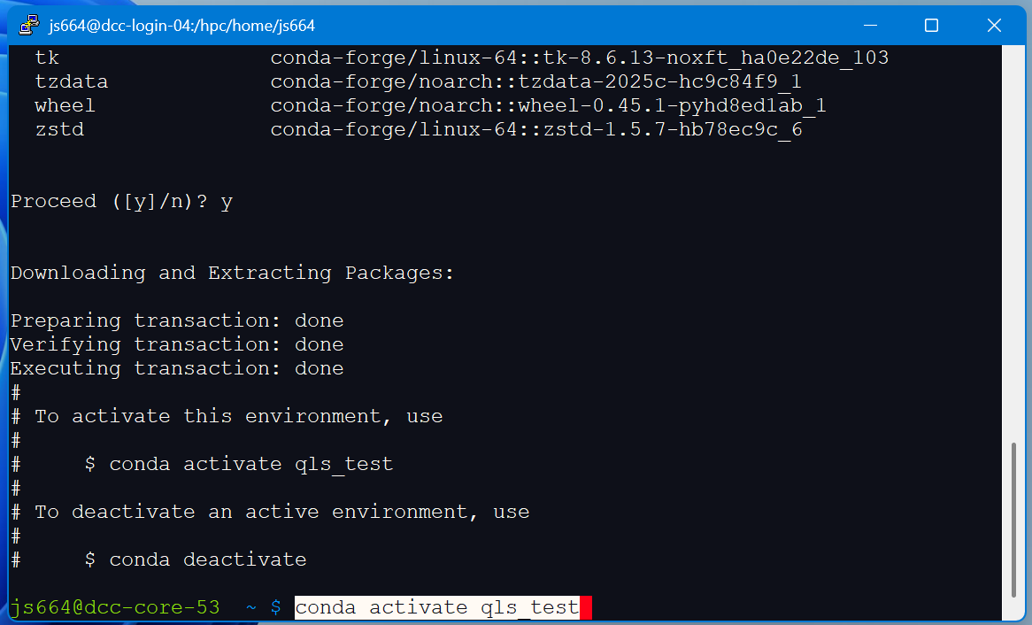
Creating python environments with Anaconda
conda activate qls_test

Slide 55
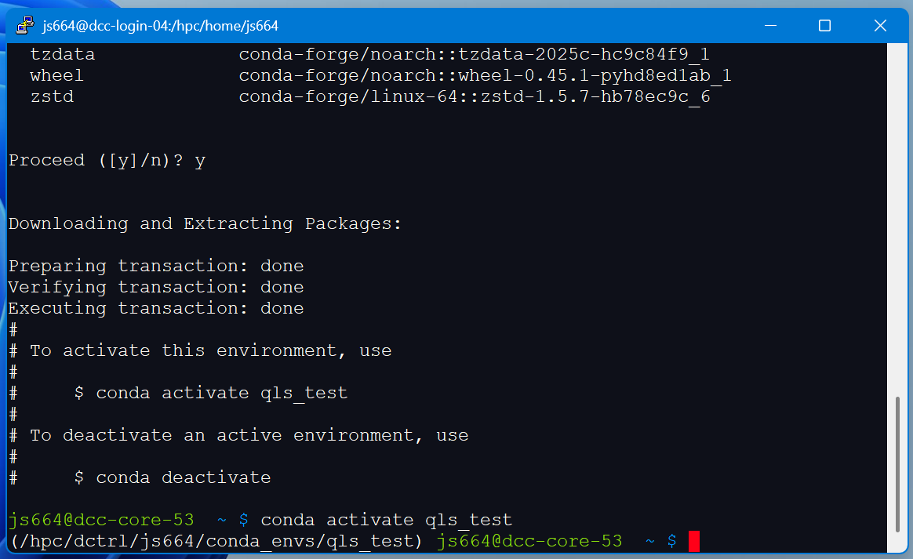
Creating python environments with Anaconda
conda activate qls_test

Slide 56
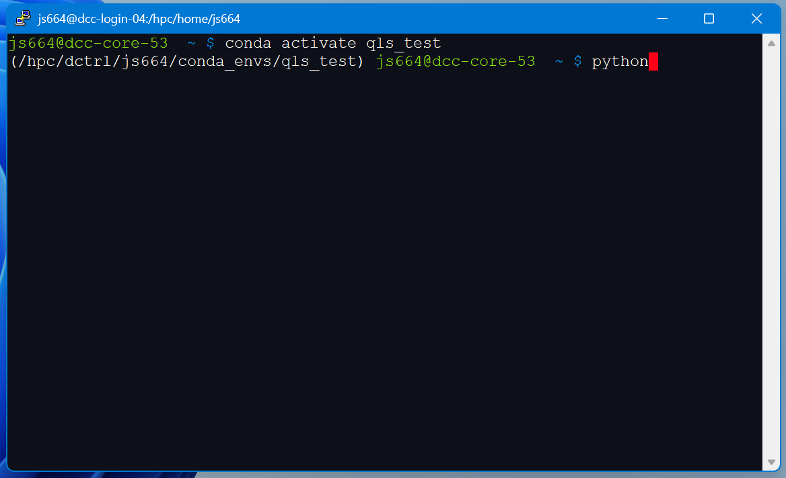
Creating python environments with Anaconda
python

Slide 57
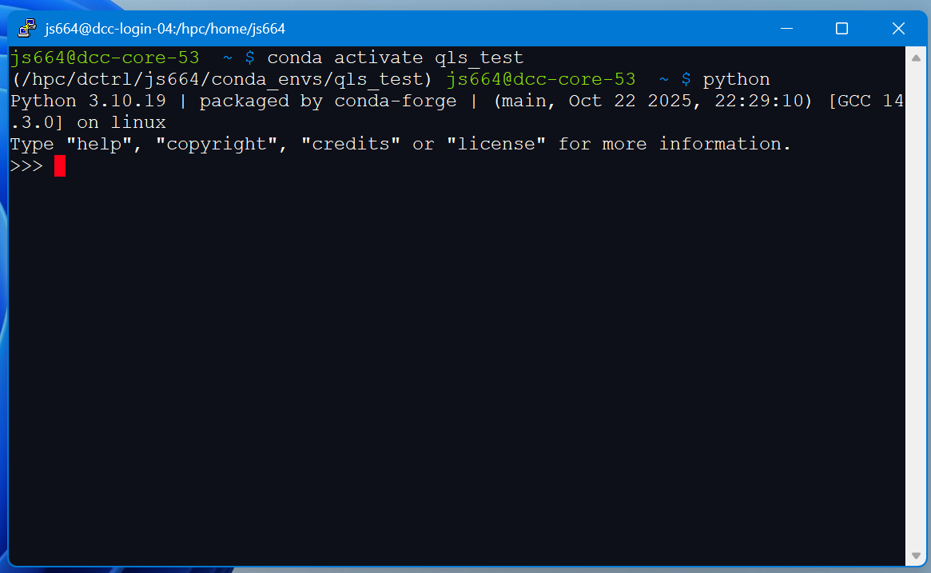
Creating python environments with Anaconda
python

Slide 58
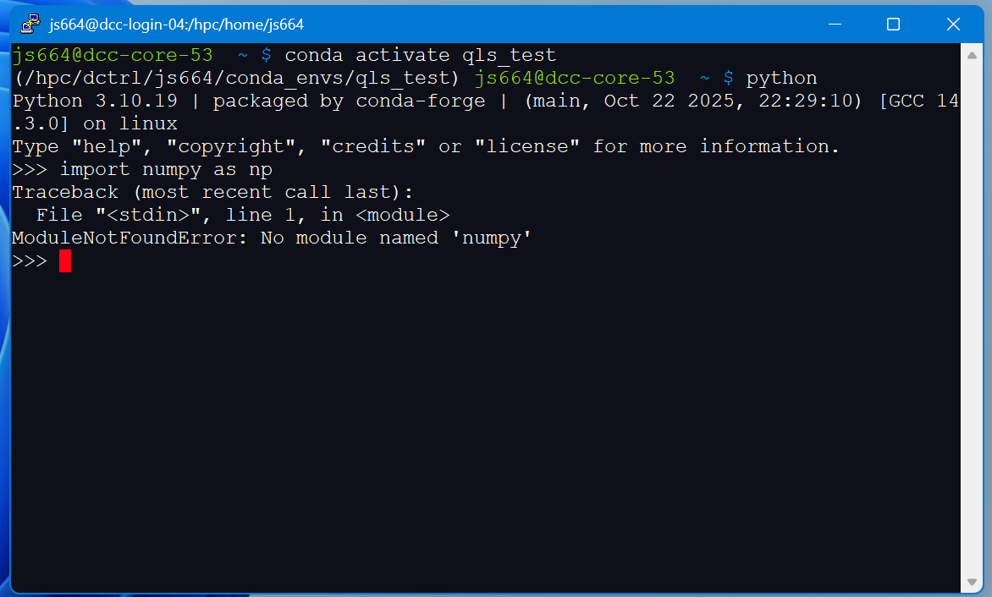
Creating python environments with Anaconda
>>>import numpy as np

Slide 59
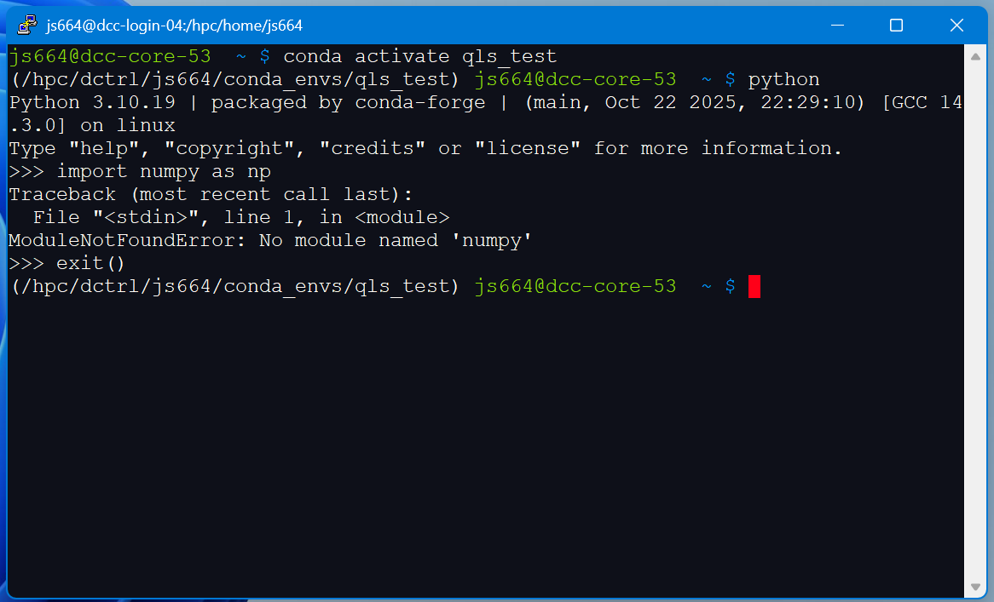
Creating python environments with Anaconda
>>>exit()

Slide 60
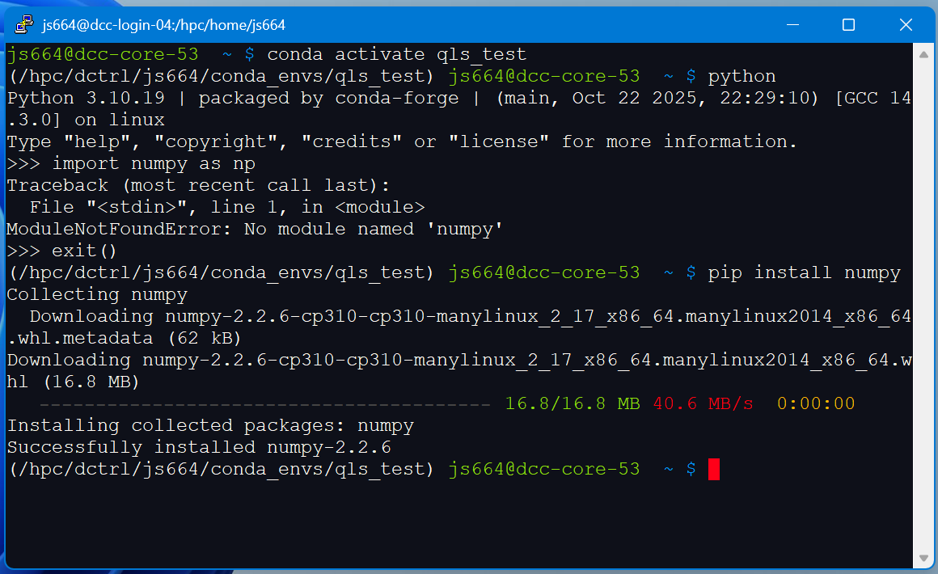
Creating python environments with Anaconda
pip install numpy

Slide 61
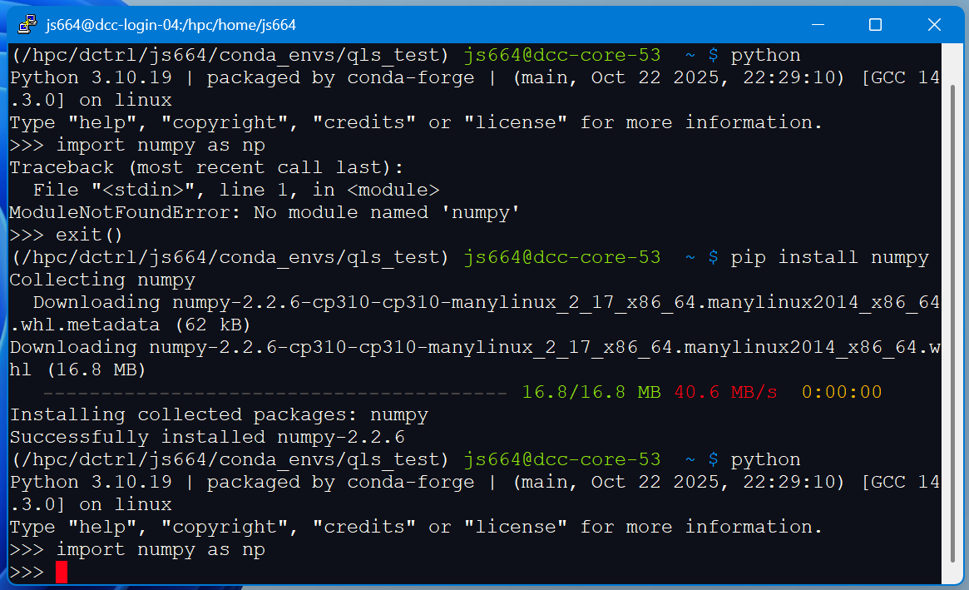
Creating python environments with Anaconda
>>>import numpy as np

Slide 62

Creating python environments with Anaconda
python script.py

Slide 63

Running Jupyter through OnDemand
pip install ipykernel

Slide 64

Running Jupyter through OnDemand
python -m ipykernel install --user --name=qls_test --display-name "QLS Test"

Slide 65
Running Jupyter through OnDemand
dcc-ondemand-01.oit.duke.edu

Slide 66


Running Jupyter through OnDemand

Slide 67

Running Jupyter through OnDemand

Slide 68

Running Jupyter through OnDemand

Slide 69


Slide 70

Changing Kernel

Slide 71

Changing Kernel

Slide 72


Slide 73
Summary
Load R or Anaconda as DCC modules
Create a personal library for R packages or conda environments
Tell R or Python where to look for packages
Run R/Python through the command line, scripts, or OnDemand

